Slide 1
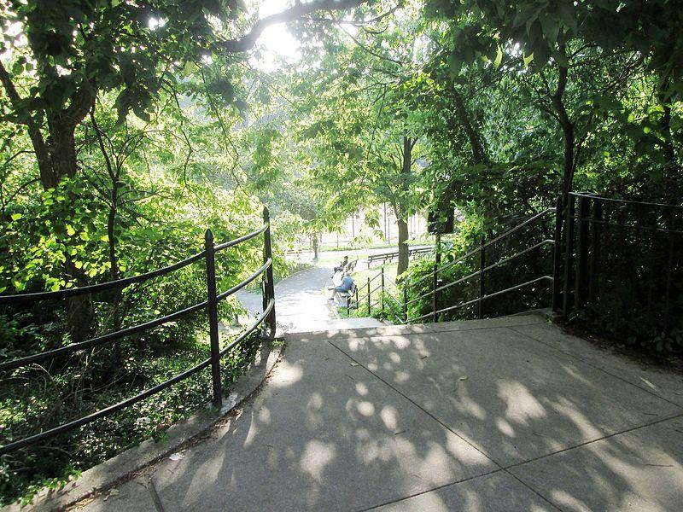
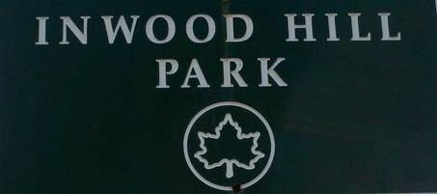
1
Welcome to today’s field trip to Inwood Hill Park!
We’re here, everybody! Let’s go out and see what we can learn to help move our class, school and city toward zero waste!
?
Notes:
https://commons.wikimedia.org/wiki/File:Inwood_Hill_Park,_West_214th_Street_entrance.jpg

Slide 2
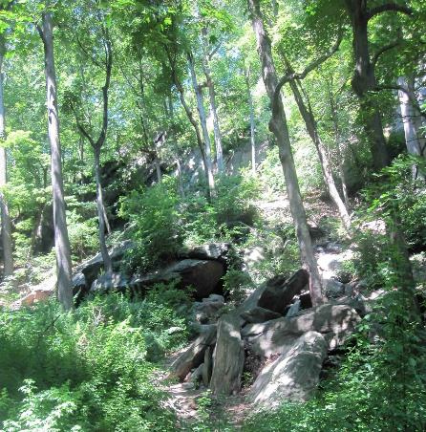
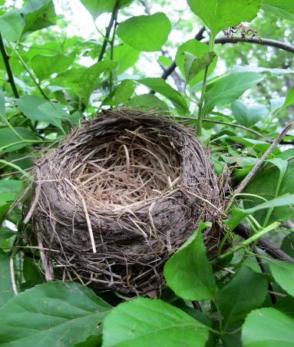
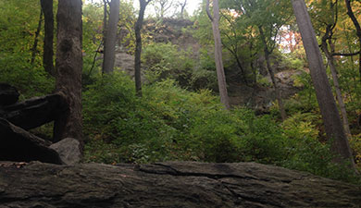
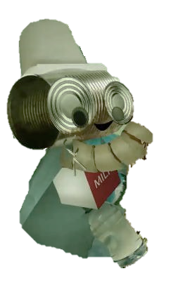
2
Welcome!
Did you know Inwood Hill Park is the last natural forest land in Manhattan?
It was a natural landscape full of hills, valleys, forests, fields, salt marshes, freshwater wetlands, beaches, springs, ponds and streams. It was home to a rich community of plants and wildlife, such as bears, wolves, songbirds, salamanders and beavers.
All of New York City once looked like this.
It had clear, clean waters with fish, porpoises and whales in the harbor, along with fresh air for all to breathe.
This land was once incredibly biodiverse.
Notes:
https://commons.wikimedia.org/wiki/File:Pothole_Inwood_Hill.jpg
https://welikia.org/wp-content/uploads/_jlm4286-beaver.jpg
https://www.flickr.com/photos/kpaulus/5799715281
http://citylore-senseandthecity.blogspot.com/2012/08/touch-inwood-hill-park-caves.html

Slide 3
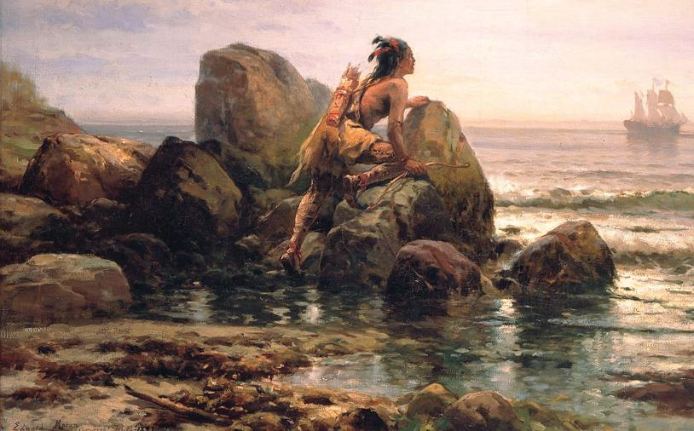
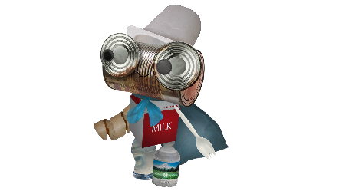
3
Among these plants, animals and surrounding waters, lived Manhattan’s first people:
the Lenni Lenape.
They called the island ‘Mannahatta’
In their language, this translates to
“island of many hills.”
Can you point out the hilly parts of Mannahatta?
Notes:
https://welikia.org/wp-content/uploads/_jlm4286-beaver.jpg
https://commons.wikimedia.org/wiki/File:Edward_Moran_-_Henrik_Hudson_entering_New_York_Harbor,_September_11,_1609_-_Google_Art_Project.jpg

Slide 4
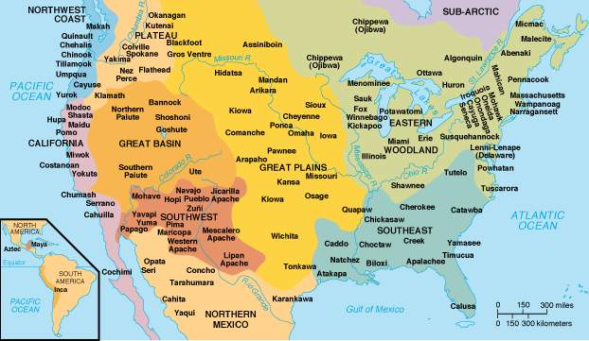
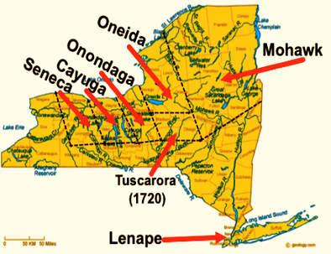
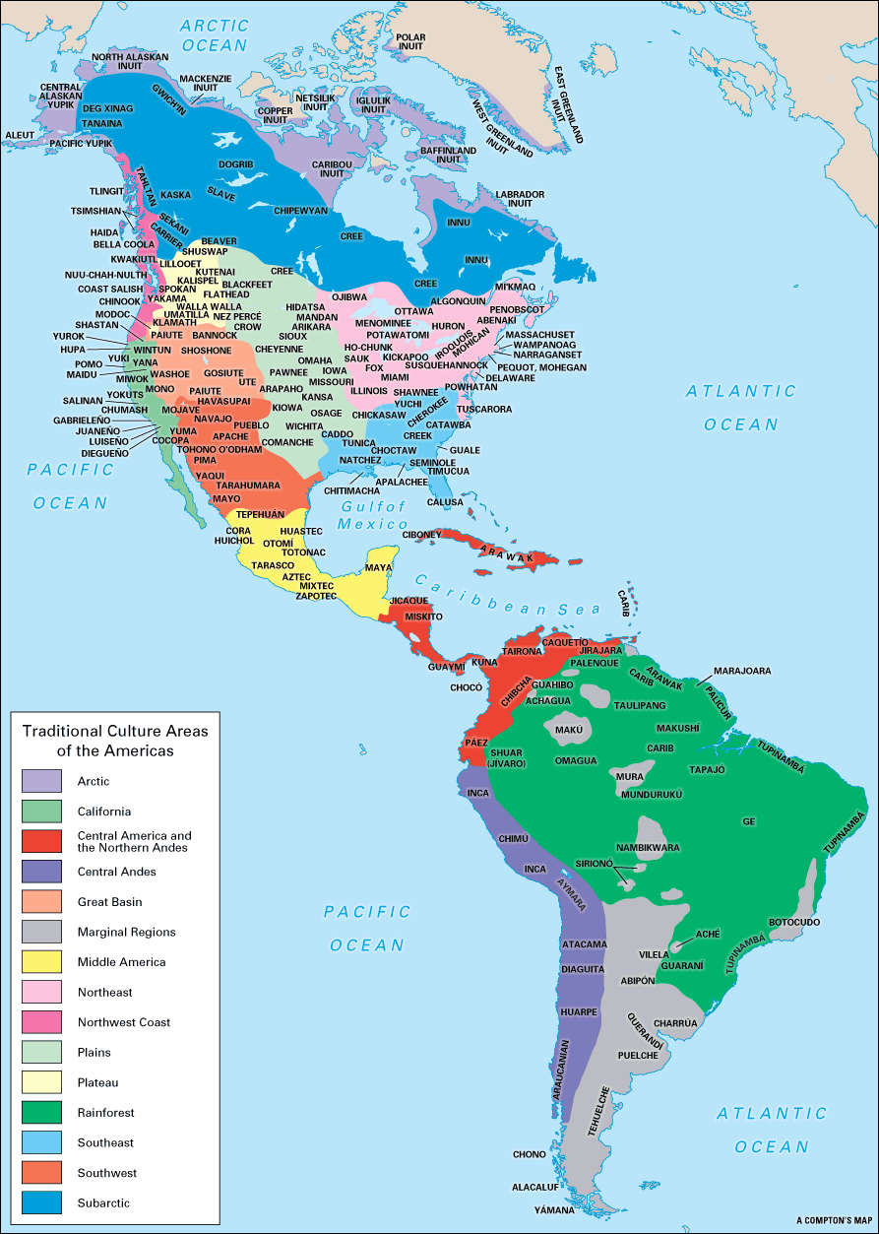
4
The Lenni Lenape are one of the many Native communities that have lived in New York State and throughout the Western Hemisphere for thousands of years.
There are thousands
of different Native communities & each is distinct with its own history, language, arts, values, traditions and beliefs.
What are the values, traditions and beliefs of your family and community?
Notes:
https://a2a16ff5-a-62cb3a1a-s-sites.googlegroups.com/site/mrssmithsfavoritesites/all-things-native-american/American%20Indians-%20Western%20Hemisphere.gif?attachauth=ANoY7cqrj1uORXyHpwawPJsdO_D1z9u3FqayacYMYL2fNamV3ZogxAxchuc6BW6dp4qayHGSzmgL35DqCAo2bfOPllRcH_3Ksm0c1in-Fwq5HRp_RRliCew2bQP44YVIny01xiYLm3xNsflgxmZqvIl_s7t3SvOp9yynFTwv2irWKAtGWTqLxCY0FS64pxjL9dzbgnwI-Q9DZ1Ah-A4vrqUEtvOPaLsWNR86NXEp3GJBT1s1jlXdbtlugnMRIZvdGi6e3QQdUoYt44tNC0TEaKUQ4HVsfWCNRdwlyfirfvv1n4N74YxUUP8%3D&attredirects=0

Slide 5
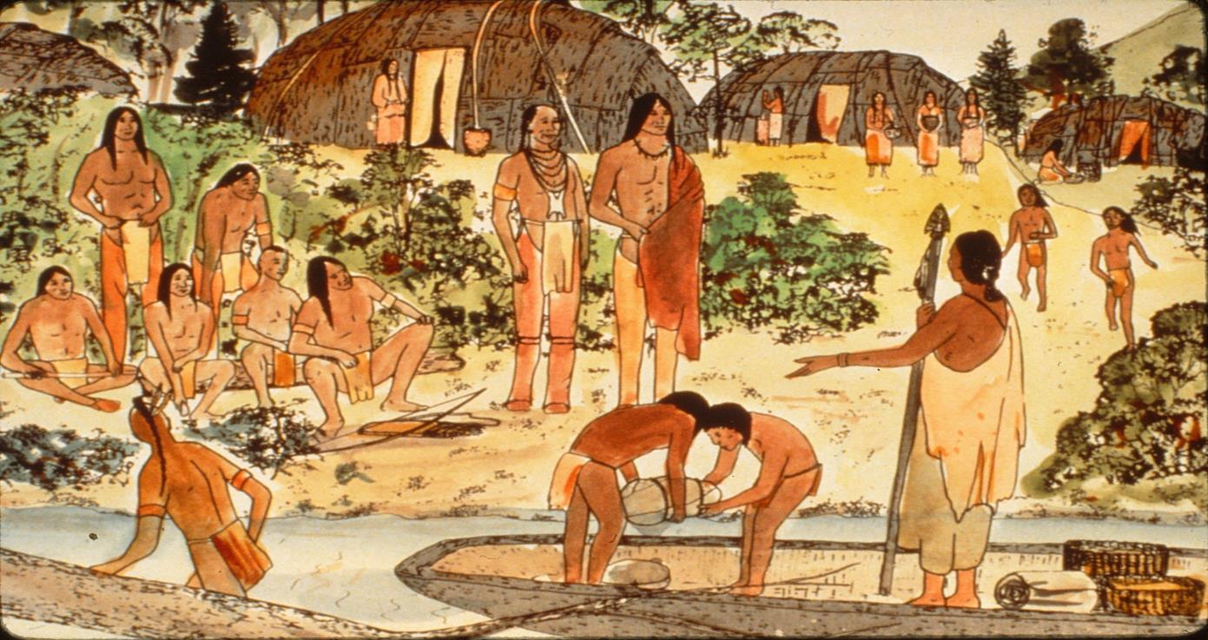
5
The Lenape have related to the environment in ways that showed respect, community and balance. They have lived in harmony and have given thanks to nature for more than 400 generations.
“We do not inherit the earth from our ancestors, we borrow it from our children.”
Native American proverb
Notes:
https://bronxriversankofa.files.wordpress.com/2014/04/community-1.jpg
https://www.heyridge.com/2015/08/the-rarely-told-story-of-the-real-bay-ridge-natives/
https://en.wikipedia.org/wiki/Lenape#/media/File:Lapowinsa01.jpg
https://welikia.org/science/recreating-mannahatta/
https://www.riverkeeper.org/hudson-river/hudson-river-journey/the-first-people-of-the-river/

Slide 6
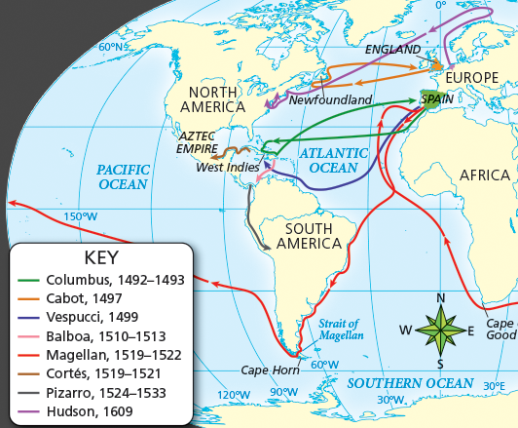
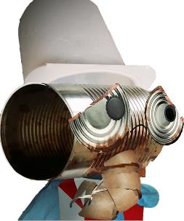
6
Beginning in the 15th and 16th centuries,
European explorers began sailing across the oceans.
Why did they leave Europe? What were they looking for? What did they expect to find?
Notes:
https://www.emaze.com/@ALZWCIQR/European-Exploration

Slide 7
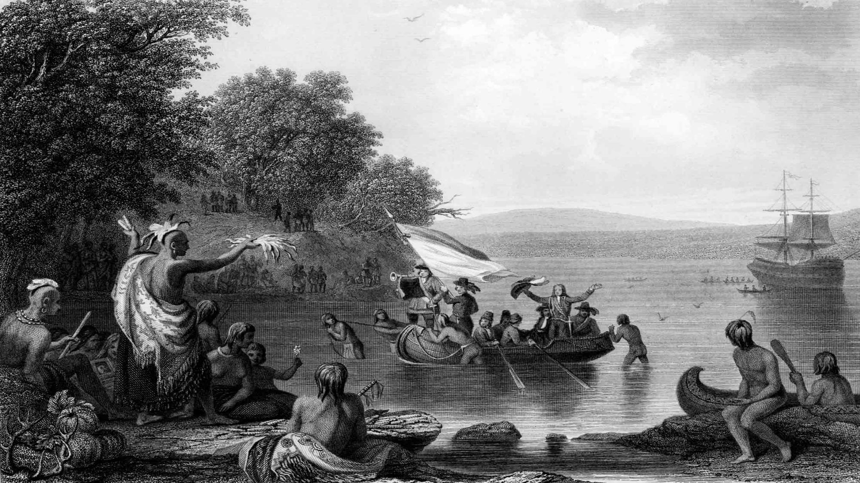
One of those explorers was Henry Hudson.
7
He sailed to North America and encountered the Lenape at Mannahatta. The Lenape called the Europeans shouwunnock, which in their language means “Salty people.”
Notes:
https://www.gilderlehrman.org/sites/default/files/content-images/08878.0003.det__0.jpg
https://www.riverkeeper.org/hudson-river/history/

Slide 8
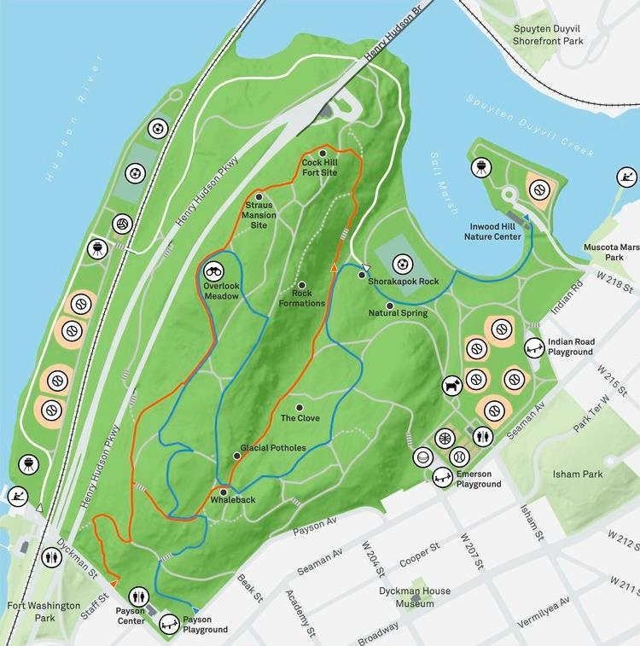
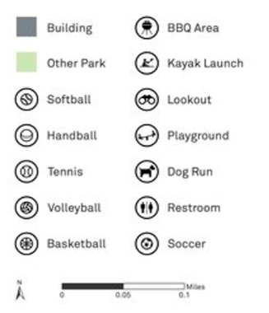
8
Time to explore the park. Let’s get into groups!
There are 3 trails to hike.
– Gray Trail (1.2 Miles)
– Blue Trail (1.7 Miles)
– Orange Trail (1.3 Miles)
Notes:
http://www.outdoorfest.com/community/2017/best-trails-by-borough-nyc
3 different trails
Learn and come back to teach rest of the class

Slide 9
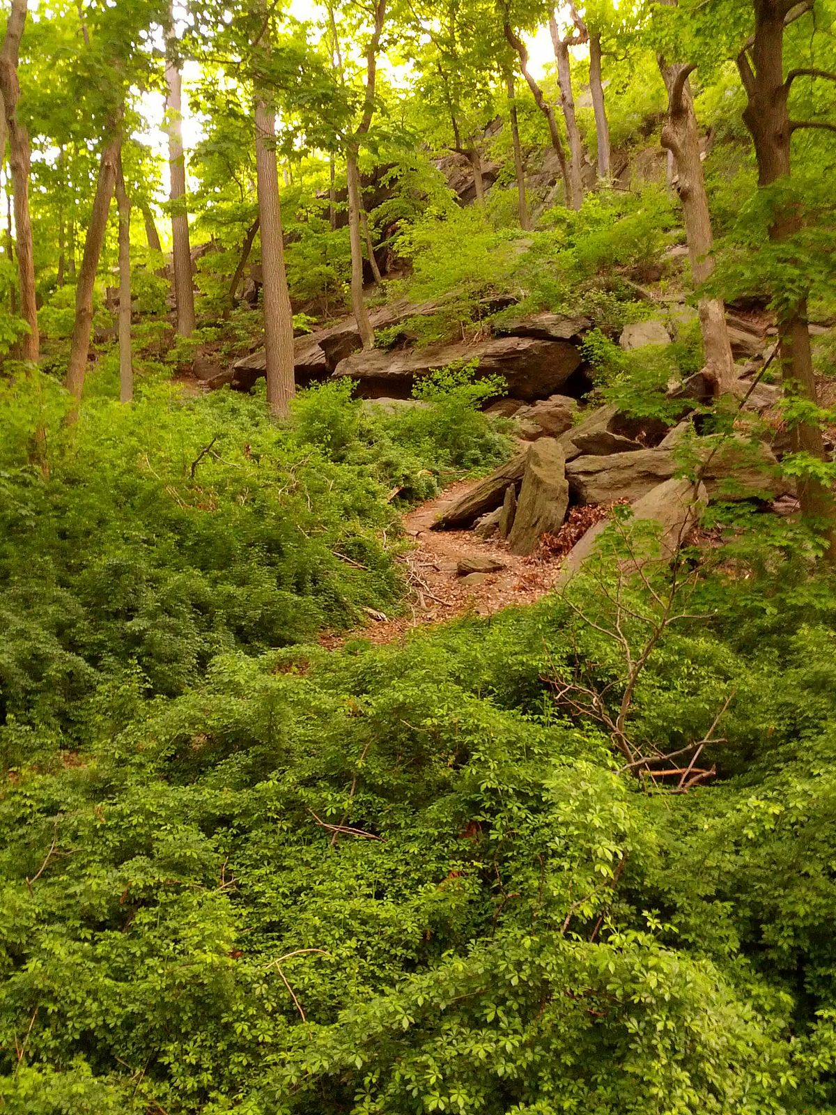
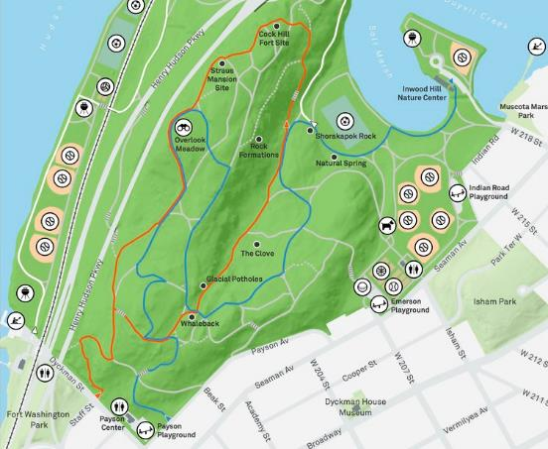
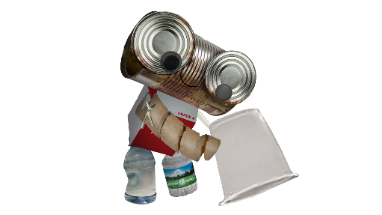
9
Here we are at the Rock Formations.
The Lenape took shelter in these natural rock formations during the summer months. This was when it was time to harvest shellfish, eels and fish from the nearby river.
Notes:
https://www.pinterest.com/pin/322570392036952776

Slide 10
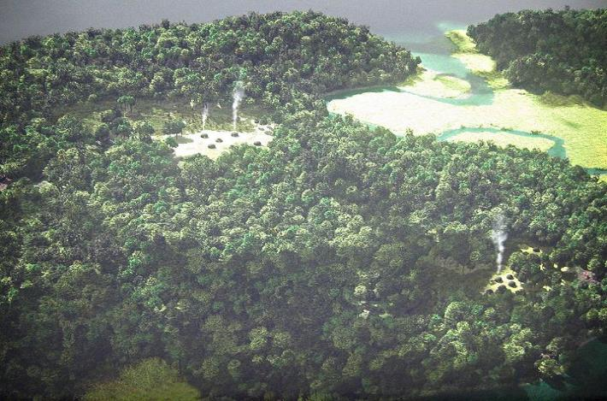
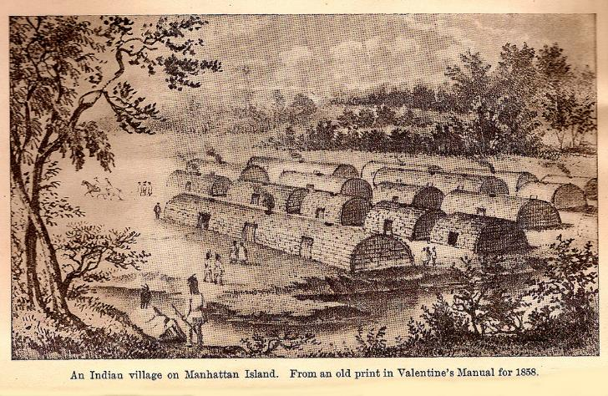
10
The Lenape relied on the natural resources from their local environment to build their homes, make their tools, sew their clothing, grow and hunt their food.
For example, they used as much of the deer as possible. The meat was eaten; hides were used for clothing, moccasins, and blankets; sinew, made from the animal’s tendons, was used for thread; bones and antlers were used to make tools; deer hooves were used to make rattles.
What natural resources do we rely upon? Where do they come from?
Notes:
https://bronxriversankofa.files.wordpress.com/2014/04/community-1.jpg
https://www.heyridge.com/2015/08/the-rarely-told-story-of-the-real-bay-ridge-natives/
https://en.wikipedia.org/wiki/Lenape#/media/File:Lapowinsa01.jpg
https://welikia.org/science/recreating-mannahatta/
https://www.riverkeeper.org/hudson-river/hudson-river-journey/the-first-people-of-the-river/

Slide 11
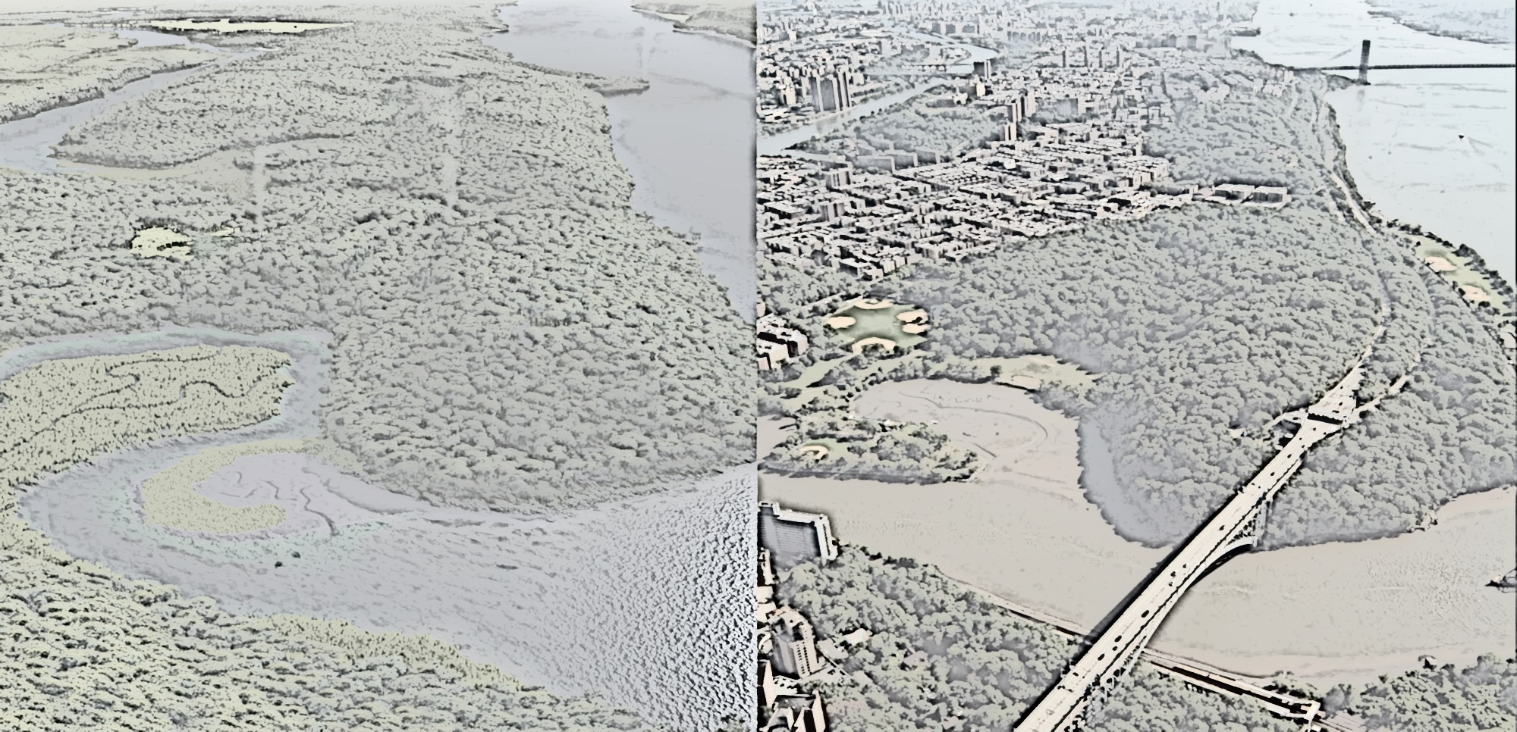
11
Now look up!
Two red-tailed hawks are flying above the park!
The first hawk looks down and sees what Manhattan looks like today.
But the second one looks down and imagines what Manhattan looked like in the past, when it was mostly inhabited by the Lenape.
What do you think the first hawk sees? What do you think the second hawk imagines?
Notes:
https://habitatthegame.files.wordpress.com/2014/05/spuytenduyvil_split.jpg

Slide 12
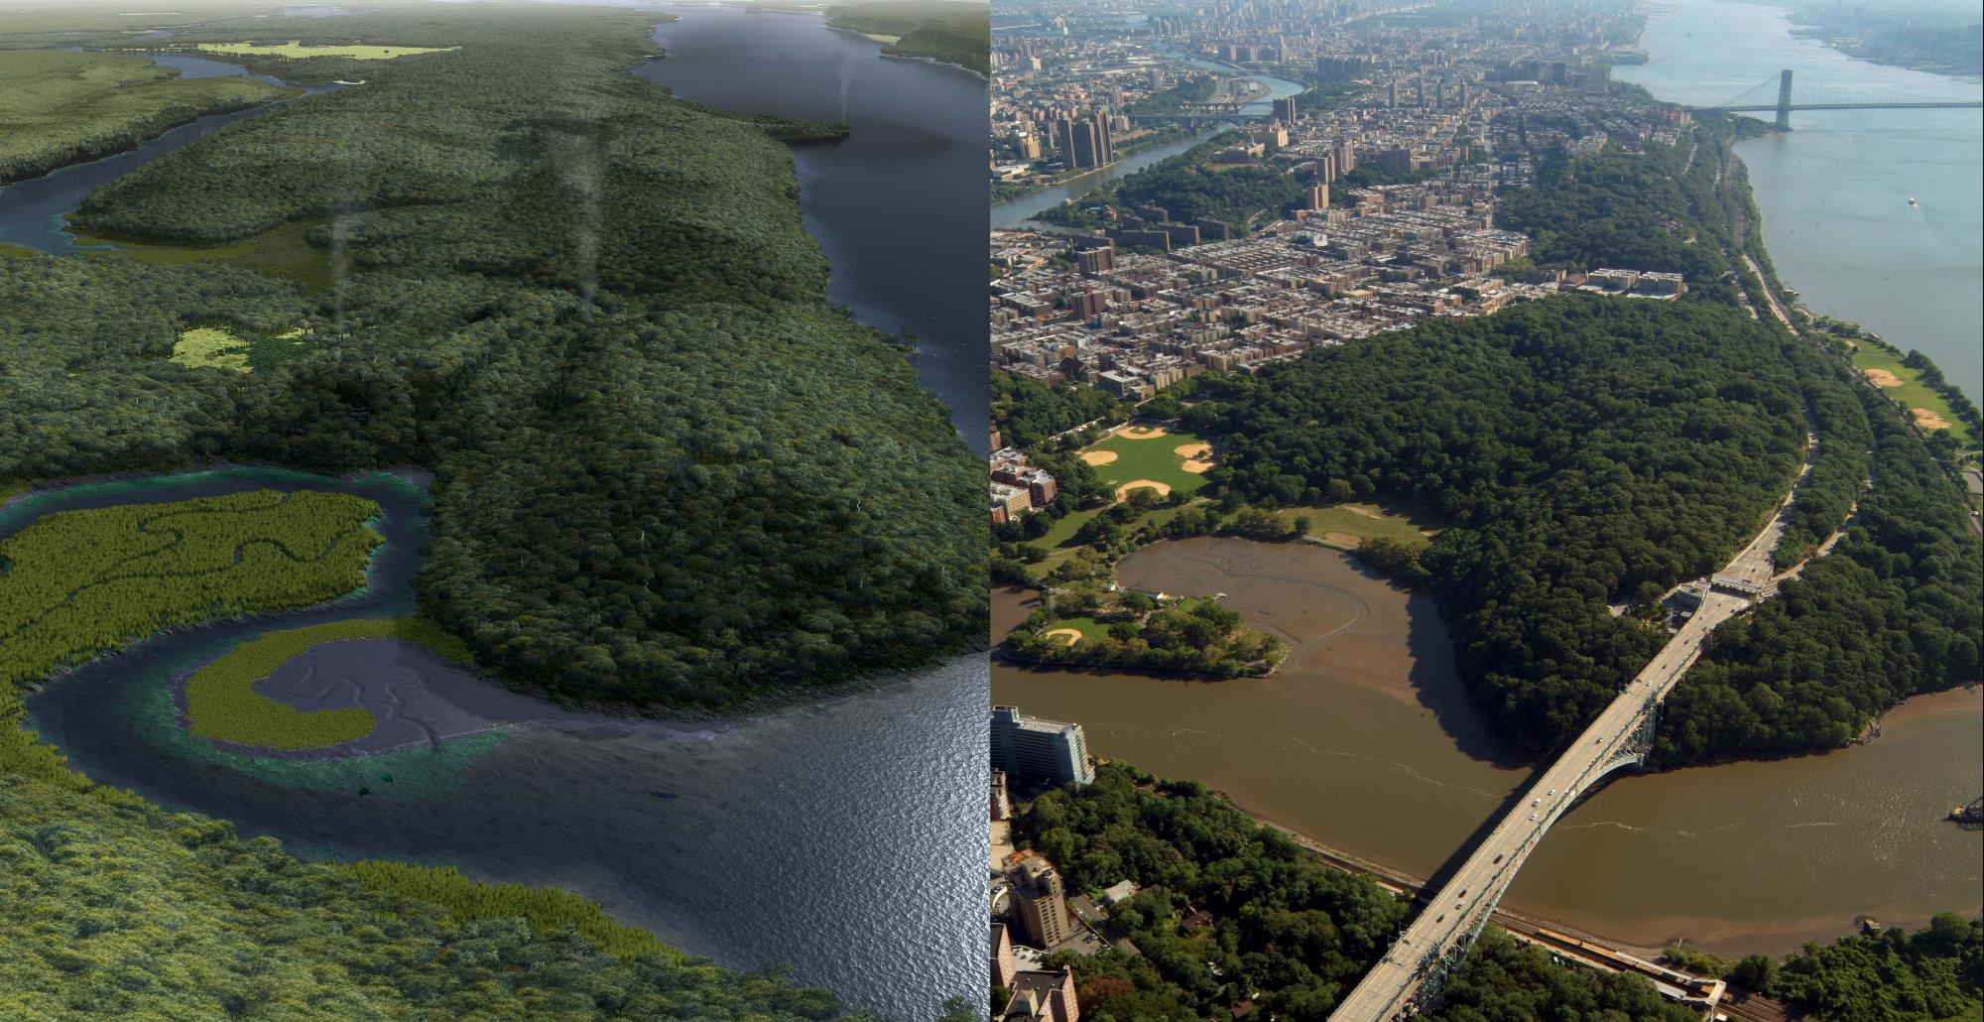
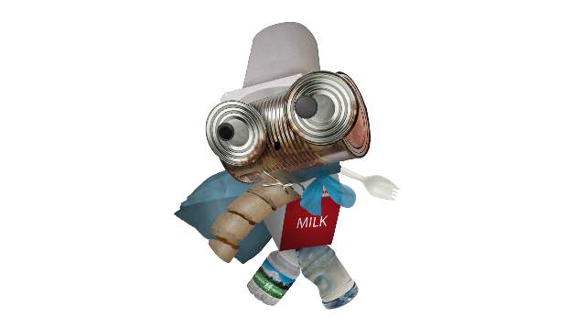
12
So how did Mannahatta...
…become Manhattan?
Notes:
https://habitatthegame.files.wordpress.com/2014/05/spuytenduyvil_split.jpg

Slide 13
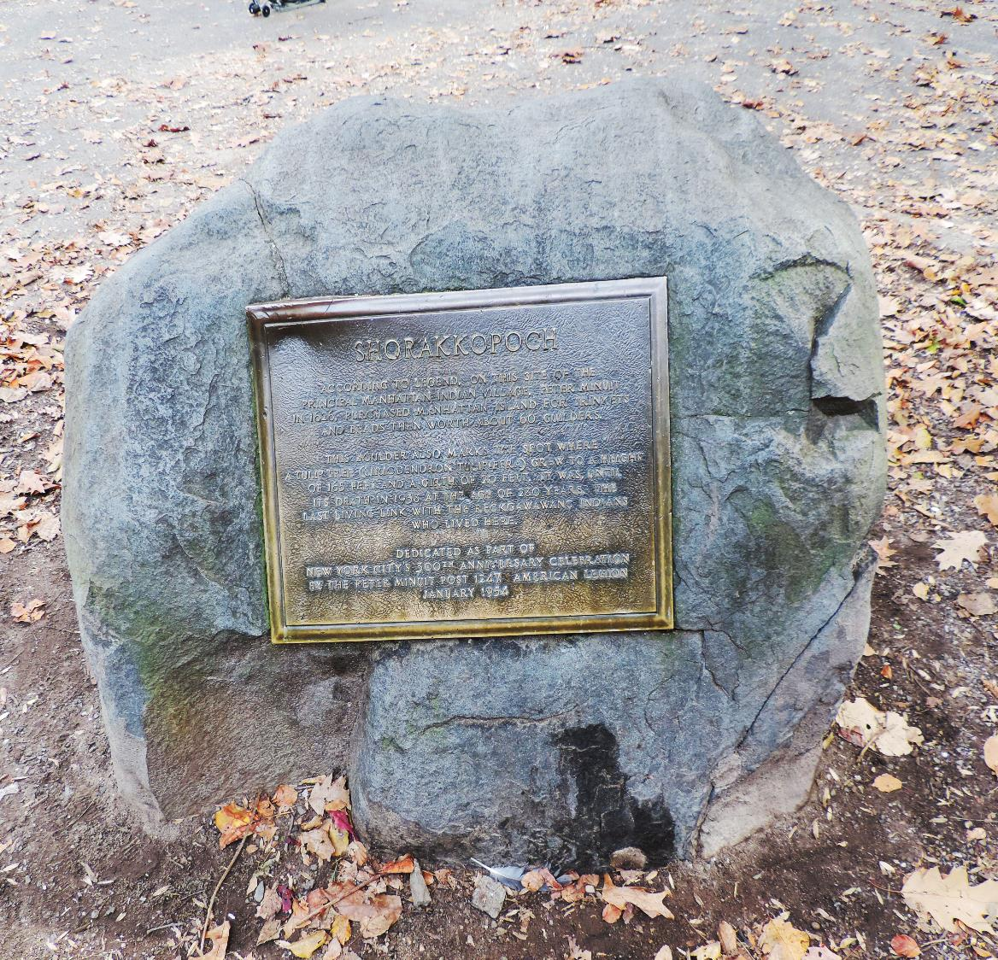
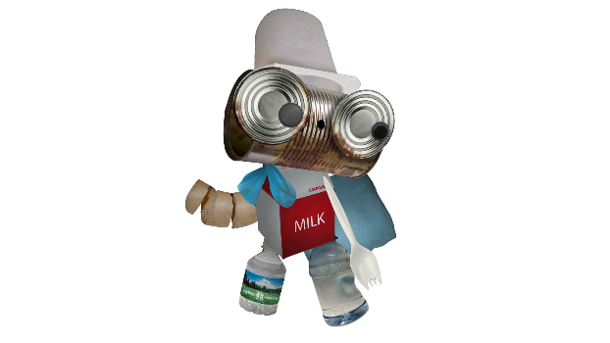
13
Here we are at Shorakkopoch Rock.
At this exact spot in the year 1626, Peter Minuit, the Dutch governor of the New Netherland colony, bought Mannahatta from the Lenni Lenape people for only $24!
What could you buy for $24 today?
Notes:
https://www.pinterest.com/pin/322570392036952776
https://welikia.org/download/curriculum/
https://commons.wikimedia.org/wiki/File:Shorakkopoch_Rock.jpg

Slide 14
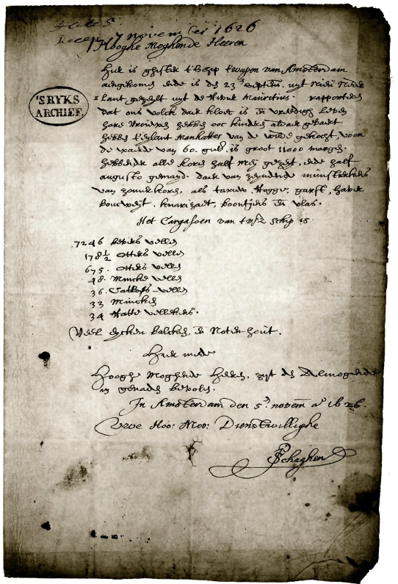
14
Here is our only proof of this purchase.
It’s a letter originally written in Dutch. We’ll read the English translation.
High and Mighty Lords, Yesterday the ship the Arms of Amsterdam arrived here. It sailed from New Netherland out of the River Mauritius on the 23d of September. They report that our people are in good spirit and live in peace. The women also have borne some children there. They have purchased the Island Manhattes from the Indians for the value of 60 guilders. It is 11,000 morgens in size [about 22,000 acres]. They had all their grain sowed by the middle of May, and reaped by the middle of August They sent samples of these summer grains: wheat, rye, barley, oats, buckwheat, canary seed, beans and flax. The cargo of the aforesaid ship is:
7246 Beaver skins 178½ Otter skins 675 Otter skins 48 Mink skins 36 Lynx skins 33 Minks 34 Muskrat skins
Many oak timbers and nut wood.
Herewith, High and Mighty Lords, be commended
to the mercy of the Almighty, In Amsterdam,
the 5th of November anno 1626.
Your High and Mightinesses’ obedient, P. Schaghen
What natural resources does the author mention in his letter to the “High and Mighty Lords”?
Notes:
http://www.thirteen.org/dutchny/interactives/manhattan-island/

Slide 15
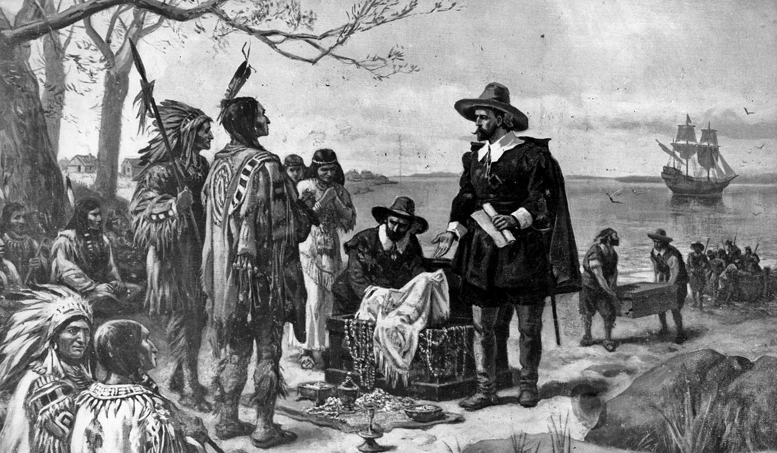
15
The Lenape, however, did not think they were selling the island to the Dutch.
Instead, they thought the Dutch were giving them gifts of appreciation for being allowed to share the island with them.
In fact, the Lenape did not believe in the ownership of land, as there was no such concept, just as there is no such thing as owning the sunlight, the air or the wind.
What do you think about this? Was this a fair deal? Compare and contrast the values, motivations and beliefs of the Lenape with those of the Europeans.
Notes:
But Mr. Davids said the Lenape did not believe in the ownership of land, and Mr. Baker added: “The land being living, it’s not something that can be owned or possessed or contained. It’s not an object.” Land ownership, as Mr. Burrows and Mr. Wallace wrote, “was a European conception, and whatever transpired in 1626 was almost certainly understood by the local side in a profoundly different way.”

Slide 16
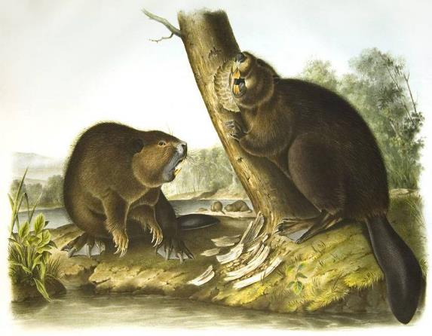
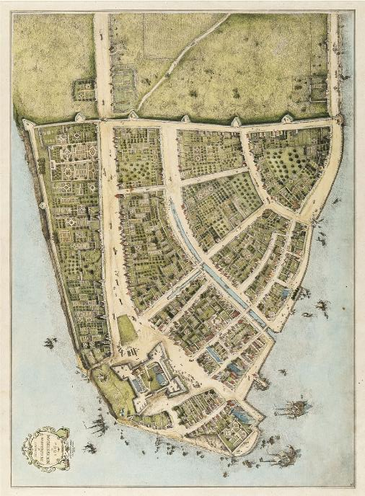
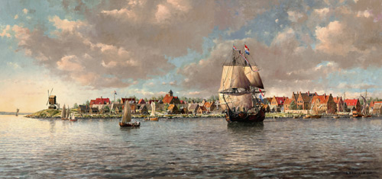
16
Since the island had so many valuable natural resources, such as timber for wood and beavers for fur, more Europeans came here to live, trade and take these resources.
The Dutch colonists built a settlement at the southern end of Manhattan. They called it New Amsterdam.
How were the colonists able to do this with the Lenape still living here? How do you think the Lenape felt about this?
Notes:
http://www.boweryboyshistory.com/2016/06/sad-tale-lenape-original-native-new-yorkers.html
https://www.theglobeandmail.com/arts/books-and-media/mannahatta-a-natural-history-of-new-york-city/article786526/#c-image-5

Slide 17
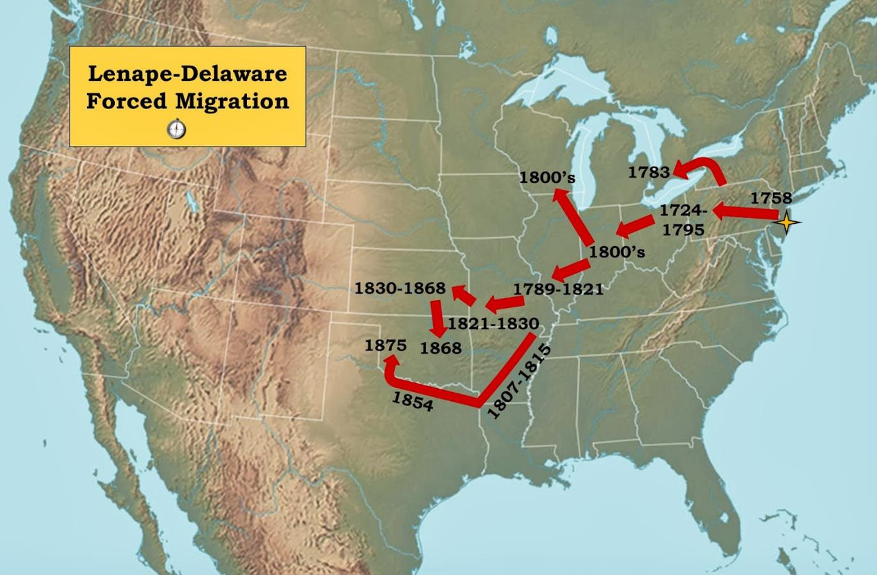
17
What followed for the Lenape was devastating loss of life, disruption of tradition, enormous loss of lands and forced migration.
Over the following decades, the Lenape had to defend their land against the invading European colonists.
Unfortunately, newly-introduced diseases from Europe and conflicts with other Native American tribes made the situation worse.
Those who survived were forced to migrate west, far away from their homelands.
Notes:
https://bsumaps.blogspot.com/2013/11/ball-state-university-immersive.html?m=0

Slide 18
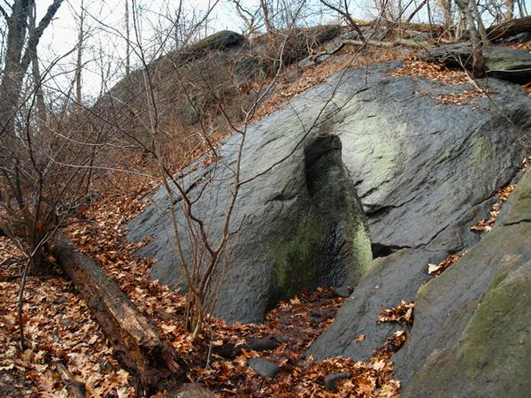
18
Let’s look at these small hills to our left.
In the 19th & 20th centuries, archaeologists began exploring Inwood Hill Park and digging into its hills, like this one.
Notes:
https://commons.wikimedia.org/wiki/File:Pothole_Inwood_Hill.jpg

Slide 19
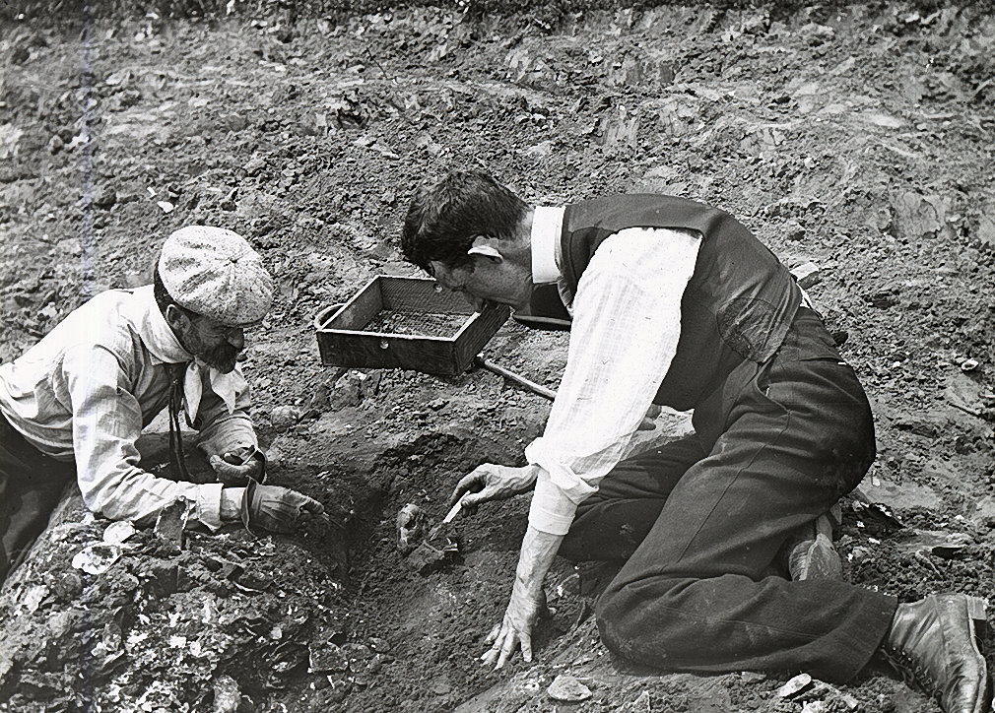
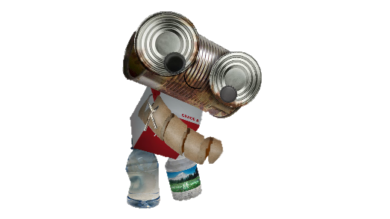
19
These archaeologists didn’t find much!
There was pottery, some arrowheads and a few shell mounds known as middens.
Middens are small hills of waste, which for the Lenape, consisted mostly of the shells of seafood they caught and ate from the river.
Although the Lenape lived here for thousands of years how did they leave so little waste? How did they live this way?
Notes:
https://books.google.com/books?id=iURDAgAAQBAJ&pg=PT143&lpg=PT143&dq=William+Calver+midden&source=bl&ots=r3ZuD0HLAg&sig=Nv2jynkQeZp9f5qUM4UpOO4PuEk&hl=en&sa=X&ved=0ahUKEwiOvPrKma3XAhVHbSYKHdZzAn0Q6AEIUTAJ#v=onepage&q=William%20Calver%20midden&f=false
http://myinwood.net/william-louis-calver-an-archaeologist-and-historical-celebrity/
http://digitalarchives.queenslibrary.org/browse/ralph-solecki-excavating-inwood-hill-park
http://myinwood.net/animals-of-old-inwood/

Slide 20
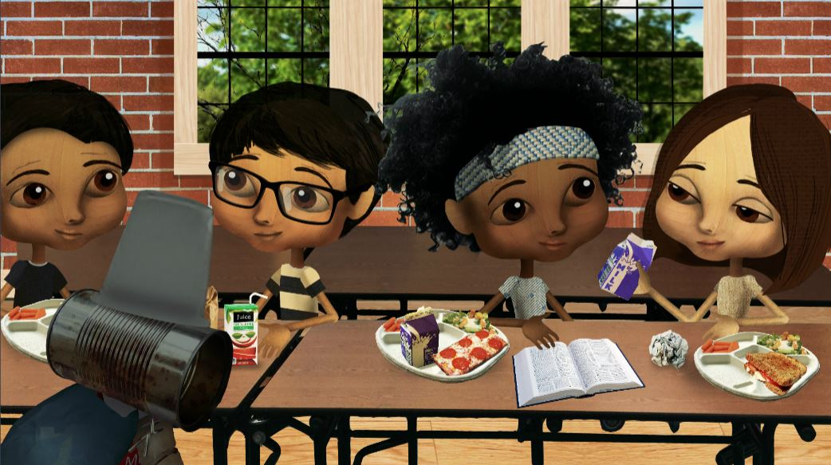
20
Compare waste from your lunch today with a meal eaten by the Native Americans
What might we leave behind for future archeologists to find when exploring the places we bury our waste?
What can we do to minimize the waste we leave behind?

Slide 21
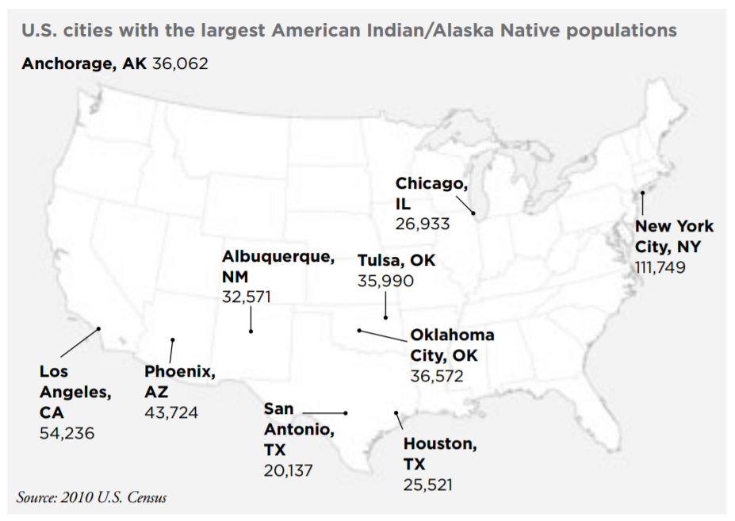
21
Today, the Lenni Lenape are one of hundreds of Native American communities still living in the United States.
Can you see which U.S. city has the largest population of Native Americans?
Notes:
https://steinhardt.nyu.edu/scmsAdmin/media/users/xr1/Language_n_Cultural_Awareness/NativeAmericanCultureLanguageNY2-27-13.pdf

Slide 22
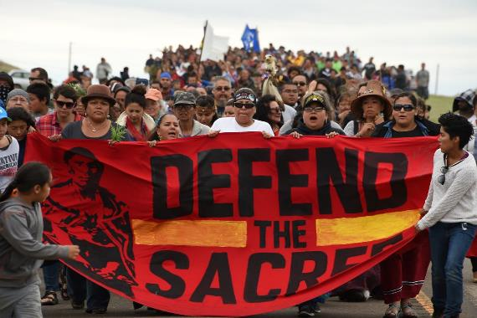
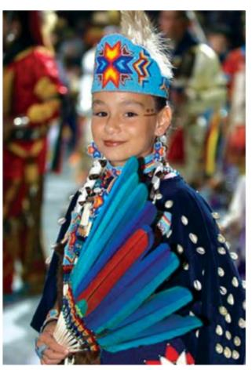
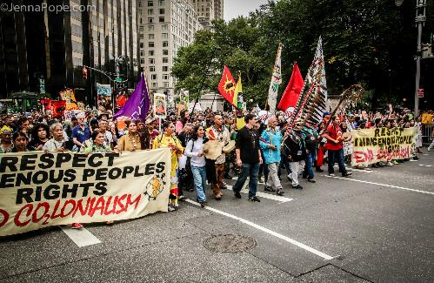
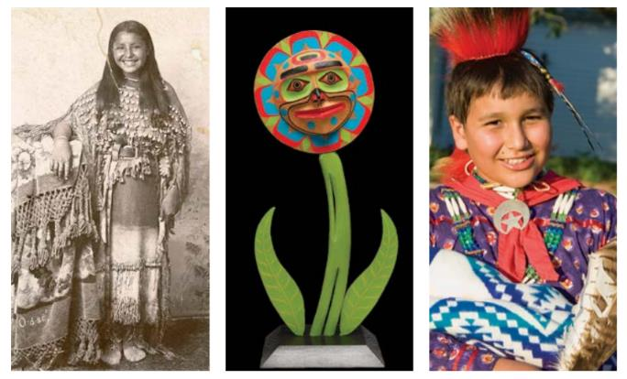
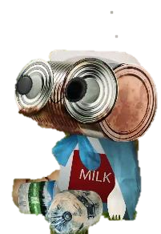
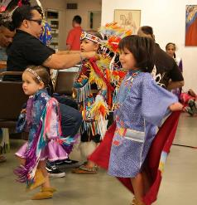
22
They, like Native people throughout the world, continue to fight to maintain the integrity and viability of their cultures.
Notes:
https://aich.org/

Slide 23
23
Thank you for visiting Inwood Hill Park!
I hope we make it back to school in time!
Notes:
https://habitatthegame.files.wordpress.com/2014/05/spuytenduyvil_split.jpg

