Slide 1
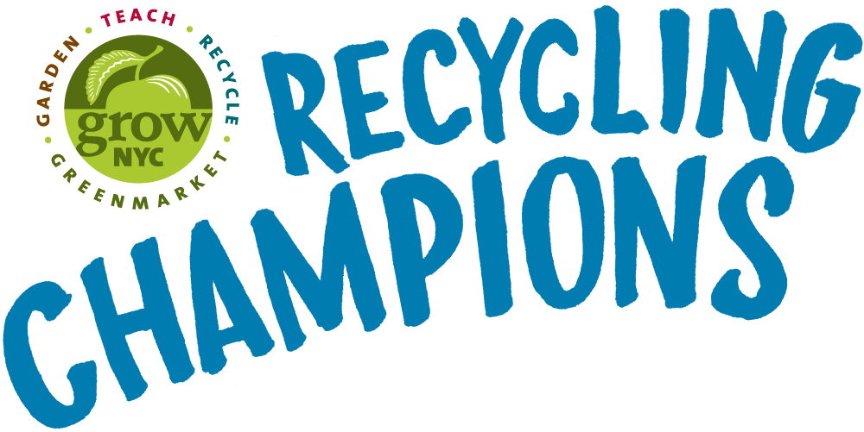
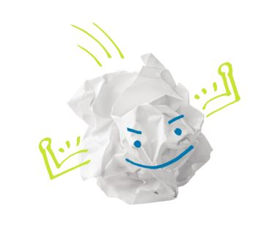
NYC Public schools

Slide 2

What’s your favorite part?
Notes:
No matter what your favorite part of living in planet Earth is, we must protect it. What are ways we take care of the earth?

Slide 3
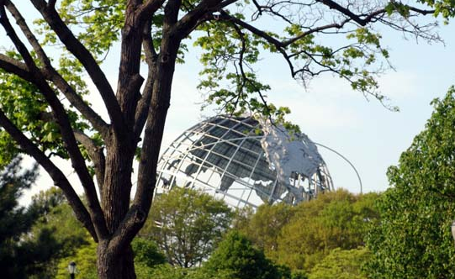


Ways we Take Care of the Earth
Reduce
Re-Use
Recycle
Notes:
The three R’s are something we are used to hearing. But what do they really mean? Can someone name examples of each?

Slide 4
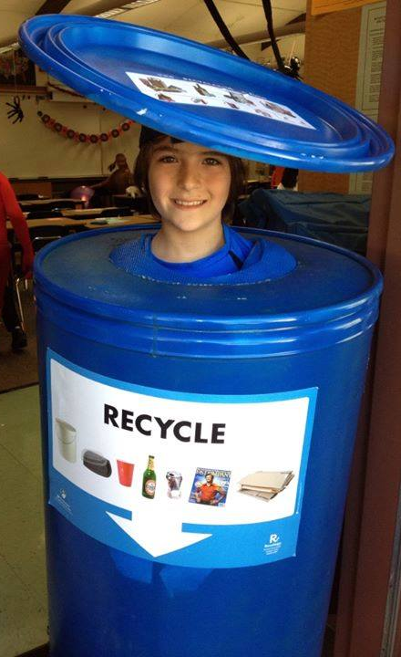
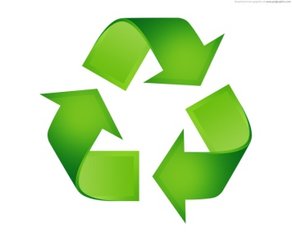
So,
What is Recycling?
Recycling = Taking a product or material and turning it into a usable raw material to make another product.
Notes:
Recycling, as opposed to reusing, is something that requires not just physical, but chemical, changes in a product. it requires from special facilities and technology. Luckily, we have access to that technology right here in NYC!

Slide 5
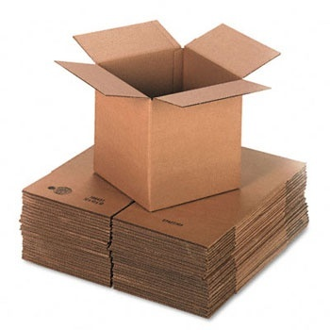
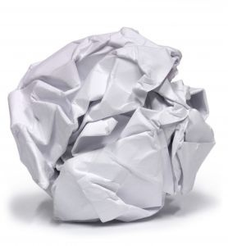
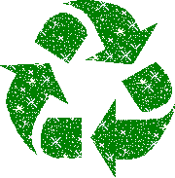
Recycling
What is Made from Recycled Materials?
Notes:
Recycled products can be simple:
Like making new paper and cardboard from used paper.

Slide 6
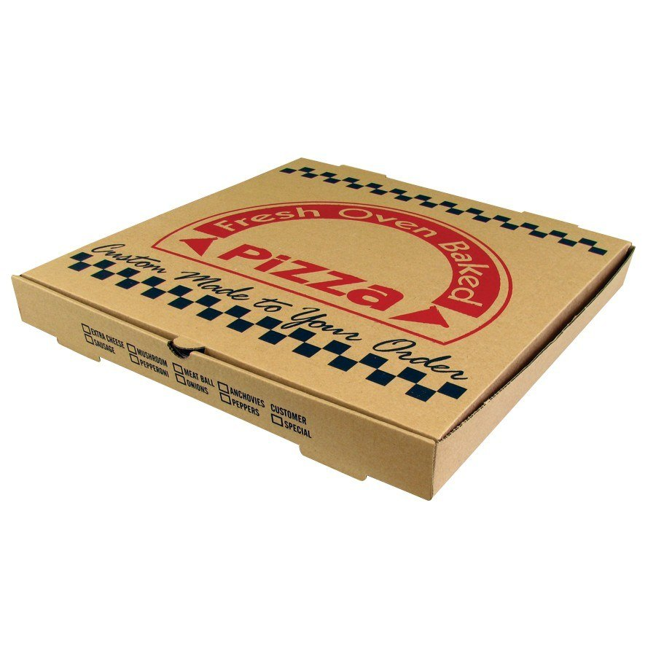
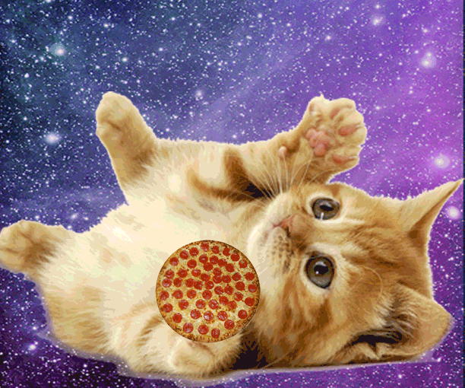
Notes:
http://www.snotr.com/video/2586/Pizza_box_of_the_future
Pizza boxes in nyc are mostly made out of recycled paper!

Slide 7
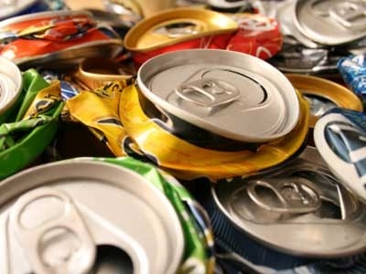
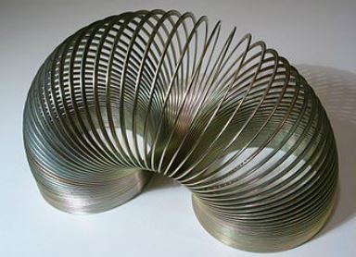
Recycling
What is Made from Recycled Materials?
Notes:
Recycling can be fun!
Like making toys/slinkys from used cans

Slide 8
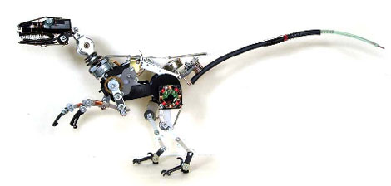
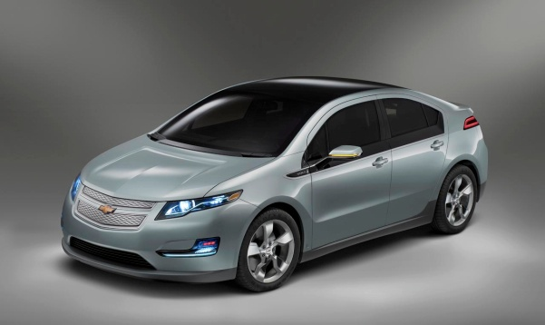
What is Made From Recycled Materials?
The Chevy Volt uses recycled metal
Notes:
-Cars often incorporate recycled steel and aluminum into their frames
-The main point of emphasizing these recycled products is that students should think creatively about what recycled materials can become.
-For example; a steel can that once contained vegetables, when recycled, could end up in a car. Every item, every product matters, and students should feel empowered by that notion.
-Students can begin to think about where raw materials like aluminum, steel, plastic, and paper come from

Slide 9
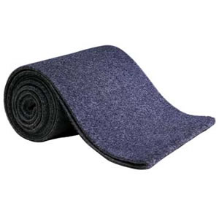
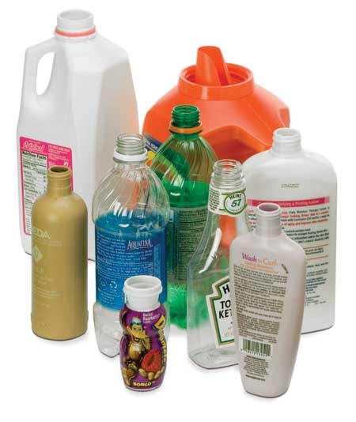
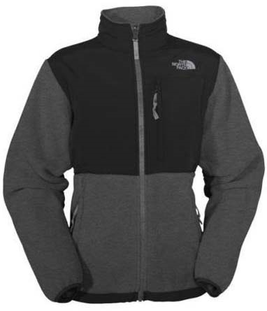
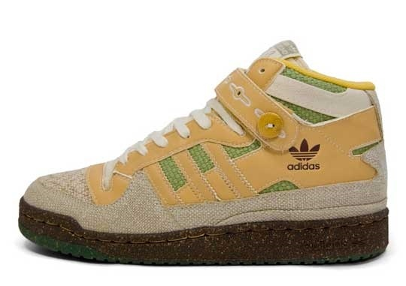
Recycling
What is Made from Recycled Materials?
Notes:
Recycling can also be complex:
Like plastic bottles, jugs, and jars becoming carpet and fleece

Slide 10

Where in SCHOOL
can we RECYCLE?
CLASSROOMS
CAFETERIAS
HALLWAYS
OFFICES
Notes:
-Pose a question to students: What can we do with the waste we generate? Why is it even important to think about this?

Slide 11

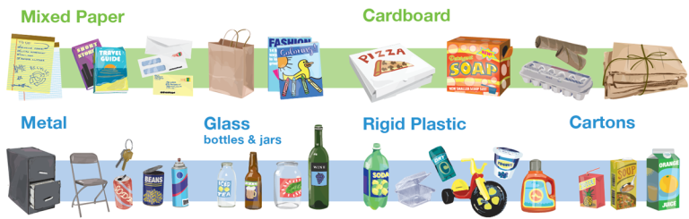
#SORT IT OUT
What goes where in NYC Recycling
Notes:
-What to recycle in NYC is the same for schools as it is for residences
-There are three streams of waste in NYC:
1.) Paper (Green)
2.) Metal, Glass, Plastic, Cartons, Foil (Blue)
3.) Trash (Black/Grey)
This next section will concentrate on learning the guidelines to NYC recycling, and remind us of its importance. RECYCLING IS SO EASY.

Slide 12
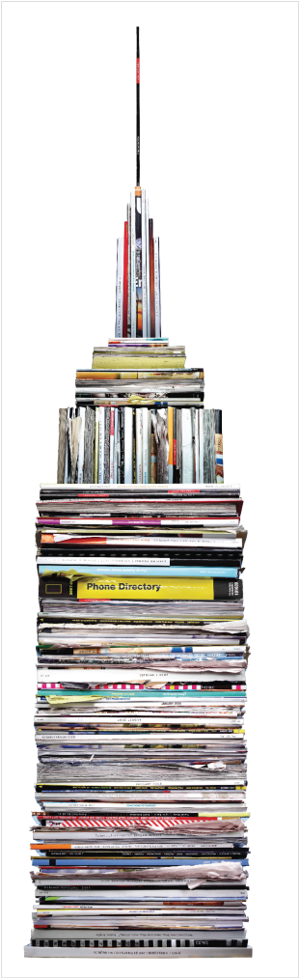
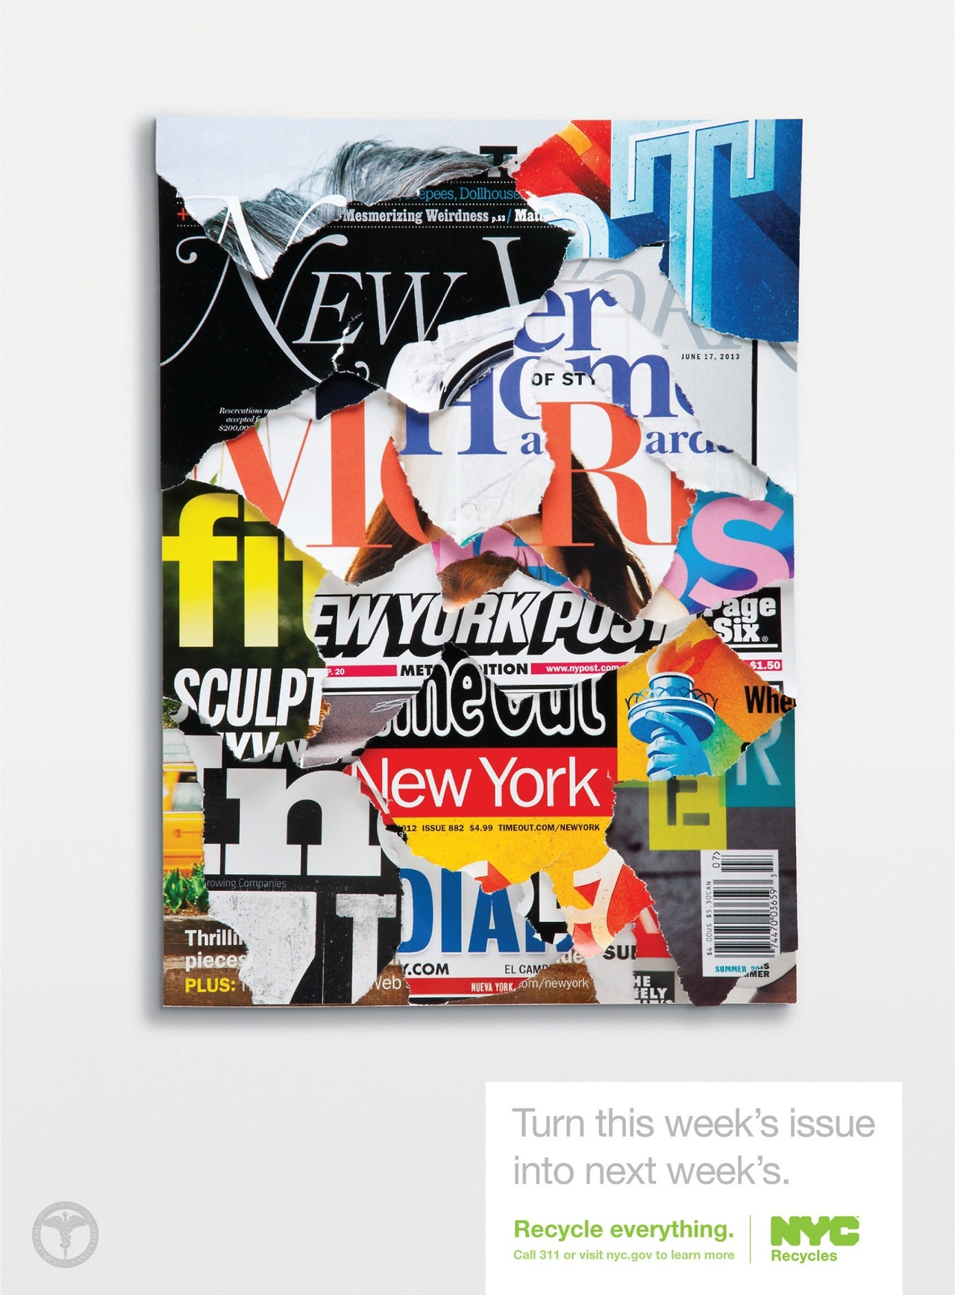
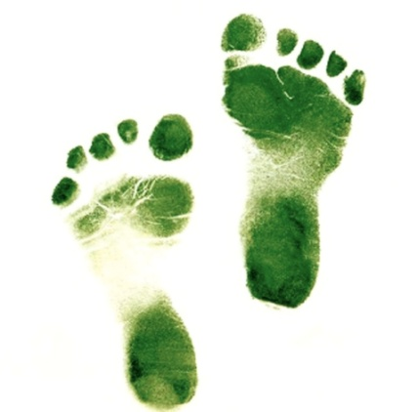
The PAPER trail
Every year, New Yorkers throw away over 400,000 tons of recyclable paper.
That’s enough to fill up the Empire State Building!

Slide 13
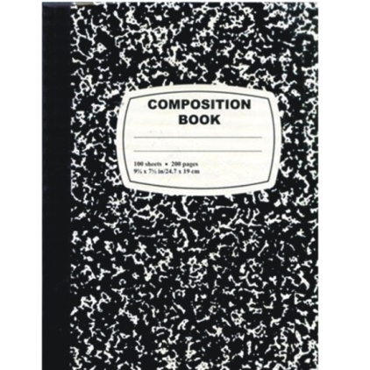
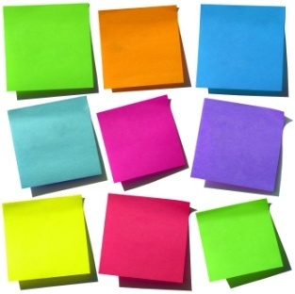

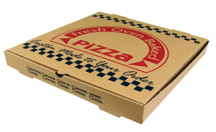
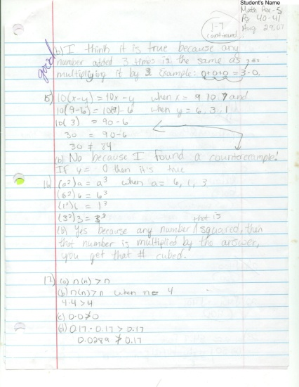
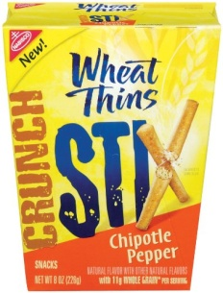
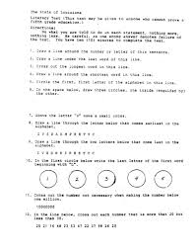
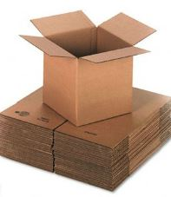
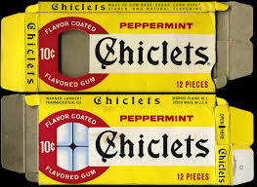
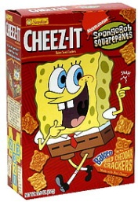
NYC Guideline to paper Recycling
if you can rip it, recycle it!
Please, no hardbound book covers, soiled paper: towels, napkins, plates, cups
Notes:
Ok, the rule to paper recycling is easy-if you can rip it, you can recycle it. Have students repeat this aloud and at once.
This means that post-its, cardboards, old homework, books (paperback), notebooks are all recyclable.
It’s easy to set up recycling in classrooms and offices.
Fun fact: if you order a pizza for a pizza party, most chances are it came from Pratt industry, paper recycler in Staten Island!

Slide 14
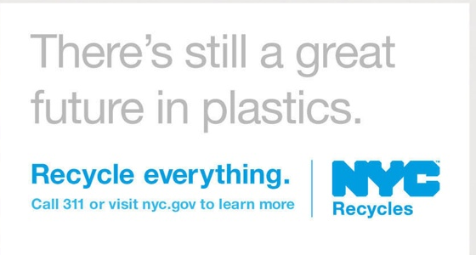
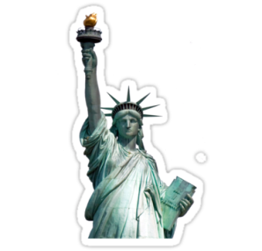
MGP
Metal, Glass, Plastics, Cartons
Every week, 460,000 pounds of beverage cartons are thrown away in NYC.
720 aluminum cans are trashed every minute in New York.
New Yorkers trash 1,579,600 pounds of plastic bottles and jugs every week.
If NYC recycled all of our steel we could build 9 new Statues of Liberty each week.
Notes:
It only takes 6 weeks for a recycled can to make it to the supermarket shelves again.

Slide 15
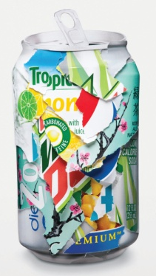
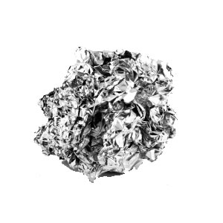
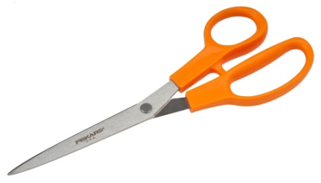
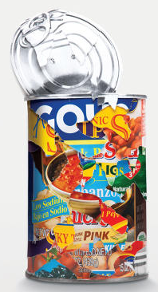
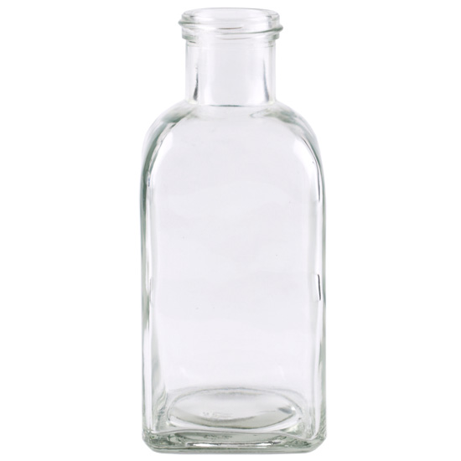
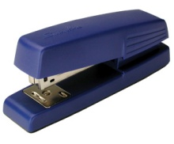
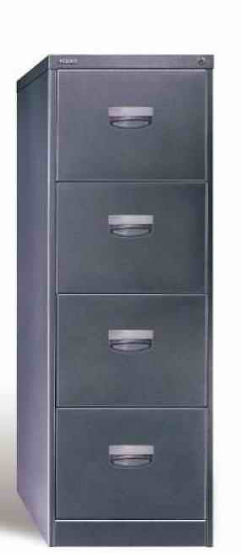
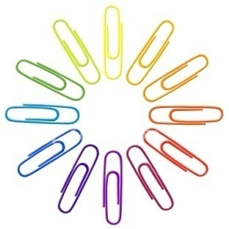

NYC Guideline to MGP Recycling
Metal Rule: Mostly Metal | Glass Rule: Check the Neck!

Slide 16
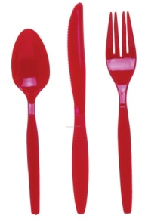
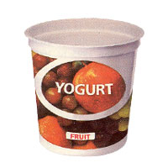
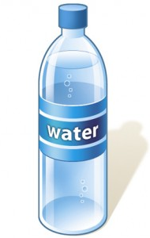

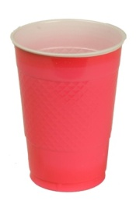
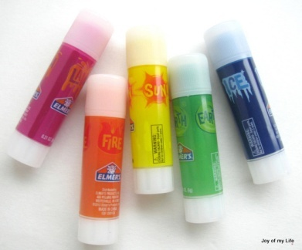
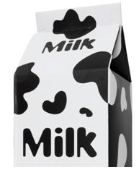
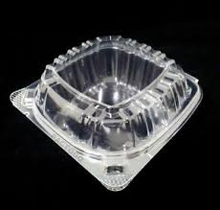
NYC Guideline to MGP Recycling
MGP: Recycle all Hard (rigid) Plastics
Foam- Bags-Film
Vinyl Wrappers
Pouches
Plastic Beverage Bottles-Take-out containers-Plastic utensils-Yogurt/desert cups-Salad containers-Plastic toys, Empty glue containers
Notes:
All hard plastics can be recycled in NYC. How to distinguish a hard plastic from others? If you can crumble it up in a ball, it’s NOT a hard plastic.

Slide 17

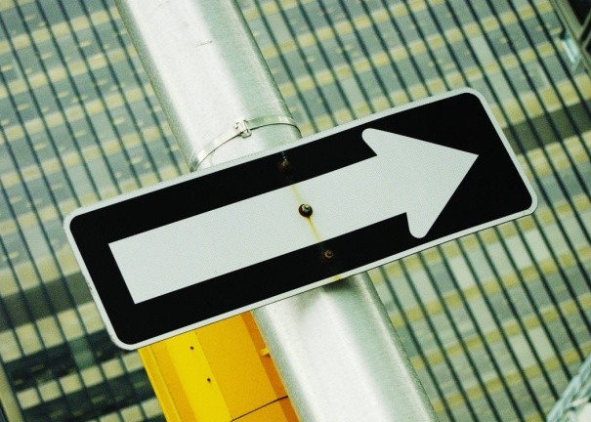

School Recycling:
What Needs to Happen
AND TAKE YOUR TRASH WITH YOU
SORT THINGS CORRECTLY
EASY, PEASY LEMON SQUEEZY!
LOOK AT THE SIGNS… THEY TAKE YOU PLACES
Notes:
Recycling is easy, look before you toss!

Slide 18

WHO WANTS TO BE A RECYCLING CHAMPION!

Slide 19
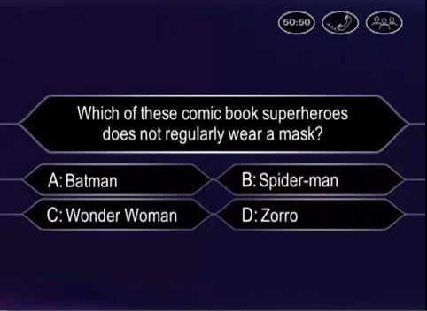



Slide 20


Slide 21

Let’s Begin!

Slide 22




Name three ways you can take care of the Earth.

Slide 23
C
If NYC recycled all of its steel, we could build 9 statues of liberty each week.
TRUE
FALSE

Slide 24
C
New Yorkers throw away enough paper to fill up the Empire State Building every year.
TRUE
FALSE

Slide 25

Name the article that does NOT go in the cafeteria blue bin:
foam tray
milk carton
spork
plastic bottle

Slide 26
HOW CAN YOU
BE A RECYCLING CHAMPION?
Notes:
We are now going to focus on how YOU can be a part of recycling in school.

Slide 27




Lead by Example
If you recycle, other students will take notice and do the same. Remember, it’s easy.

Slide 28


Start or join a Green Team!

Slide 29










Spread the word!
Notes:
Instructional Demonstrations to students in other clasess
Student / Staff Handouts
Morning Announcements
Decorate recycling bins
Make posters to share with fellow students
Don’t be afraid to use your voice and talents!

Slide 30

THANK YOU FOR RECYCLING!

