Slide 1
0 X 30
Notes:
How many of you know what this “0 x 30” means or have seen it somewhere in the city?

Slide 2
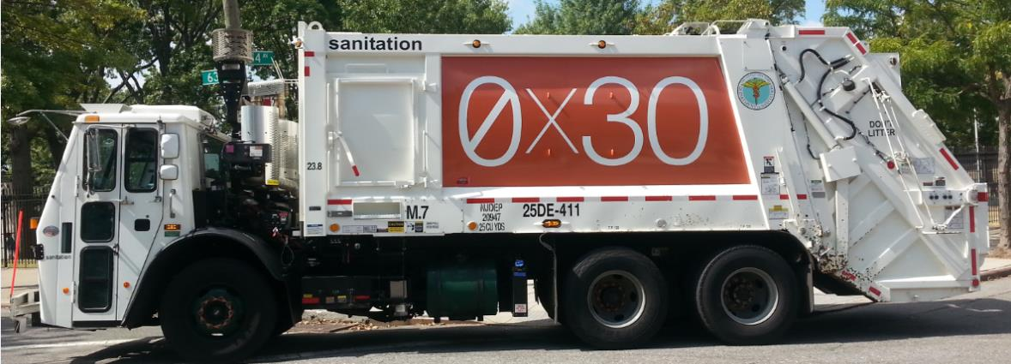
Notes:
Zero Waste to landfills by 2030. Department of Sanitation is instrumental in bringing this vision to a reality by providing funding, infrastructure, and operational support citywide.

Slide 3
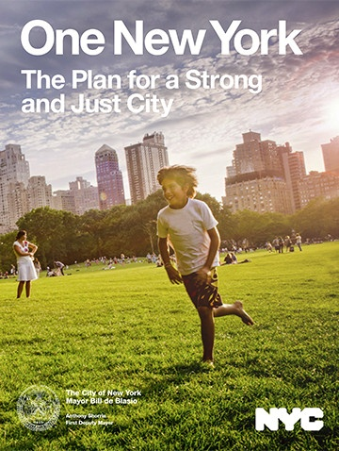
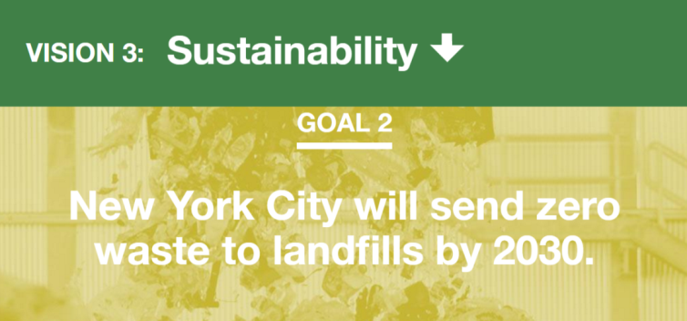
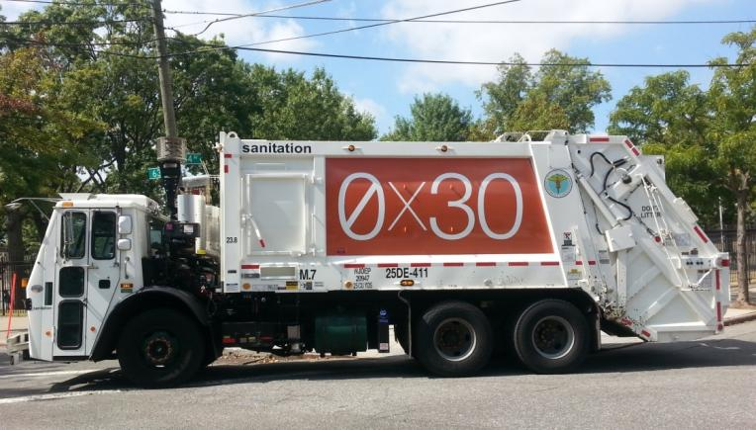
Notes:
Bill de Blasio’s Plan for NYC. One of those visions is around Sustainability – including sending zero waste to landfills by 2030.

Slide 4
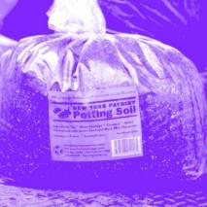
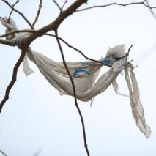
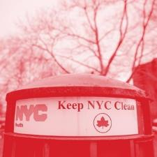
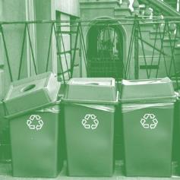
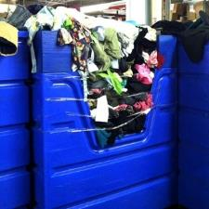
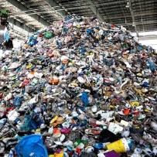
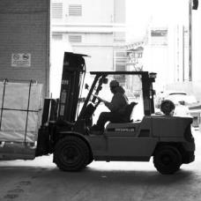
Expand the NYC organics program to serve all New Yorkers by the end of 2018.
Reduce the use of plastic bags and other non-compostable waste.
Make all schools Zero Waste Schools.
Give every New Yorker the opportunity to recycle and reduce waste, including at NYCHA housing.
Enhance curbside recycling program.
Expand opportunities to reuse and recycle textiles and electronic waste.
Reduce commercial waste disposal by 90% by 2030.
Develop a Save-As-You-Throw program to reduce waste.

Slide 5
Getting to Zero

Slide 6
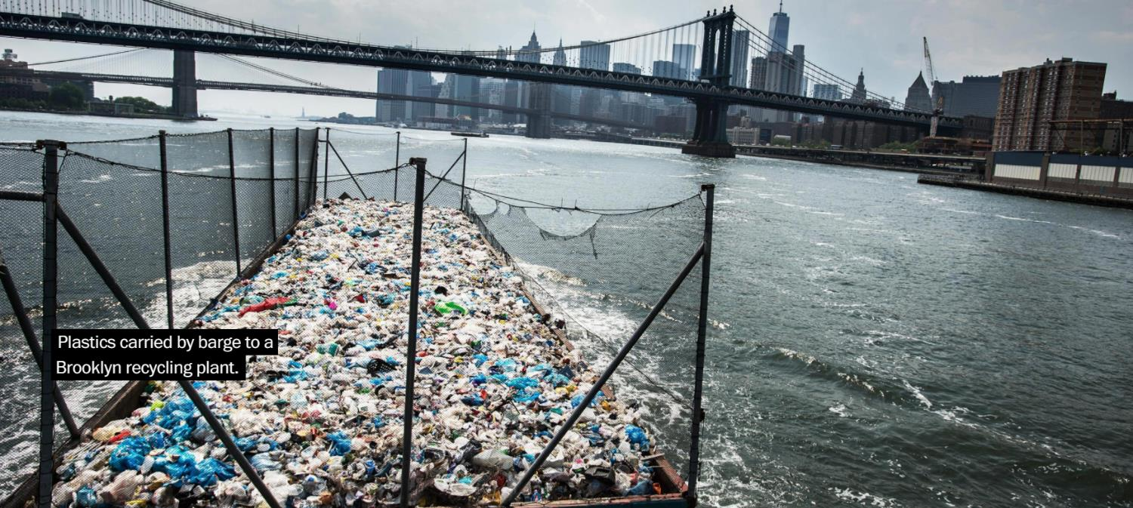
NYC: Weight of Waste
New York City produces 6 million tons of garbage per year.
Source:
https://www.washingtonpost.com/graphics/2017/world/global-waste/?hpid=hp_hp-visual-stories-desktop_no-name%3Ahomepage%2Fstory&utm_term=.ad598af0fdce#newyork
Notes:
JM

Slide 7
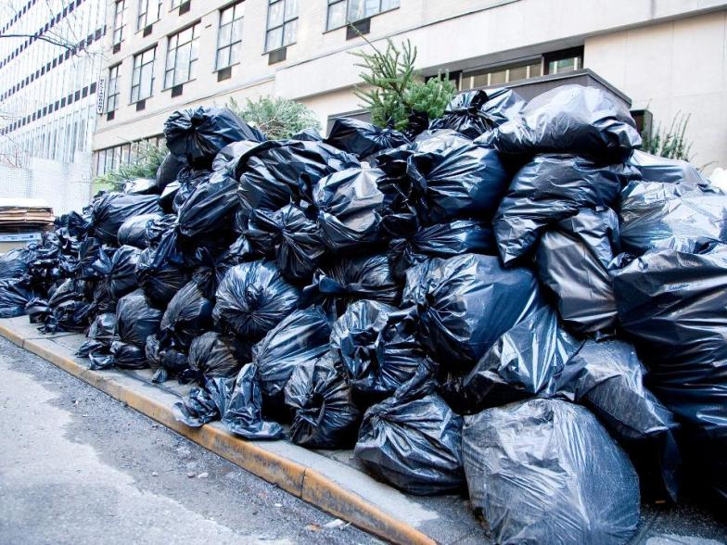
115,000 TONS/WEEK!
Waste adds up!
Notes:
How many of you see piles of garbage likes these everyday, ready to be picked up? It’s a regular sight in New York.
So waste in NYC adds up a lot. If 6 million tons are thrown away every year, that means approx. 115,000 tons a week is thrown away in NYC.

Slide 8
Notes:
Ask what the word “diversion” means. Allow students to try to explain what they think it means.
Define diversion rate.
What year are we in now? How many years before 2030?
What percentage of our waste is remaining? (84%)
So we have a very short amount of time to find alternatives for our waste disposal if we are going to reach Zero Waste by 2030!

Slide 9
Trash Journey & Impact
Notes:
Right now 84% of that 6 million tons of garbage is going to landfills. Let’s take a look at how our waste gets there and the impact it has along the way...

Slide 10
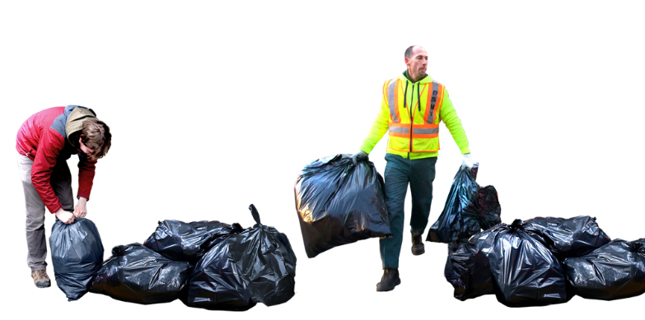
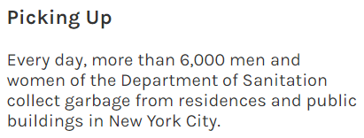
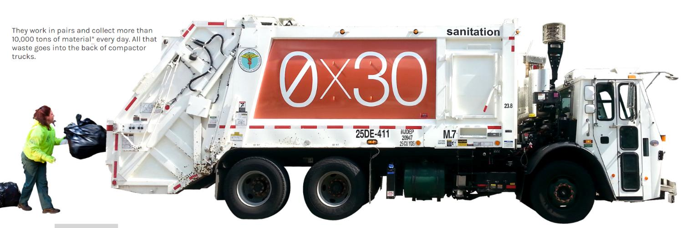

Slide 11
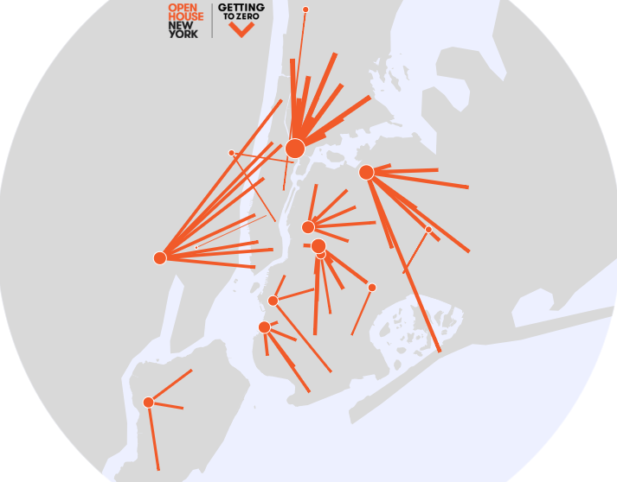

Slide 12
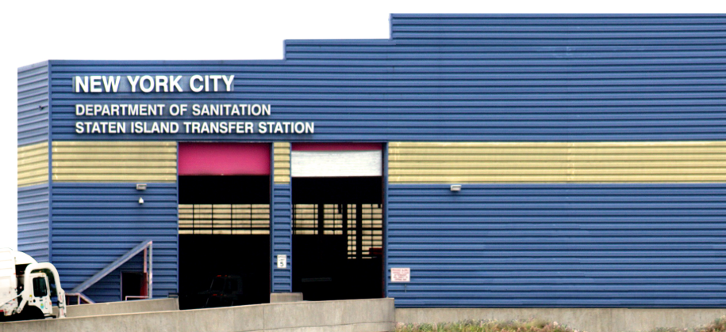
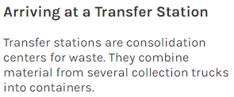
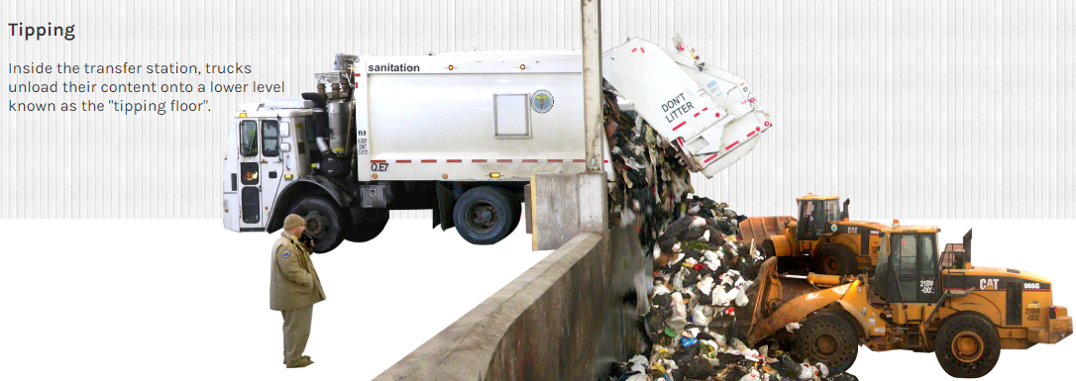

Slide 13
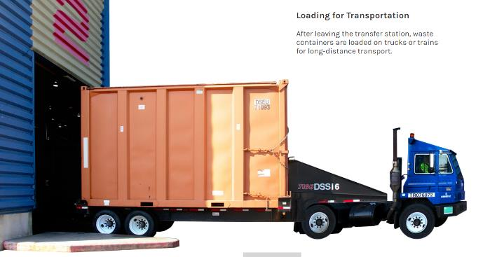
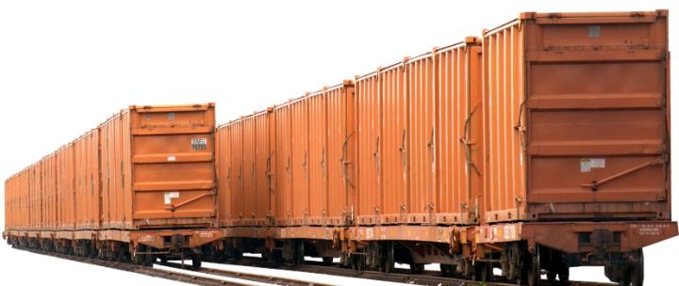

Slide 14
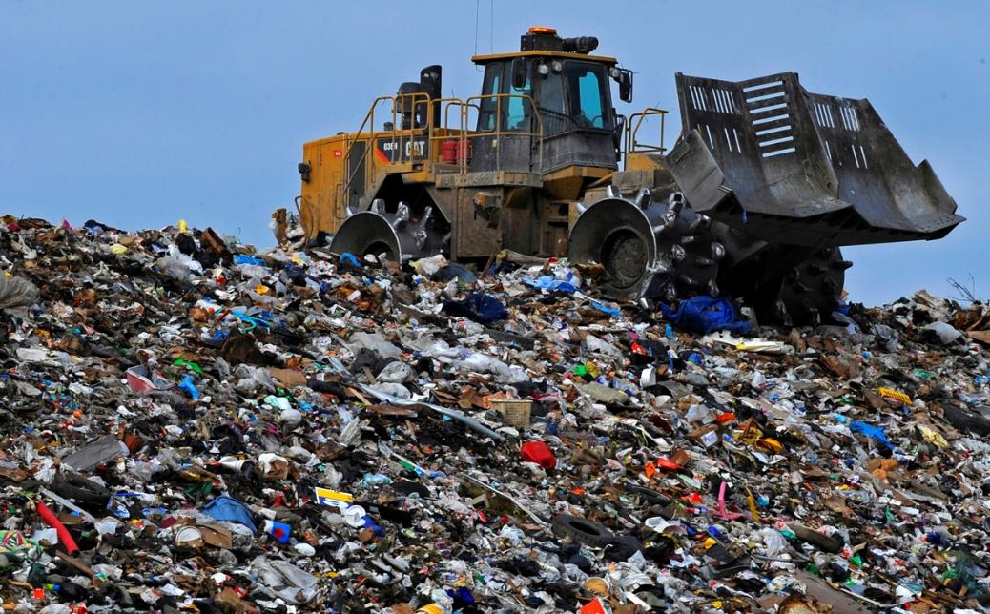
NEXT STOP:
Landfills
Notes:
After it goes from local transfer stations it heads to landfills. Ask where are the landfills in NYC? Answer: there are no active landfills left in NYC

Slide 15
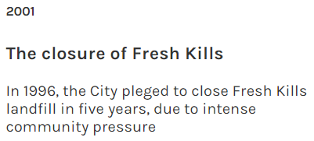
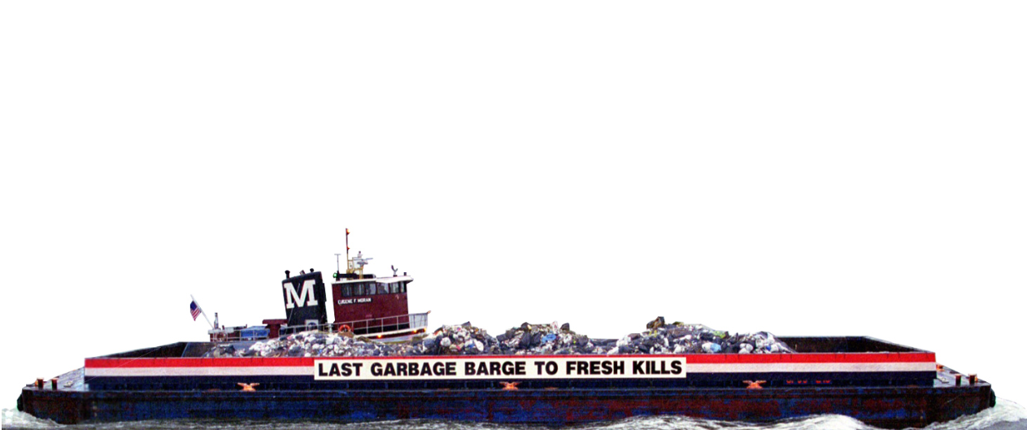
Notes:
After Fresh Kills was finally closed in 2001, the City began using private transfer stations to send all of its waste outside of New York City. This meant increased reliance on trucks for waste export, leading to more traffic and air pollution.

Slide 16
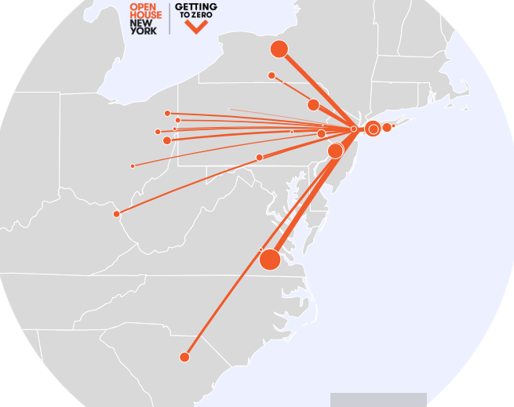
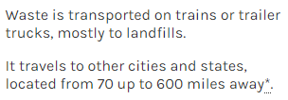
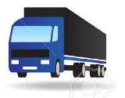
Exporting waste costs NYC
close to $400 million/year

Slide 17
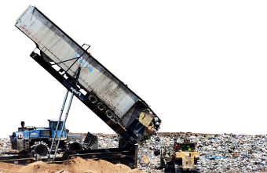
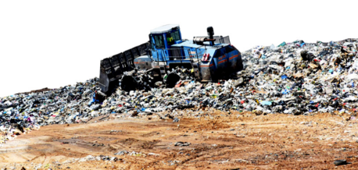
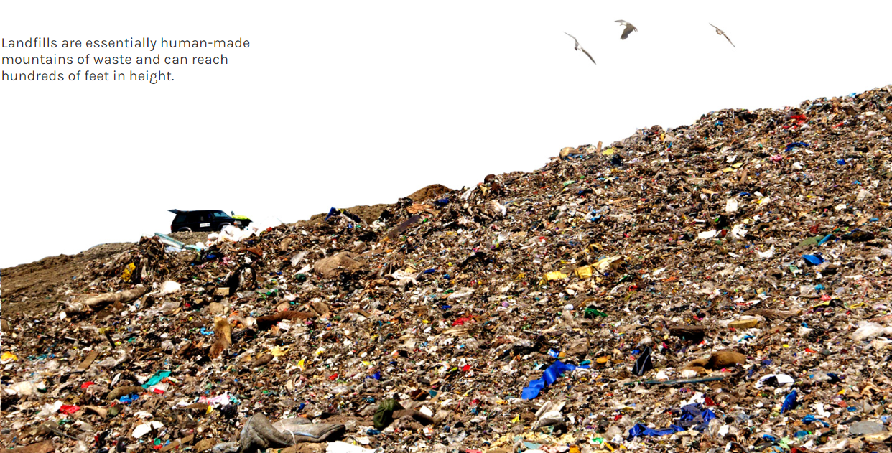

Slide 18
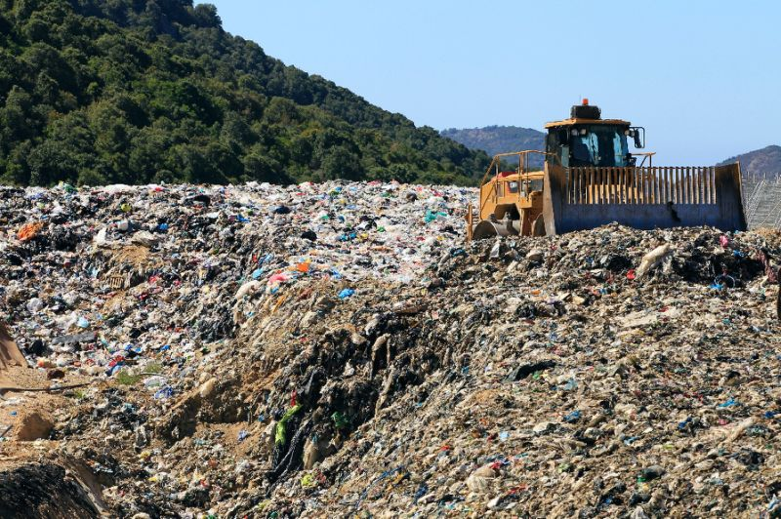
METHANE GAS RELEASED
LEACHATE
Notes:
There are a lot of problems with our current system of sending waste to landfills, as it is very harmful for our environment and planet.
As this pictures shows, when landfill waste degrades and rain rinses the resulting products out, leachate is formed. Leachate is a black liquid that contains organic and inorganic chemicals, heavy metals as well as pathogens; it can pollute the groundwater and can be a public health risk.
The decay of organic waste in landfills also creates methane gas, a very potent GHG, and a major contributor to Climate Change. Because landfill waste isn’t exposed to Oxygen the waste breaks down slowly and releases methane gas.

Slide 19
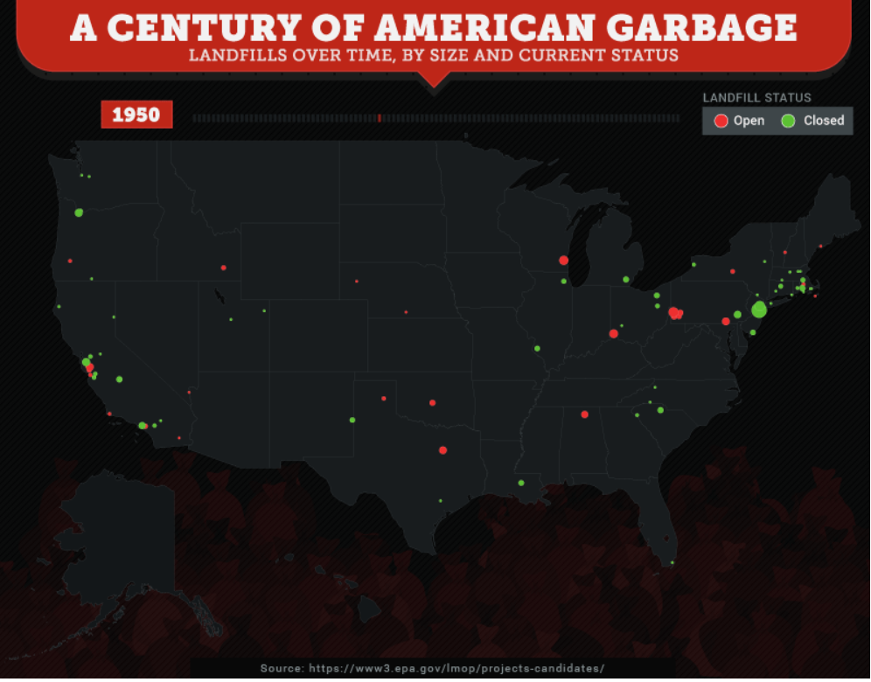
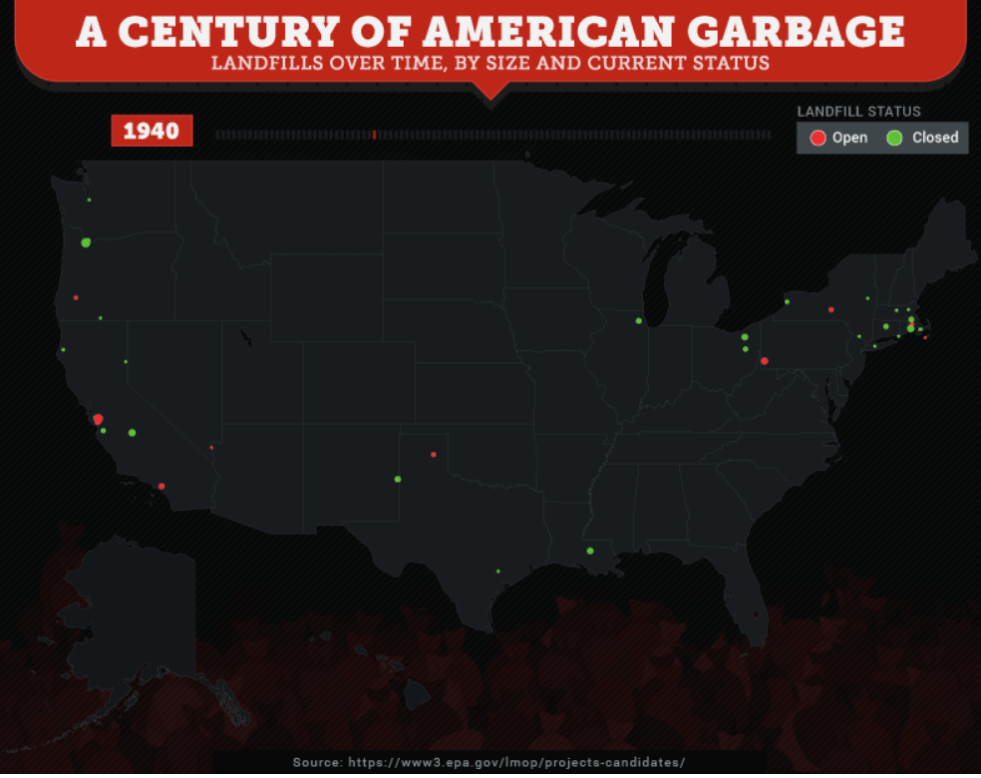
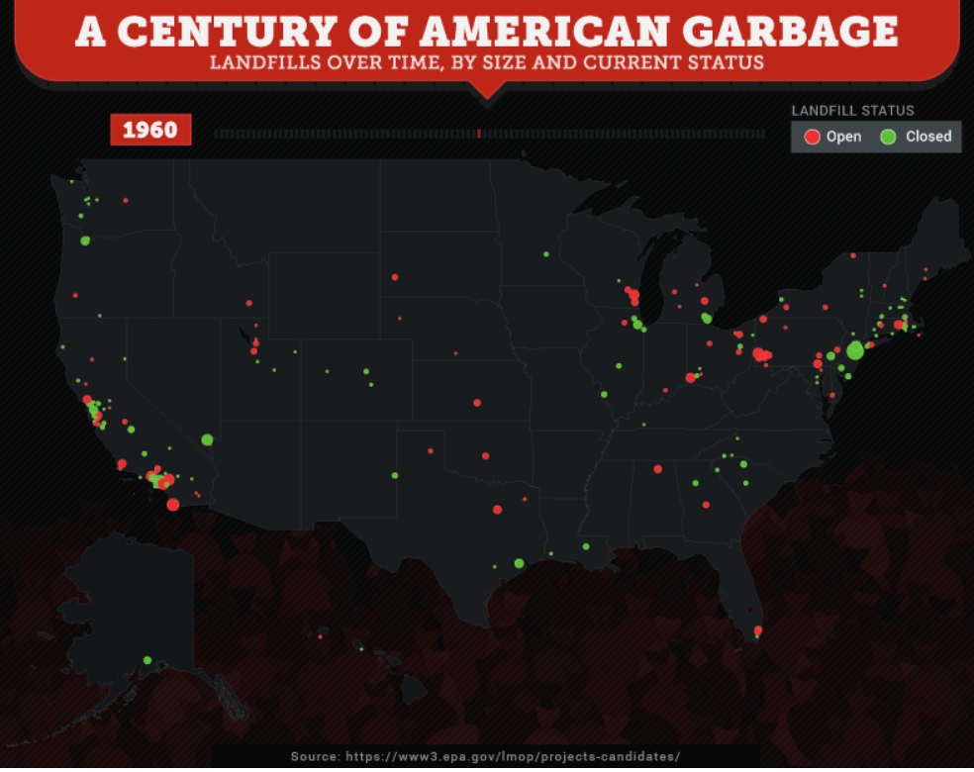
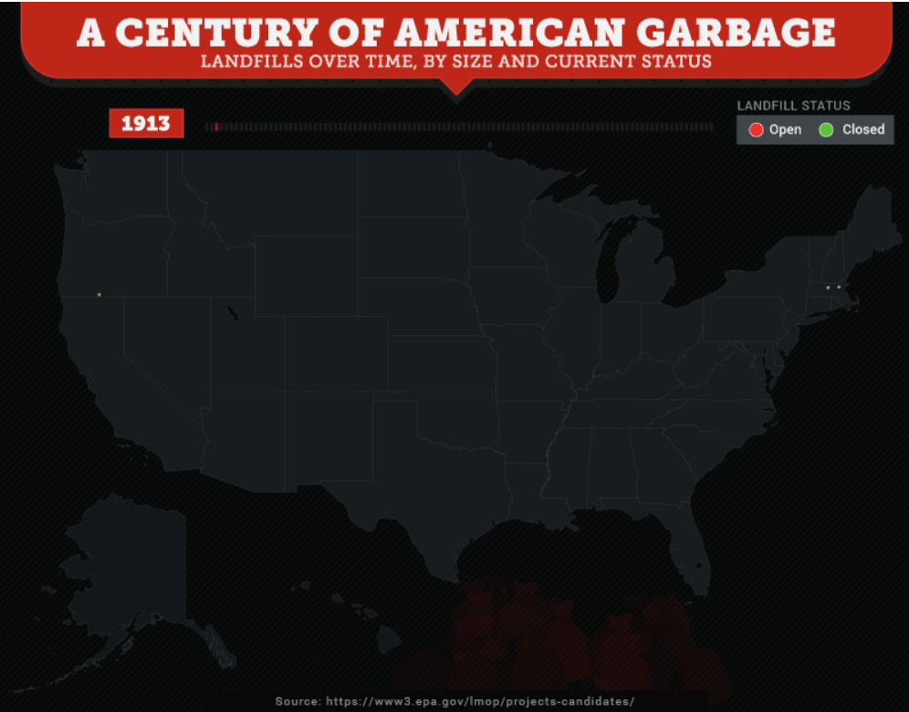
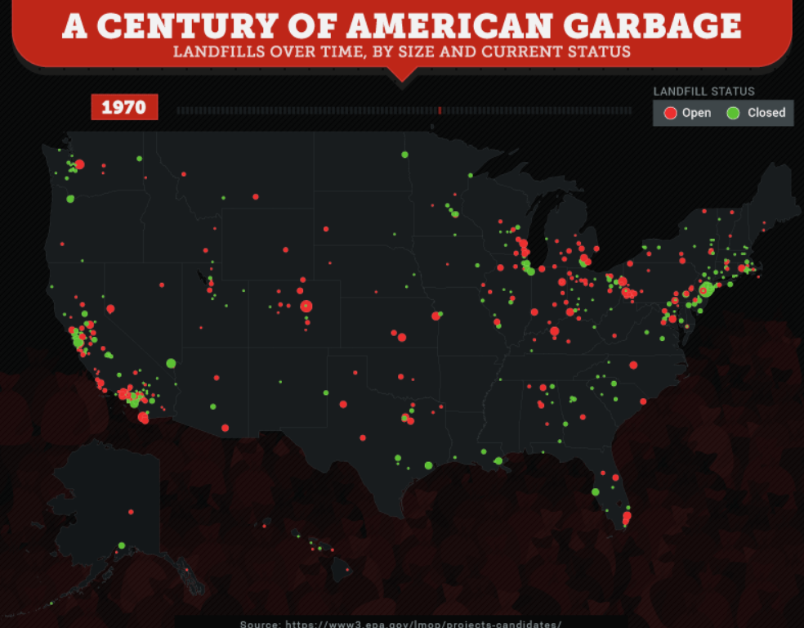
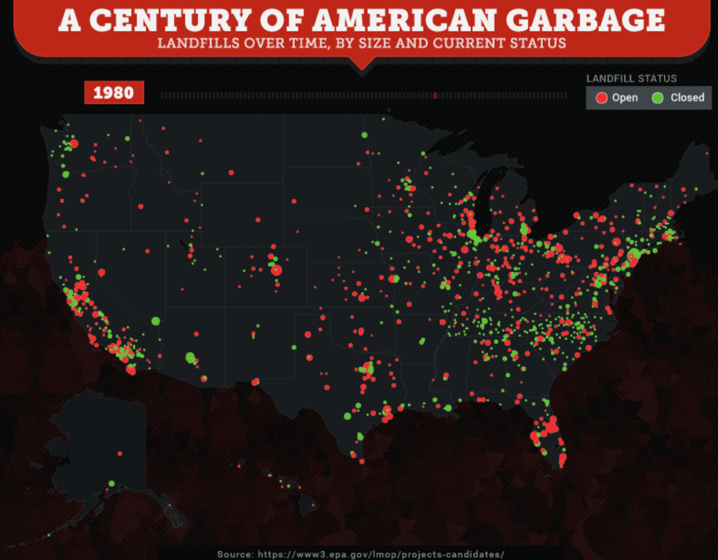
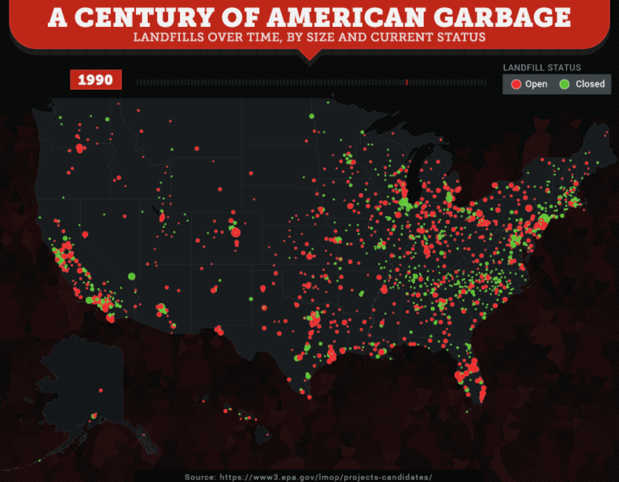
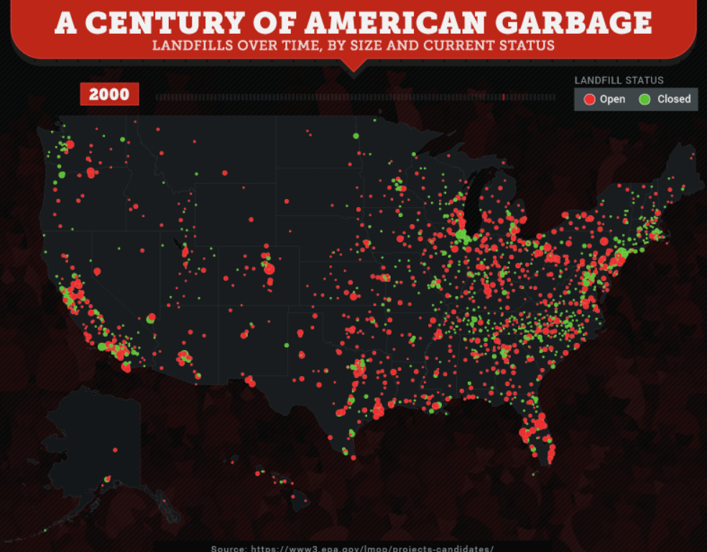
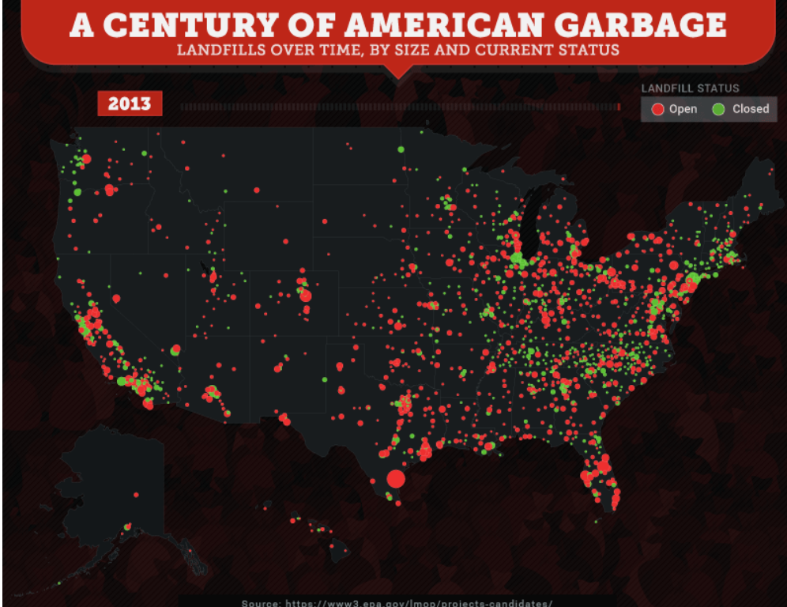
Notes:
As you can see, the US has had a growing need for more landfills over the past 100 years.

Slide 20
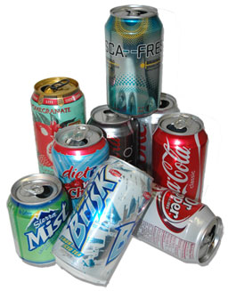
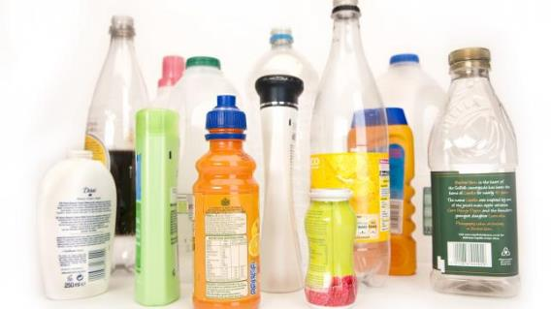
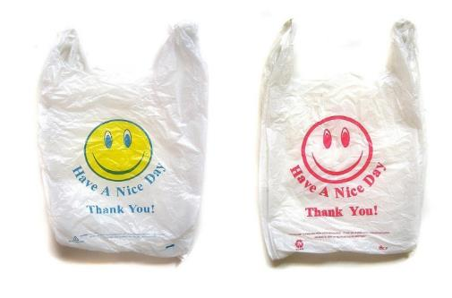
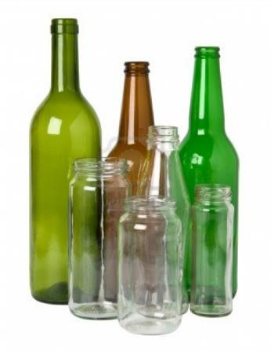
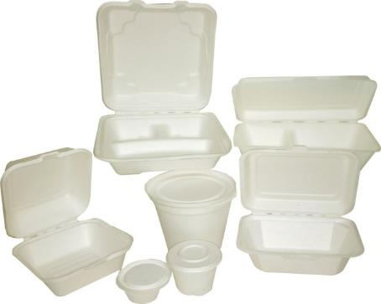
350
500
1000
A million years??
Notes:
How long does it take for a can to break down in a landfill?
If it take 500 years for a plastic bottle to break down, does it completely go away? Most of these items will outlive us by many many years.

Slide 21
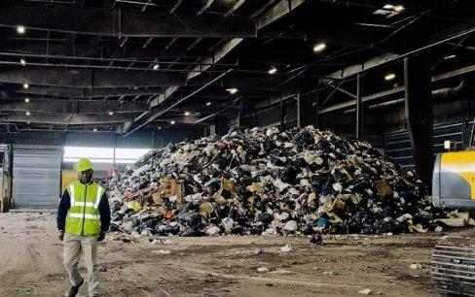
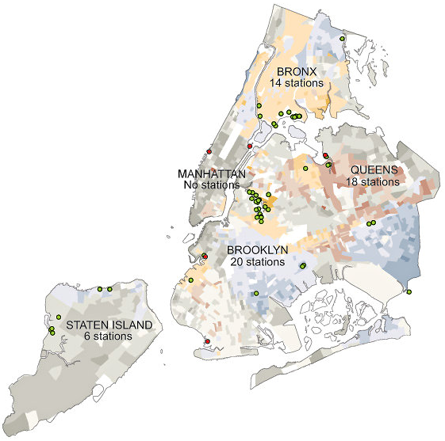
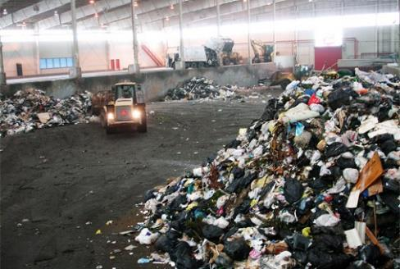
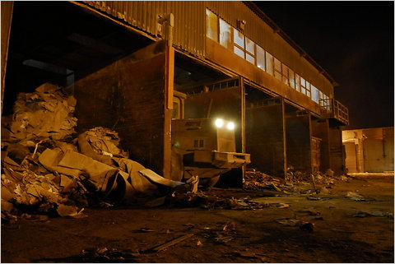
WASTE TRANSFER STATIONS
Over 70% of NYC’s waste passes through 3 neighborhoods: South Bronx North Brooklyn SE Queens
Notes:
First lets talk about- Where does our waste go? Waste Transfer Stations are places that our waste goes after its picked up from the curb by the garbage trucks.
New York City’s has 58 waste transfer stations, garbage trucks take their trash to these stations and the garbage gets loaded onto trucks, railcars, or marine barges for export. Because WTS are not evenly distributed throughout the City and because most stations use trucks for export, a lot of unnecessary truck traffic and air pollution is created, but more so in these 3 neighborhoods.
Currently, the South Bronx, North Brooklyn and SE Queens handle over 70% of the 12 million plus tons of waste moving through WTS in NYC annually.
Many of these stations are located where land was cheapest and communities were not as empowered to fight these stations and many of these stations started springing up disproportionately in low-income communities and communities of color especially in the 90’s.
Just recently, a bill was introduced in NYC to cap the amount of waste that can be brought into transfer stations in these overburdened communities. Nearly 40% of all garbage goes through District 34th (North Brooklyn and parts of Queen)
http://brooklynink.org/2015/12/21/54669-too-much-trash/
http://nylcv.org/news/mayor-de-blasio-endorses-waste-equity-legislation/

Slide 24
Notes:
Ask students what percentage of a school’s waste is recyclable or compostable?

Slide 25
So…why YOU? Why schools?
86%
is recyclable or compostable
1,800 NYC schools
1.1 million students
x 800,000 meals daily
= HUGE IMPACT!

Slide 26
Recycling 101

Slide 27
Sort It Out!
Notes:
Use “Sort It Out” as an interactive way to have students learn what materials go in which bins (appropriate for schools with Organics/Brown Bin collection)

Slide 28
Green Bin
Don’ts

Slide 29
Blue Bin
Don’ts
Notes:
No plastic bags, wrappers, pouches, and foam

Slide 30
What Goes in My
Trash Bin?
Soft Plastics
Chip Bags
Plastic Wrappers

Slide 31
NO RECYCLABLES IN THE TRASH BIN

Slide 32
Logged!
Mined!
Drilled!
Extracted!
Notes:
All of our man-made products are made from Natural Resources. Ask students to where paper comes from, where metals come from, where plastic coes from, and where glass comes from before showing them the answer.
• We cut down trees to make paper products.
• We mine for ores to make metals.
• We extract sand to make glass.
• We drill for petroleum and natural gas to make plastics.
• And the cartons are manufactured with an assortment of materials each has inside it: plastics, paper and sometimes metal.

Slide 33
Recycling can create up to 7x more jobs than sending waste to landfills.
Benefits: Jobs
SIMS Municipal Recycling (BK)
Pratt Industries (S.I.)
Composting Facilities (near NYC)
Notes:
When we recycle we have the opportunity to recognize that these everyday items were made from raw materials from the earth. We begin to own our responsibility to conserve our natural resources and give them a new life.
And in addition to all the environmental benefits, there are economic benefits for New Yorkers. Keep our resources local and build local jobs in the recycling industry.

Slide 34
Green Bin Journey

Slide 35
What Goes in My
Green Recycling Bin?
Mixed Paper
Cardboard

Slide 38
Notes:
Recycled paper is unloaded, pulped, pressed, corrugated and processed into cardboard boxes, many of which are pizza boxes sold at your local pizzeria!

Slide 39
Blue Bin Journey

Slide 40
What Goes in My
Blue Recycling Bin?
Metal
Rigid Plastics
Glass
Cartons

Slide 41
Notes:
Most materials you put in blue bins throughout the city travel by barge down to Sims Municipal Recycling Facility in Sunset Park, Brooklyn.

Slide 43
Notes:
At Sims, blue bin materials are mechanically sorted, baled, and prepared for sale to manufacturers that use recycled goods as raw materials in their products.

Slide 45
Brown Bin Journey

Slide 46
What Goes in My
Brown Organics Bin?
All Food Scraps
Compostable Trays
Napkins
Food-soiled Paper

Slide 50
School Recycling Systems
Notes:
The first step in establishing any good recycling program is to make sure that the appropriate recycling systems are in place. Review what is in place already and/or highlight what piece of the infrastructure puzzle may be missing at your school. Build curiosity around how design and infrastructure might impact recycling behaviors. Are there any creative ways to make change, as students, to these larger recycling systems?

Slide 51
Bins and Signage
Classrooms and Offices
Cafeteria
Hallways and Shared Spaces
Notes:
Infrastructure: What’s been done already or needs to be done? Some schools have all the recycling infrastructure they need throughout theire building, others need to get creative and figure out how to make sure that recycling infrastructure and signage is uniform building-wide

Slide 52
Collection, Storage, Set-out, Trainings
Dual-bin collection
Designated storage space
Curbside set-out
Custodial Staff Trainings
Notes:
Infrastructure: DOE Office of Sustainability can be a resource in helping to create dual-bin collection systems for custodial staff (to ensure stream separation), off-curb storage areas, demarcating curbside set-out, and educating custodial staff

Slide 53
DSNY Collection Schedule
Notes:
Operations: DSNY provides operational support for your recycling program. (Include your school’s DSNY Setout Schedule. Find it at nyc.gov/dsny. Enter your building address under “Collection Schedule”)

Slide 54
Research & Data
Notes:
How can Research & Data give us a better understanding of what and how people are recycling and composting in the city and in schools citywide? Let’s look at some of the recent data collected to gain insight on the issues at hand. This may motivate us to do our own research in our school to see if what is happening across the city is comparable to what is happening at our school. The data can also help inform us as we begin to plan for action. Critical thinking question: How do recycling infrastructure (systems), recycling knowledge, and attitudes towards recycling affect our recycling behaviors?

Slide 55
Notes:
Every 4 years or so the Department of Sanitation (DSNY) conducts a waste characterization study to assess changes in the composition of discarded material and to inform development of waste management programs and services like recycling, composting, and reuse. These studies involve collecting samples of waste and sorting samples into multiple material categories to produce statistically representative and generalizable information about what is in a city’s waste stream and in what quantitites.

Slide 56
Notes:
Have students read pie chart again. Ask is anything in particular jumps out to them? This is data captured by the DSNY Waste Characterization Study and allows us to recognize how much waste (organic food waste, particularly) comes out of school cafeterias, for example.

Slide 57
Notes:
Capture Rate: the percentage of materials that are properly sorted (placed in the correct bin). The goal is high Capture Rates.
Contamination Rate: the percentage of waste materials that are improperly sorted (placed in the wrong bin). The goal is low Contamination Rates.
Ask students to analyze the data.
Note:
Schools are good at capturing high percentages (57.9%) of paper for recycling, but not good at capturing MGP (blue bin – metal, glass, plastic, cartons) for recycling (19.4%)
Green paper recycling streams have low contamination rates (17.2%) and blue bin streams have high contamination rates (40.6%)

Slide 58
Notes:
The goal of the Zero Waste Schools program is to divert all recyclable and compostable waste from approximately 100 Zero Waste Schools in 5 years. The program started with 100 schools to establish best practices that could be scaled up citywide, with the ultimate goals of all schools becoming zero waste schools. Data captured for this report are from those 100 Zero Waste Schools.

Slide 59
Zero Waste Schools Report: Year 3
Notes:
From Zero Waste Schools Year 2 Report. Explain graph. Ask questions about graph to build familiarity reading multiple data points, along both x and y axis.
FY = fiscal year.
MGPC = Metal, Glass, Plastic, Cartons

Slide 60
Notes:
Actual Diversion Rate: the percentage of all waste materials measured (Grand Total) that are actually sorted correctly, recycled and diverted from (not sent to) landfills. All Trash and incorrectly sorted materials are sent to landfills. The goal is high Diversion Rates.
Potential Diversion Rate: the percentage of all waste materials measured (Grand Total) that could be recycled and diverted from (not sent to) landfills. This data will highlight the room for improvement.

Slide 61
Notes:
Are recycling behaviors lagging behind the infrastructural and operational systems in place at your school? Why? Facilitate a solution-driven brainstorm discussion. You, the students, are the “x” factor, the changemakers. How can we bridge the gaps between systems, knowledge and behaviors?
Would it be useful to collect some data at your own school to serve as a baseline before you start your work?
Student-led bin tallies, surveys, interviews, observations and waste investigations are great places to start to build baseline data before commencing a project and ensure your project is built to meet the needs of your own school community.

