Slide 1
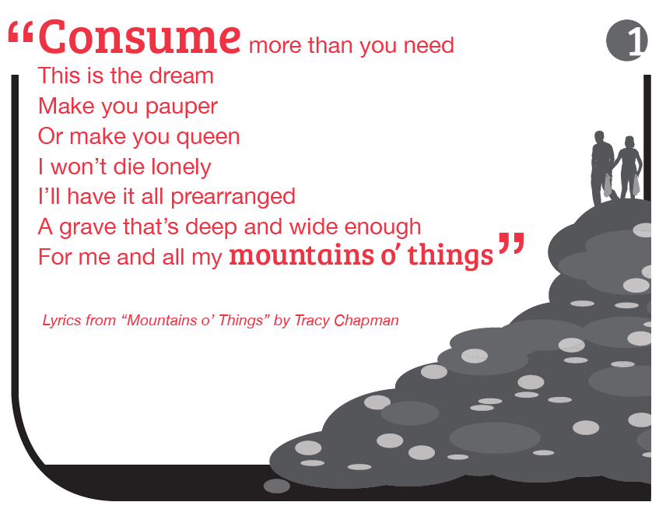
Notes:
JM

Slide 2
Notes:
JM

Slide 3
Notes:
JM

Slide 4
Notes:
JM

Slide 5
Notes:
JM

Slide 6
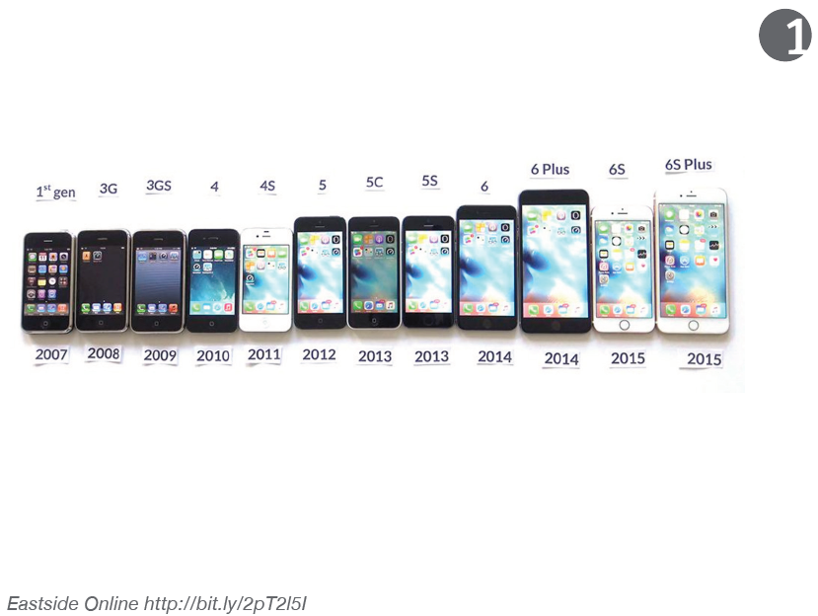
Notes:
JM

Slide 7
Notes:
JM

Slide 8
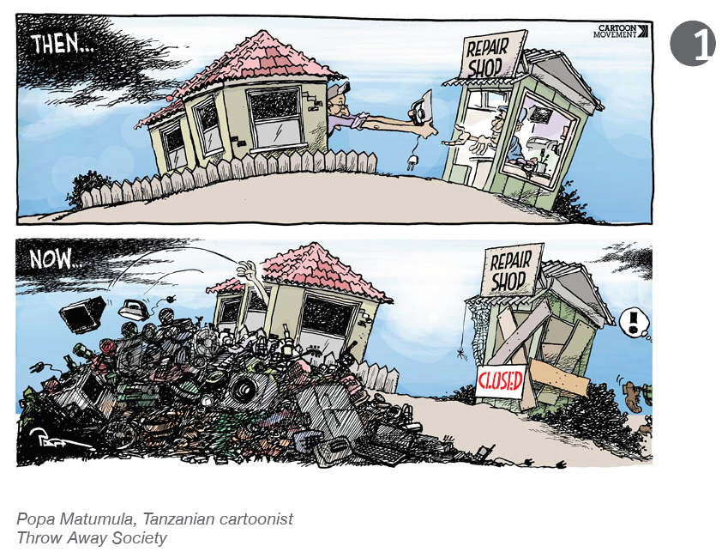
Notes:
JM

Slide 9
Notes:
JM

Slide 10
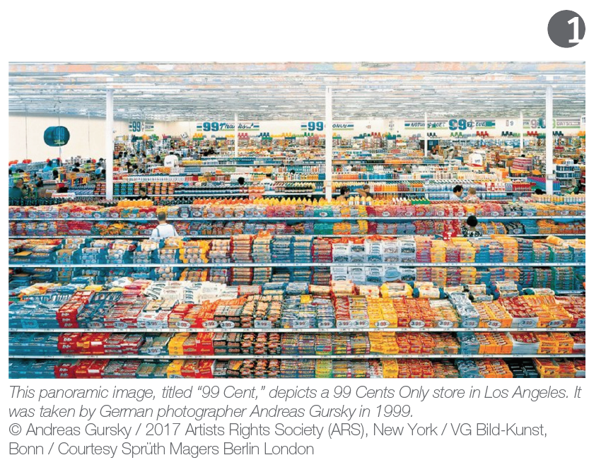
Notes:
JM

Slide 11
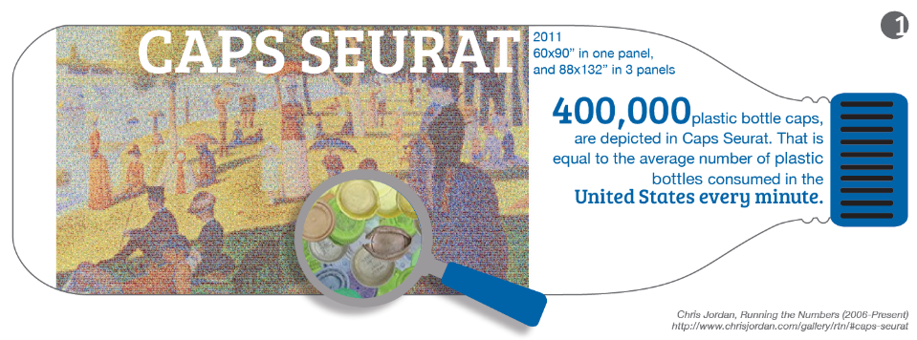
Notes:
JM

Slide 12
Notes:
JM

Slide 13
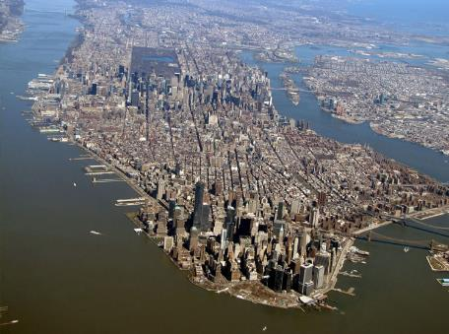
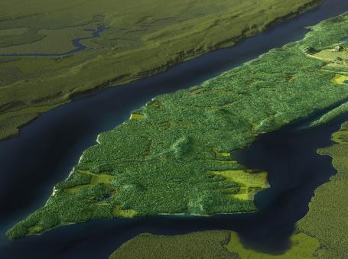

Slide 14
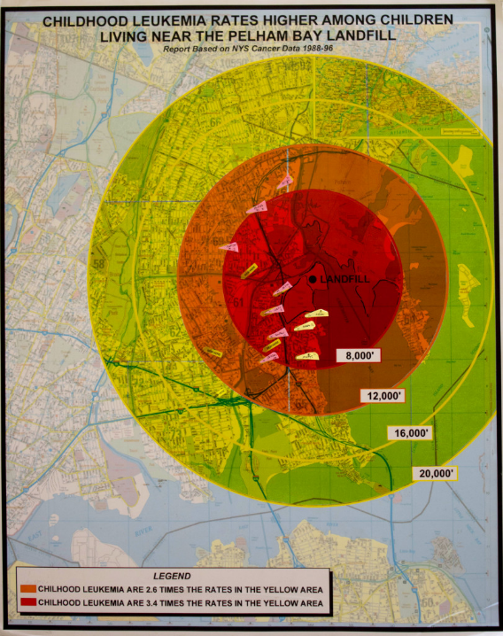
In the 1960s and 1970s, over 1.1 million gallons of chemicals were
illegally dumped into the Pelham Bay Landfill, located in the Bronx. Many of chemicals were toxic and seeped into the surrounding water, soil, and air.
A decade later, numerous neighborhood children developed Acute Lymphoblastic Leukemia, believed to be a result of the illegal dumping. Three children died before they reached their teens, and those that survived spent their childhood dealing with this terrible disease. Many still stuffer side effects from the treatment to this day.
http://www.jamesgrebey.com/the-true-cost-of-the-pelham-bay-landfill-case/

Slide 15
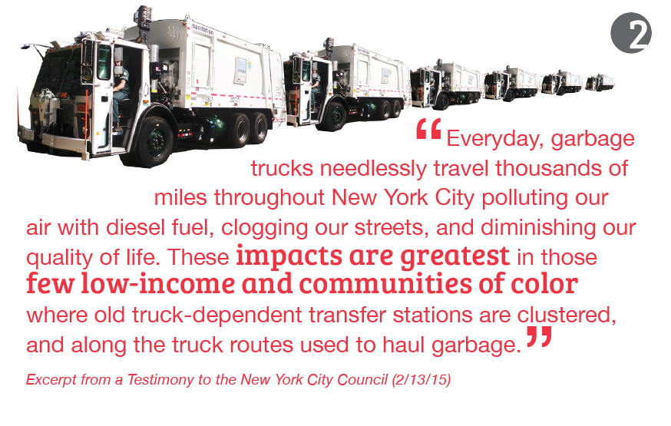
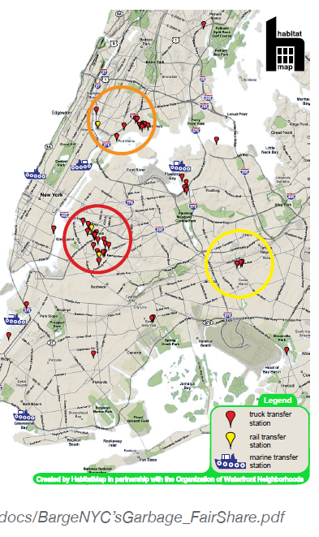
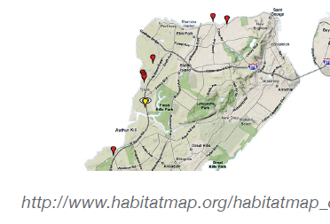
Notes:
JM

Slide 16
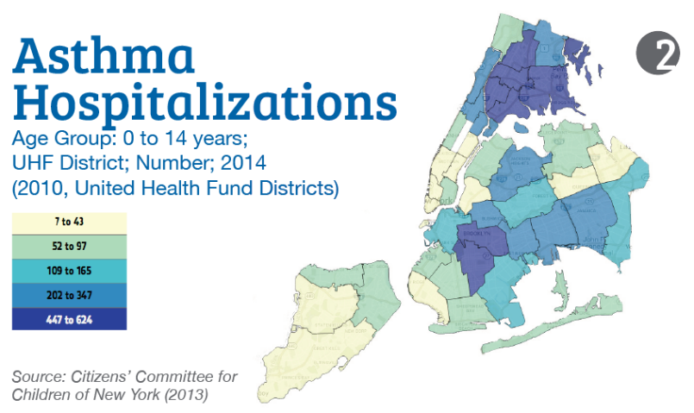
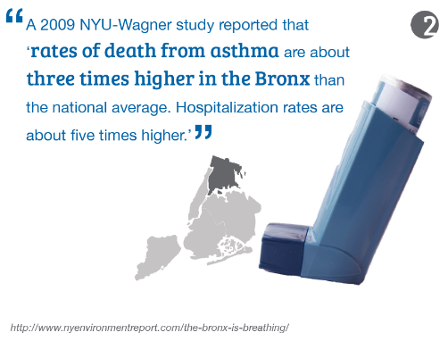
Notes:
JM

Slide 17
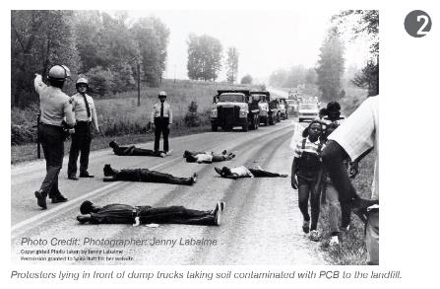
Notes:
JM

Slide 18
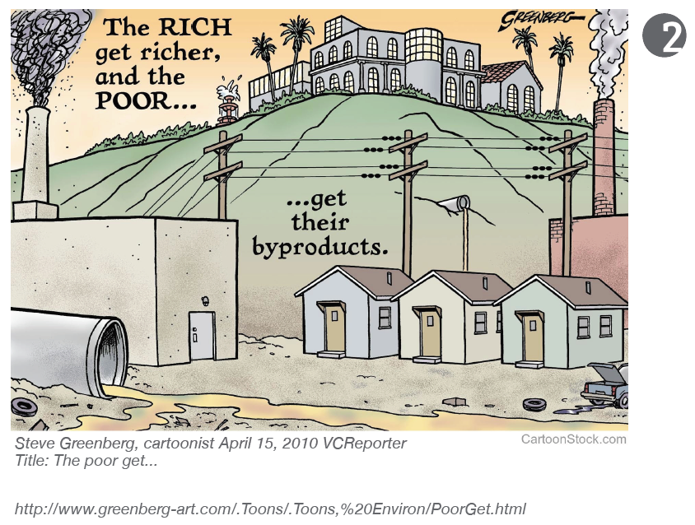
Notes:
JM

Slide 19
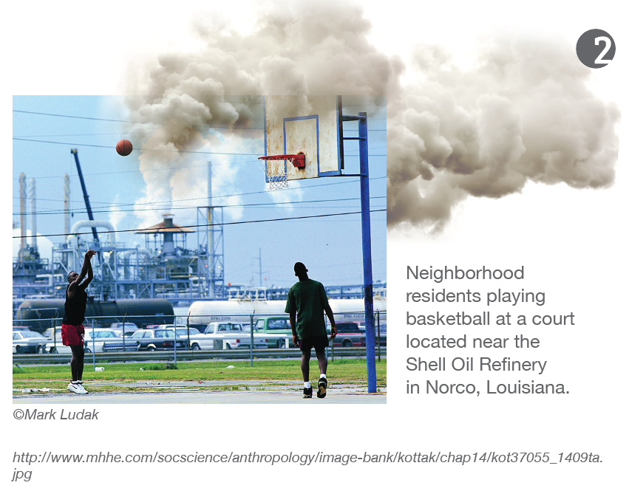
Notes:
JM

Slide 20
Notes:
JM

Slide 21
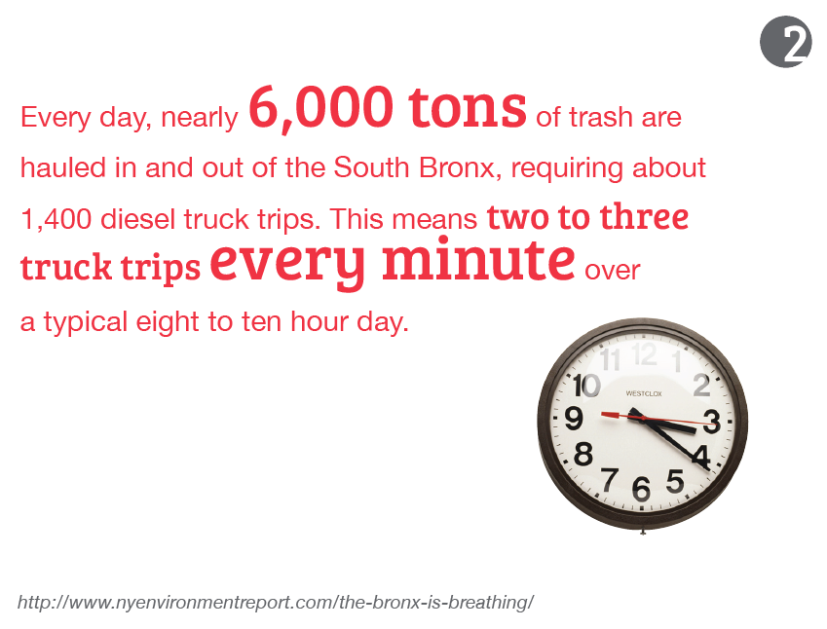
Notes:
JM

Slide 22
Notes:
JM

Slide 23
Notes:
JM

Slide 24
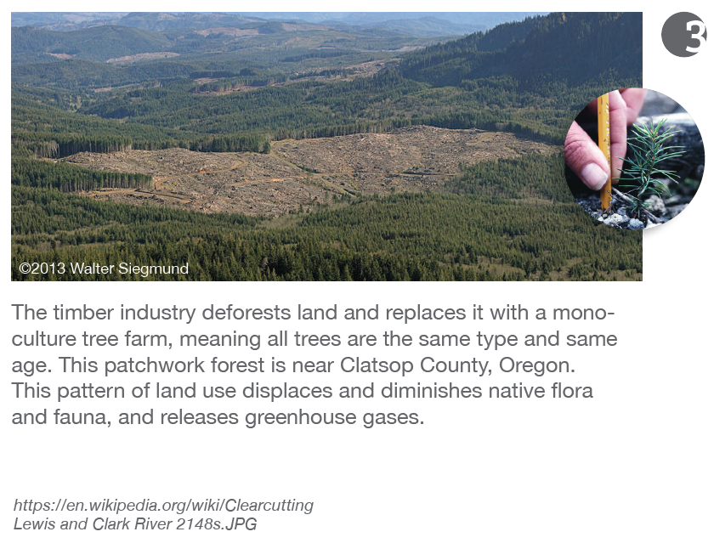
Notes:
JM

Slide 25
Notes:
JM

Slide 26
Notes:
JM

Slide 27
Notes:
JM

Slide 28
Notes:
JM

Slide 29
Notes:
JM

Slide 30
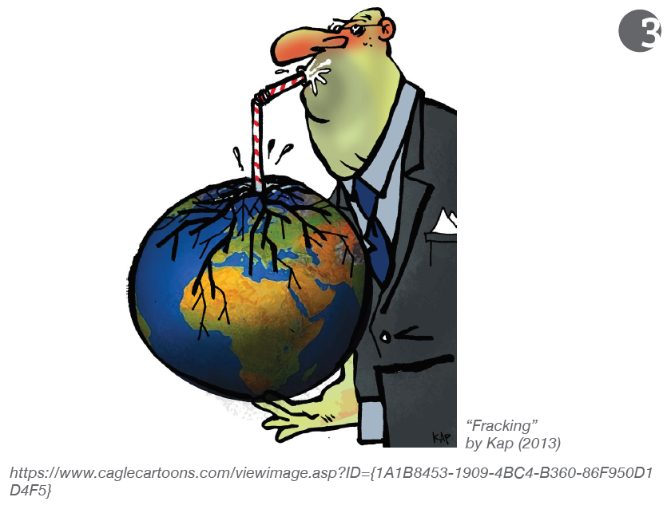
Notes:
JM

Slide 31
Notes:
JM

Slide 32
Notes:
JM

Slide 33
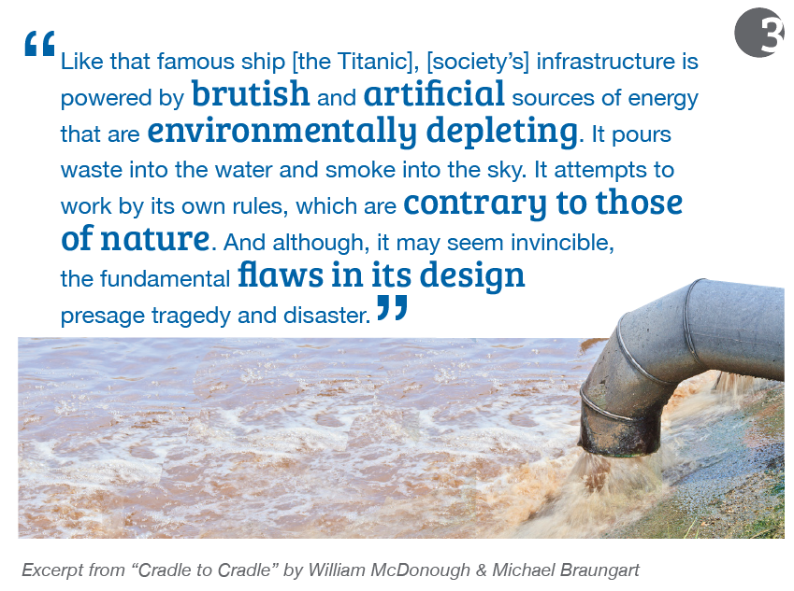
Notes:
JM

Slide 34
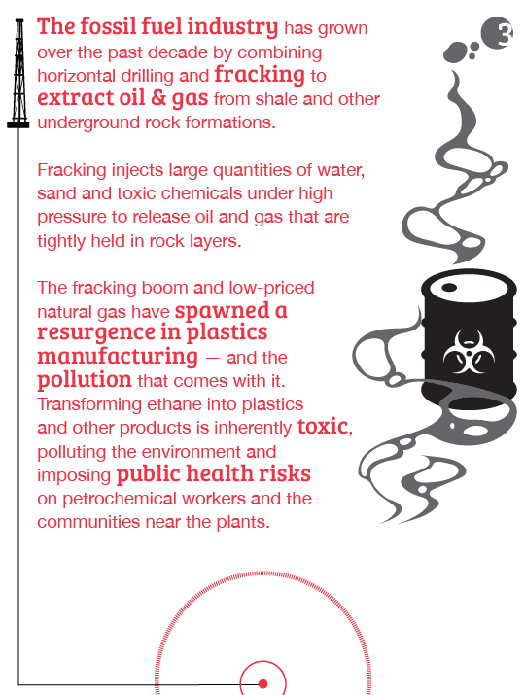
Notes:
JM

Slide 35
Notes:
JM

Slide 36
Notes:
JM

Slide 37
Notes:
JM

Slide 38
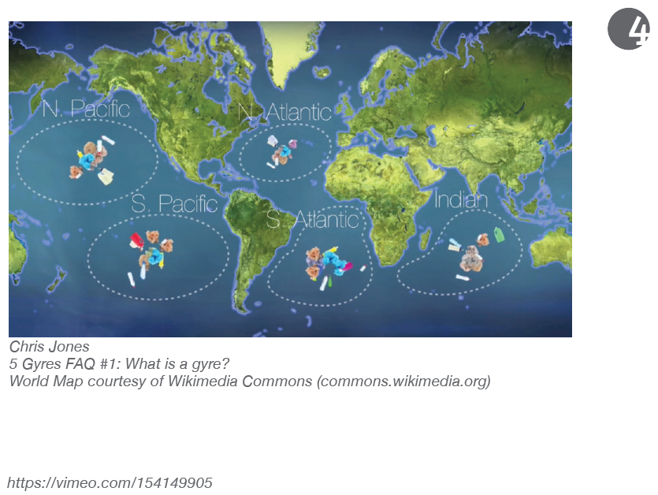
Notes:
JM

Slide 39
Notes:
JM

Slide 40
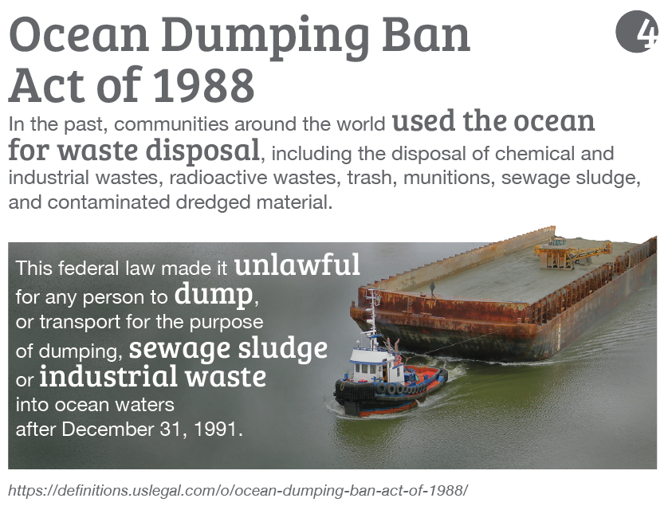
Notes:
JM

Slide 41
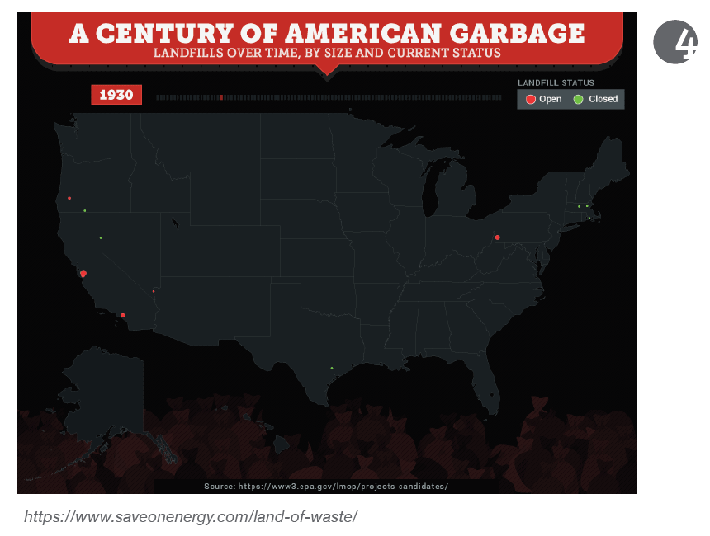
Notes:
JM

Slide 42
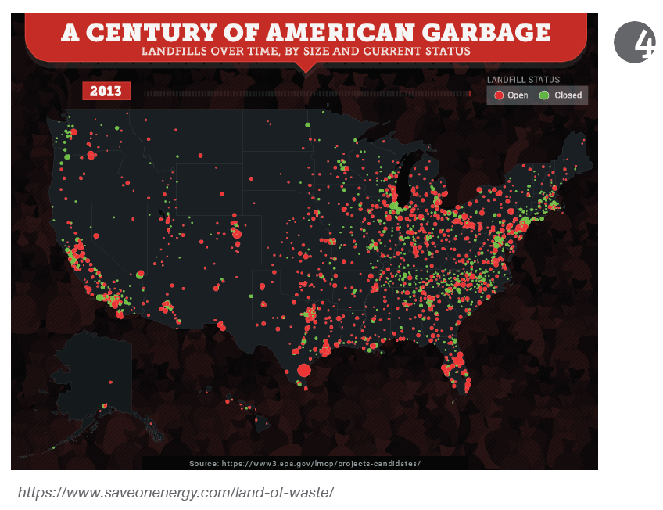
Notes:
JM

Slide 43
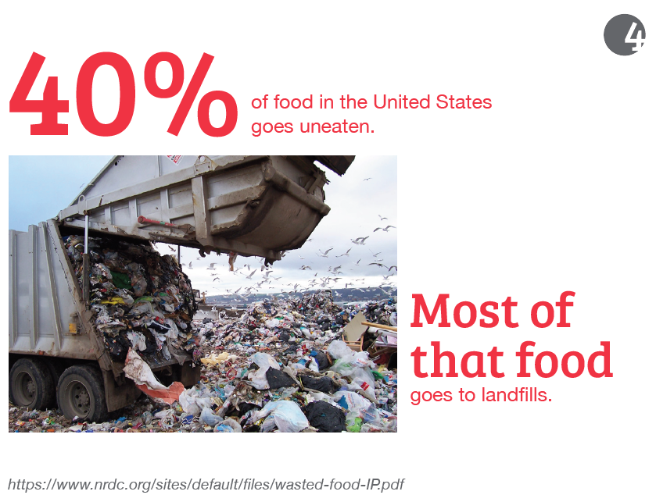
Notes:
JM

Slide 44
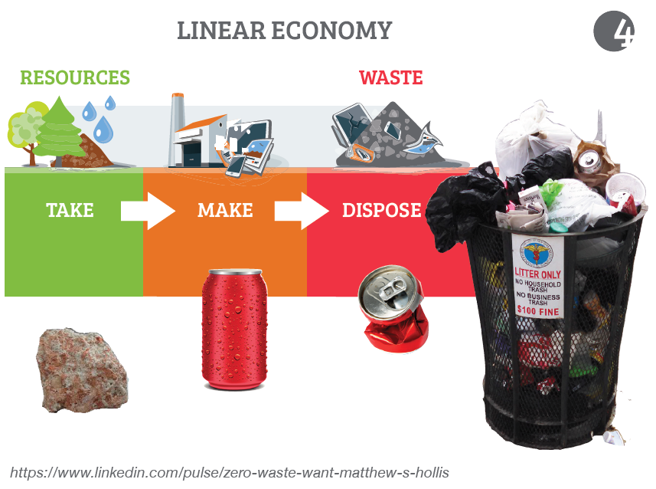
Notes:
JM

Slide 45
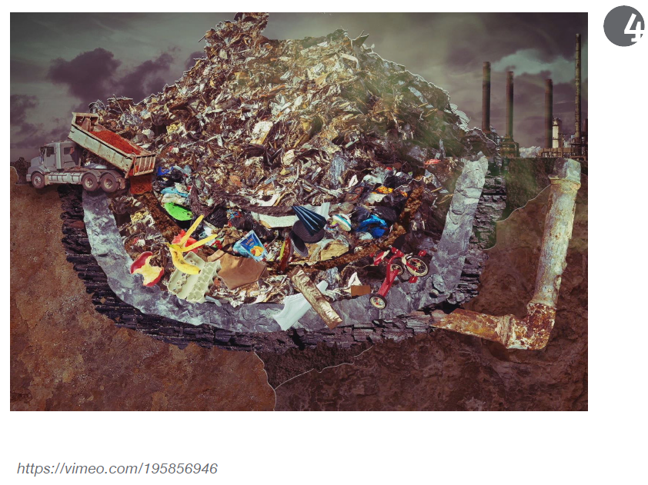
Notes:
JM

Slide 46
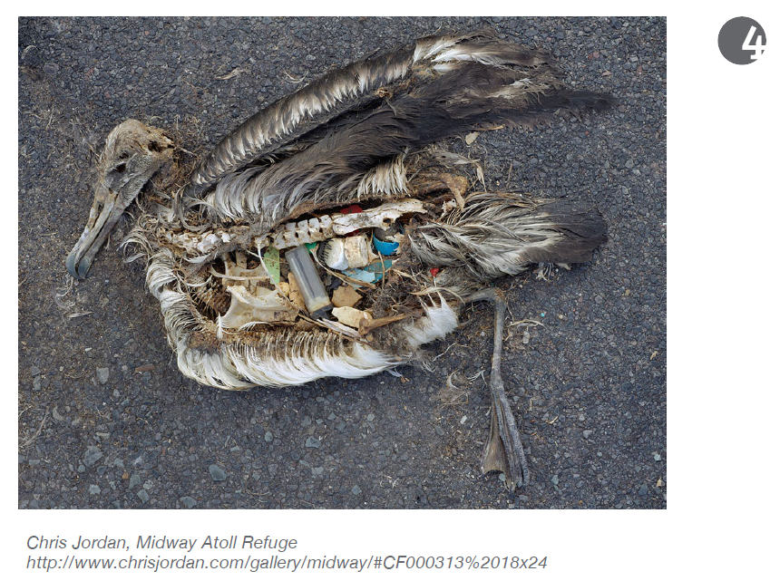
Notes:
JM

Slide 47
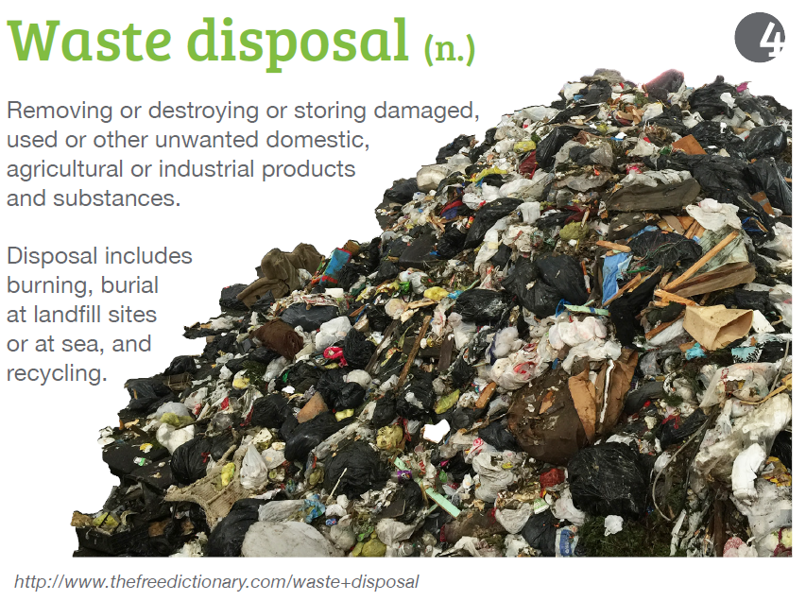
Notes:
JM

Slide 48
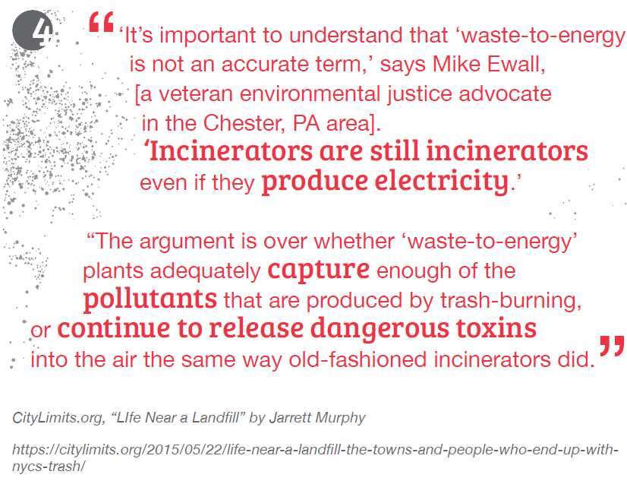
Notes:
JM

Slide 49
Notes:
JM

Slide 50
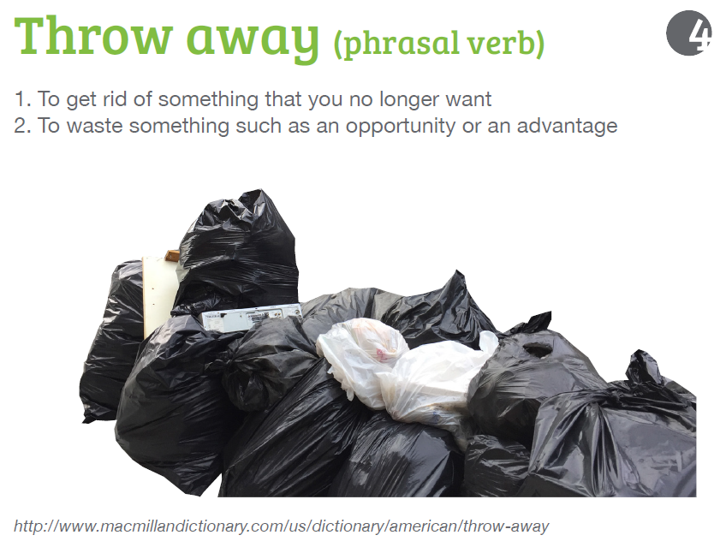
Notes:
JM

Slide 51
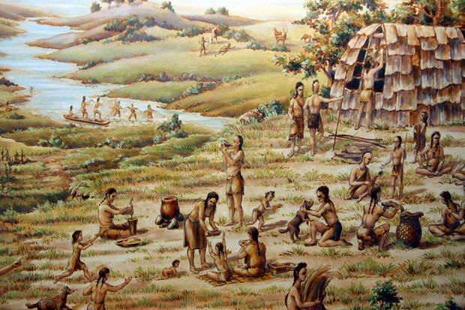
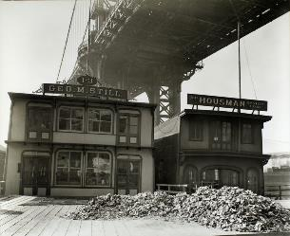
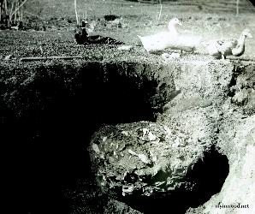
The first people of this land are the Lenni Lenape. The Lenni Lenape ate oysters regularly, as did their ancestors, chucking the shells into enormous piles over thousands of years. These piles of shells are called middens.
Middens are some of the oldest and largest piles of intact garbage dating from after the last ice age.
In fact, middens helped inform the names of early New York streets, such as Pearl Street in Manhattan. Even more, a 1980s restoration of the Statue of Liberty yielded over 9,000 artifacts–ancient tools, bones, broken pottery, and refuse from countless past dinners!
Notes:
https://www.atlasobscura.com/articles/the-voluminous-shell-heaps-hidden-in-plain-sight-all-over-nyc

Slide 52
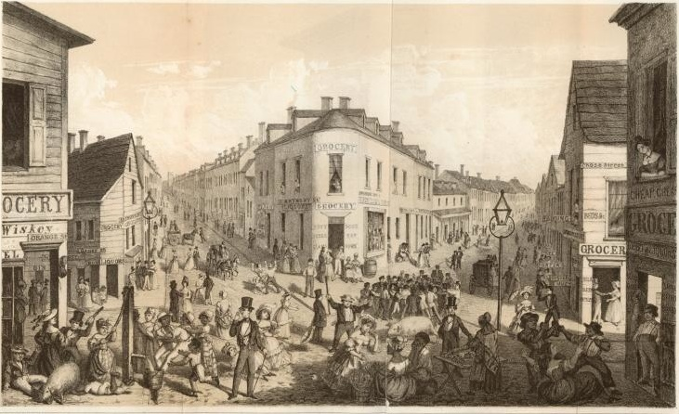
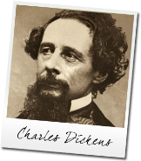
Before street cleaners and a real sanitation department, New York City relied on one tactic: free-roaming pigs, who fed on household food scraps tossed into the gutters.
“Two portly sows are trotting up behind this carriage, and a select party of half-a-dozen gentlemen hogs have just now turned the corner. Here is a solitary swine lounging homeward by himself. He has only one ear, having parted with the other to vagrant-dogs in the course of his city rambles. . . . They are the city scavengers, these pigs.”
- Charles Dickens, written during his travels of New York in 1842
https://ephemeralnewyork.wordpress.com/2013/11/18/new-york-citys-free-roaming-trash-eating-pigs/

Slide 53
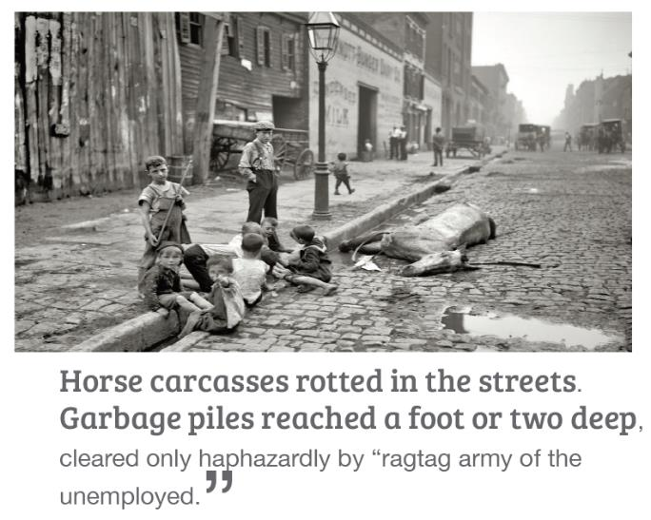
Notes:
JM

Slide 54
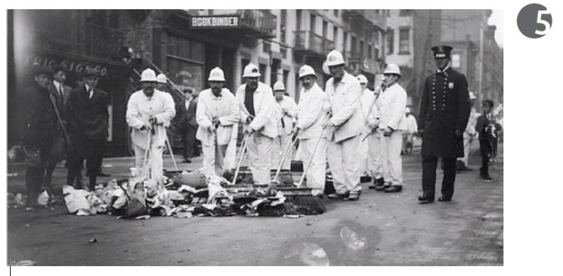
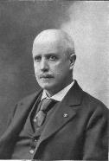
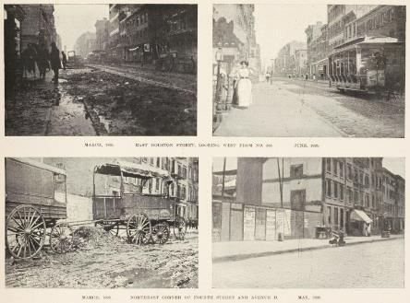
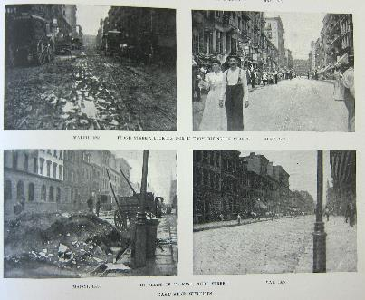
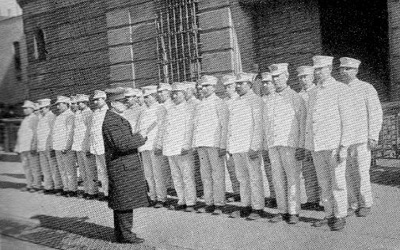
In 1895, New York City hired Colonel George Waring as commissioner of the Department of Street Cleaning.
He treated the department as an army, mandating that street cleaners wear white uniforms to convey a sense of cleanliness, give the workforce a dignity, and make the public aware that there was a serious and dedicated effort to clean the city. It was a brilliant success. Hence their nickname, the “White Wings.”
1893
1895
1893
1895
Notes:
http://longstreet.typepad.com/thesciencebookstore/2016/04/before-and-after-on-the-mean-streets-of-nyc-1890s.html
https://ephemeralnewyork.files.wordpress.com/2008/08/sanitmen.jpg

Slide 55
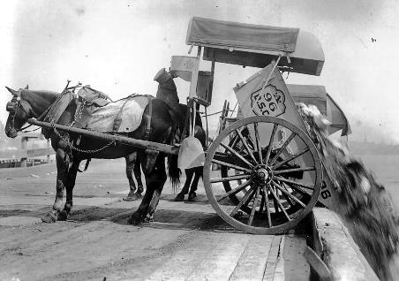
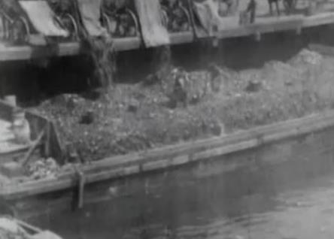
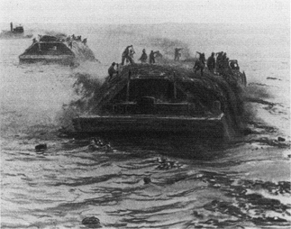
Throughout the 1880s, 75 percent of New York City’s garbage was being dumped into the Atlantic Ocean, Although city officials pledged to end ocean dumping, they couldn’t find workable alternatives. It continued into the 1900s, and was finally halted by the U.S. Supreme Court in 1934.

Slide 56
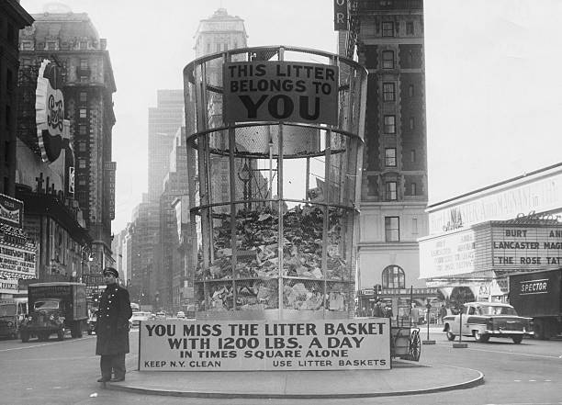
A mid-1950s campaign to prevent littering in New York included a gigantic waste basket in Times Square.

Slide 57
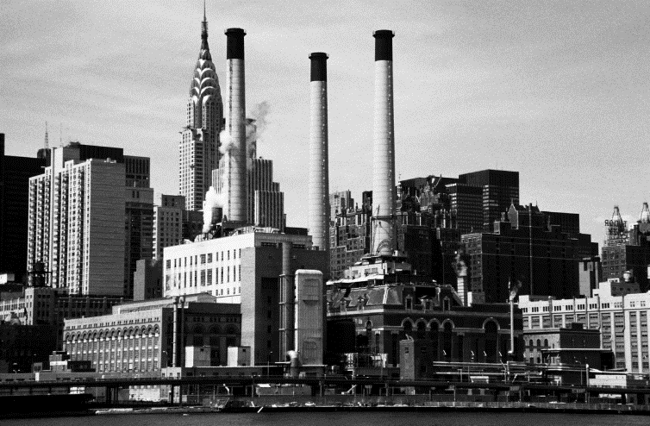
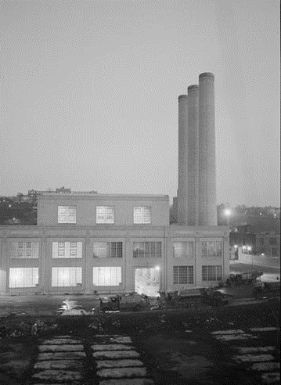
New York City's first incinerator – the first in the nation – was built on Governors Island in 1885. By the 1960's, the city was burning almost a third of its trash in its 22 municipal incinerators and 2,500 incinerators in apartment buildings.
However, a combination of environmental problems, health concerns and operating costs made incinerators less attractive by the mid-1980’s, In 1990, the last working municipal incinerator stopped burning.

Slide 58
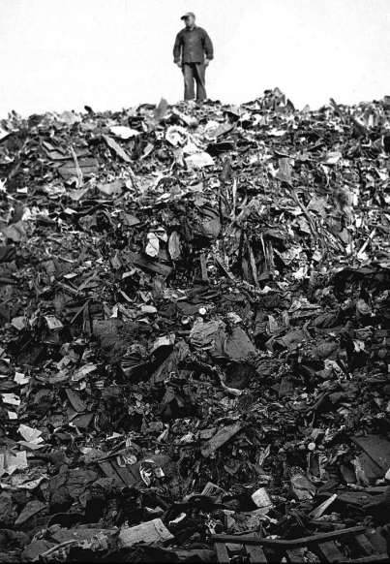
Before it closed in 2001, Fresh Kills was the largest landfill in the world, visible from space, and is still one of the largest structures ever built in the history of humankind. It’s 2,200 acres were nearly three times of the size of Central Park.
View of Fresh Kills landfill,
circa 1950.

Slide 59
Notes:
JM

Slide 60
Notes:
JM

Slide 61
20 percent of the larger NYC metropolitan region is built on landfill.

Slide 62
Notes:
JM

