Slide 1
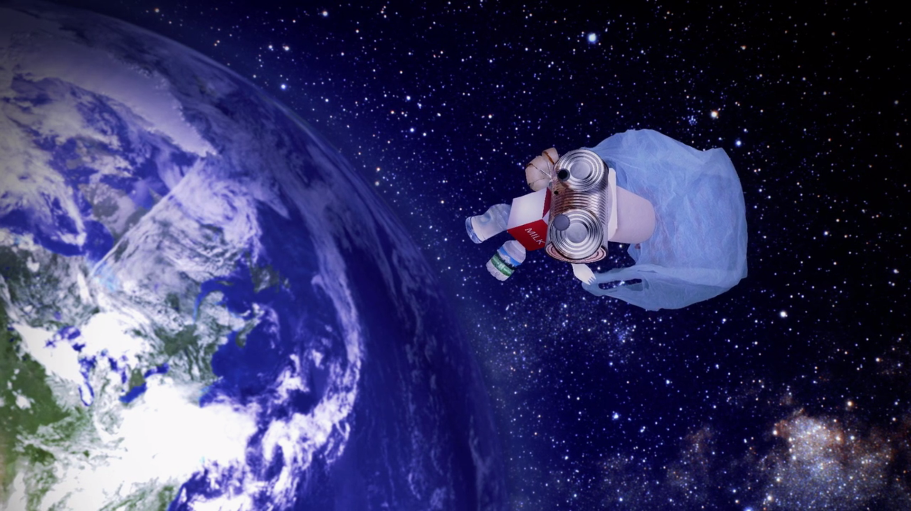
Rusty’s...
around-the-world
Adventure!
Notes:
Dear Class,
It’s me, Rusty. I hope you are having a lovely year bringing your school to zero waste. As you may know, I am on an amazing around-the-world adventure learning all about this beautiful planet we live on together. I have seen so many wonderful sights, met so many fascinating creatures, and learned so many interesting facts out here.

Slide 2
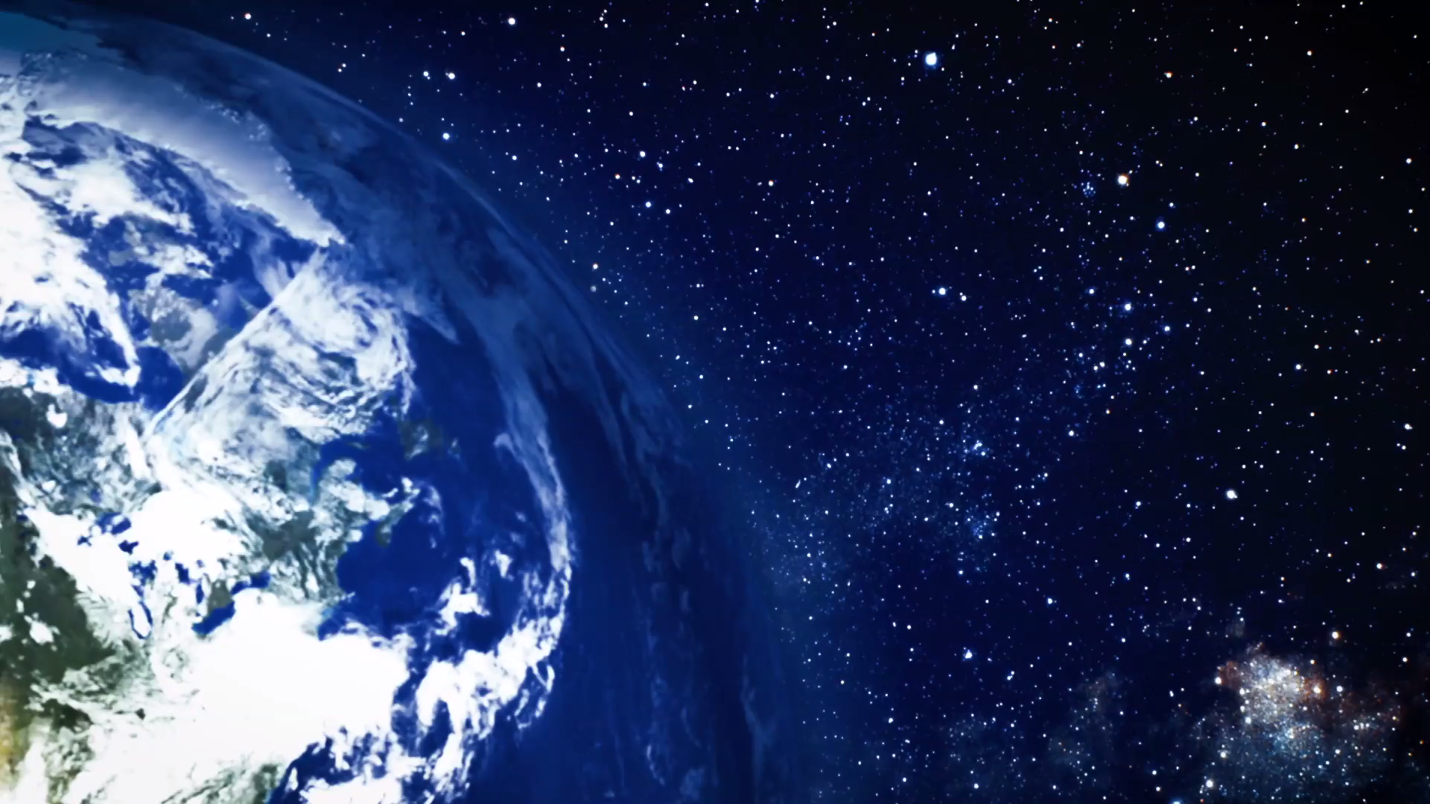
Scientists believe that at least one million species of life could be living out here.
These places provide over ½ of the oxygen you humans breathe.
These places cover over 70%
of the earth’s surface.
Where am I?
Notes:
For example, did you know that where I am now live over one million different kinds of species? Or that these places provide over half of the oxygen you humans breathe every day? Or that they cover over 70% of the earth’s surface? Do you have any idea where I am, class? Can you take a guess?

Slide 3
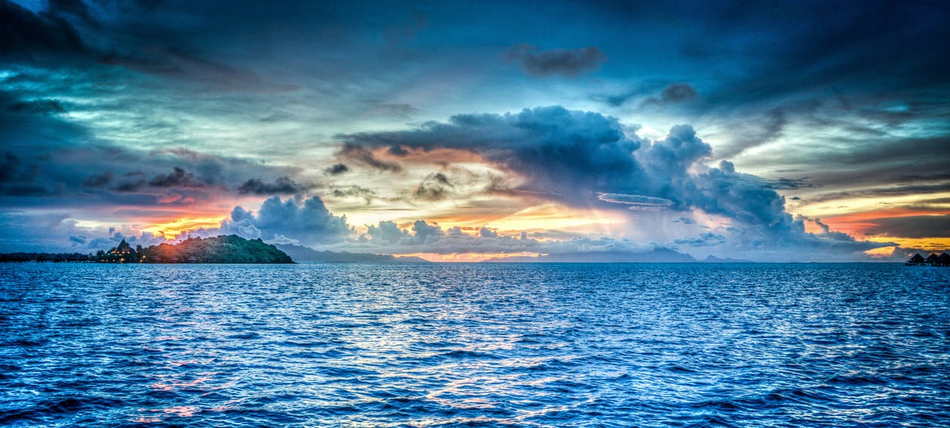
the oceans!
Notes:
Yes, that’s right! I have been traveling the world’s oceans.
https://www.pexels.com/search/ocean/

Slide 4
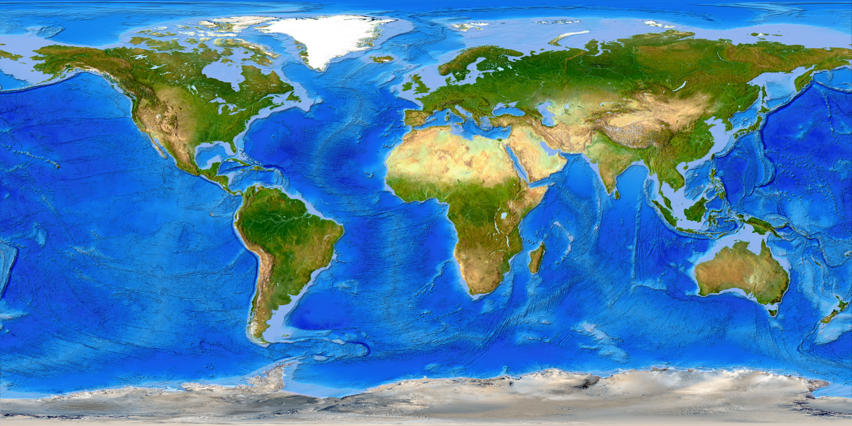
Arctic
Pacific
Atlantic
Indian
Southern
Notes:
Have you learned about the oceans in school? Do you know how many there are? Do you know where each one is located?
https://commons.wikimedia.org/wiki/File:Large_World_Map_bright.jpg

Slide 5
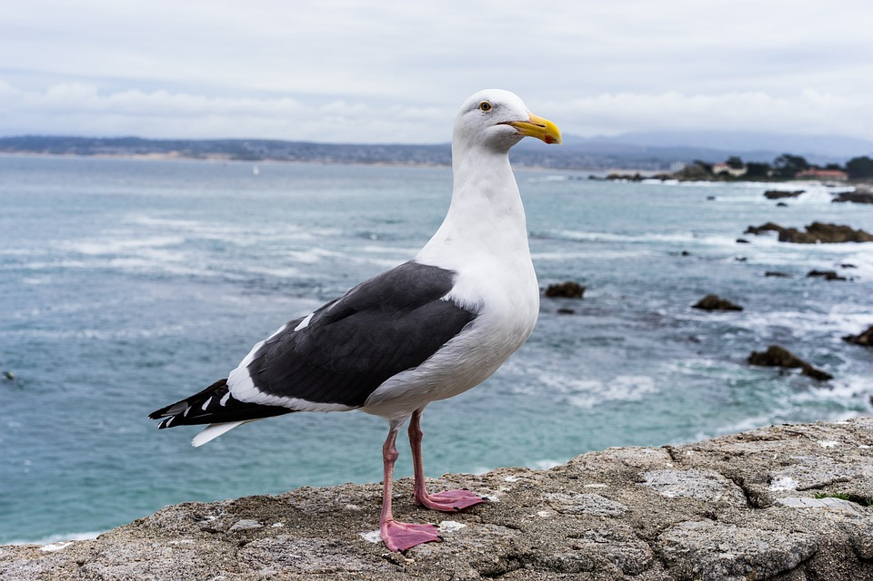
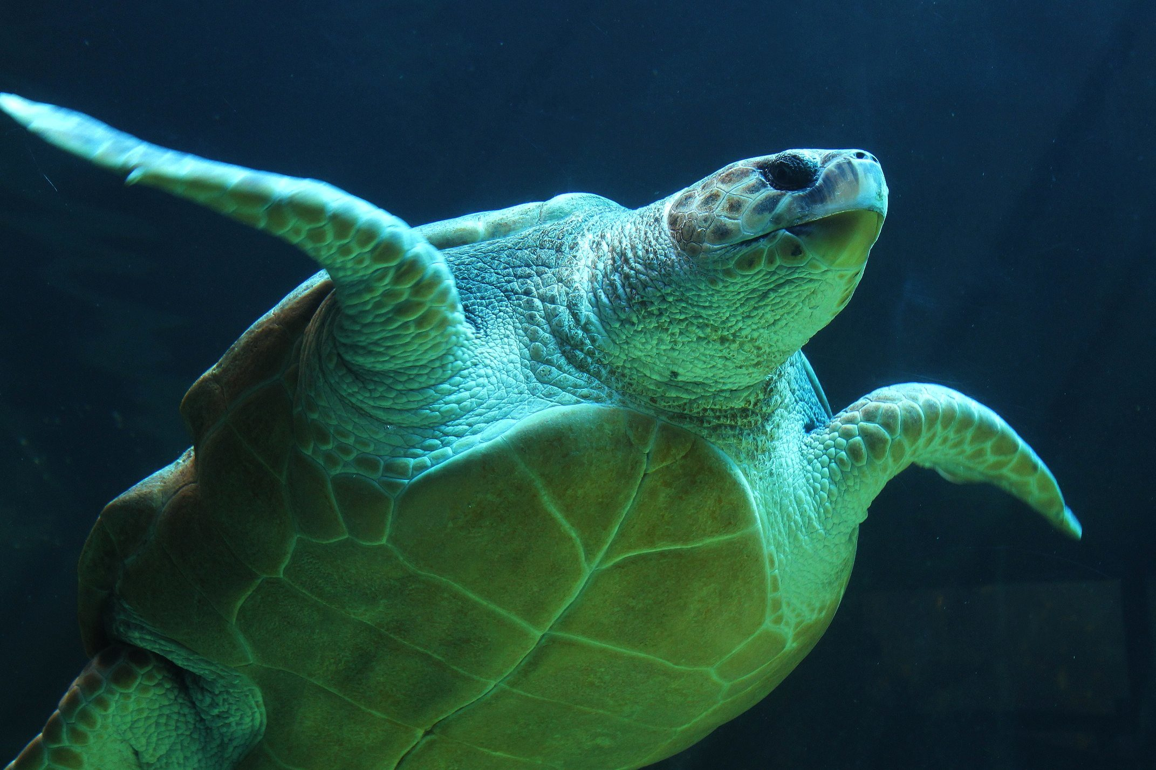
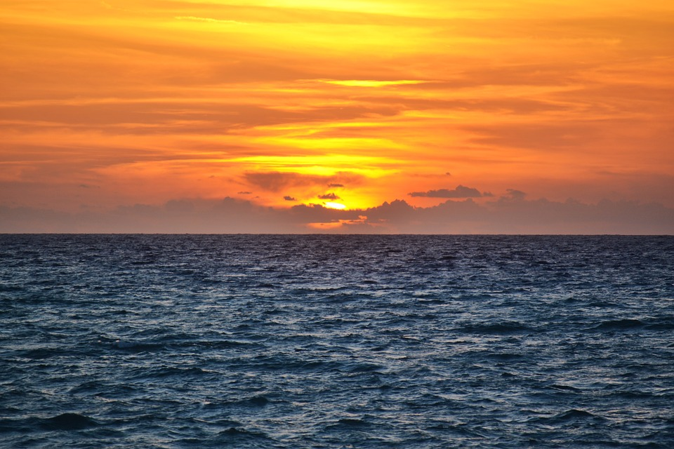
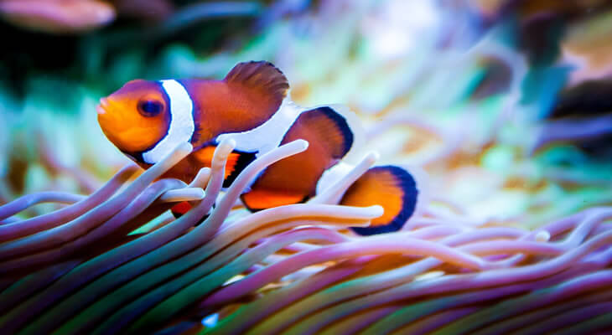
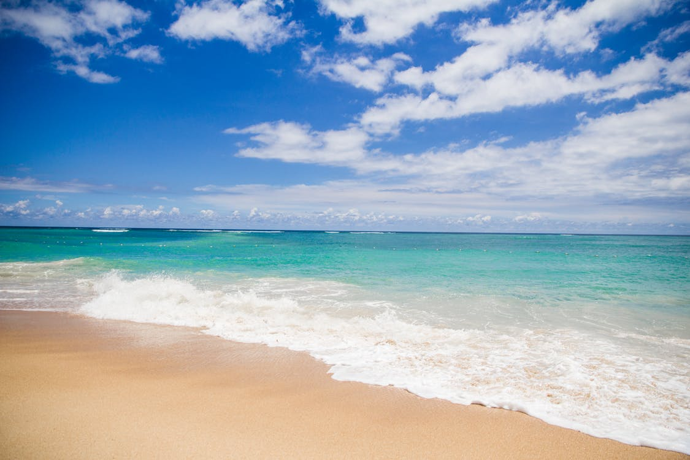
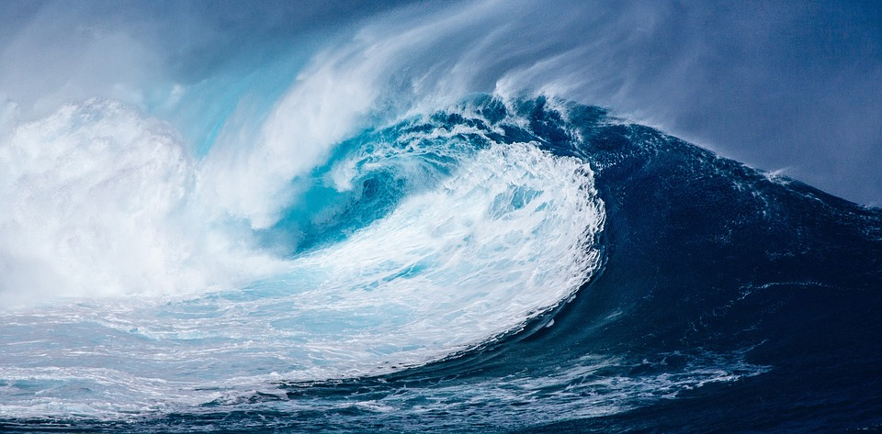
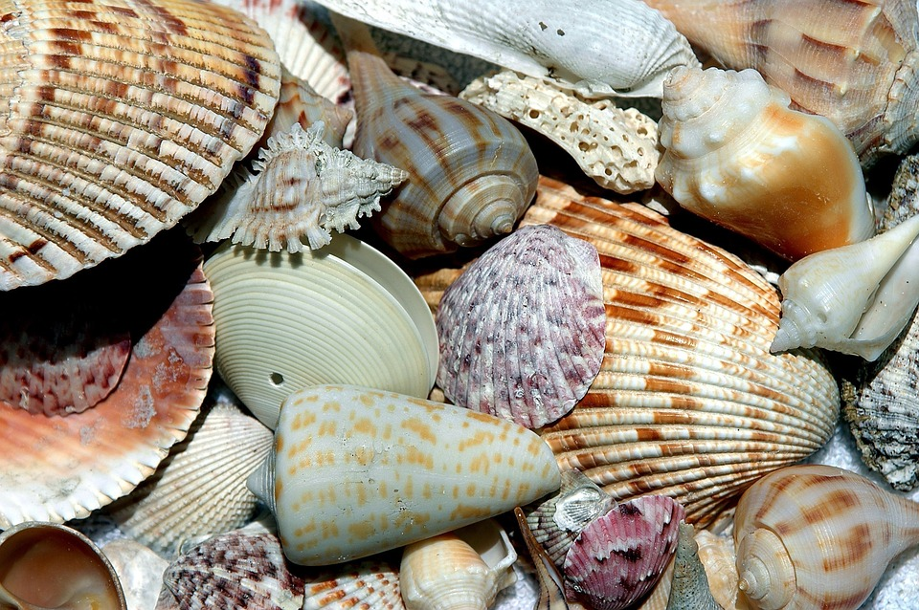
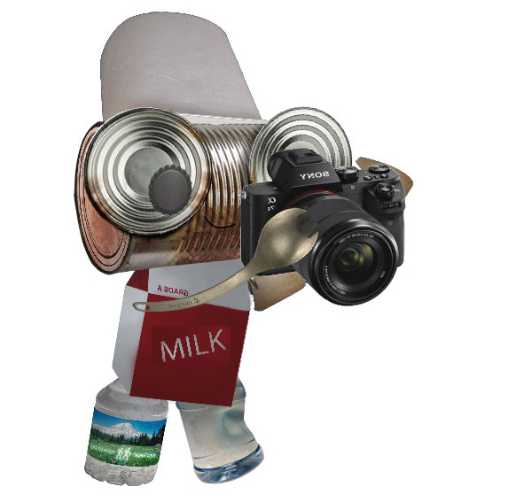
Notes:
The discoveries here, class, have been endless! There are beautiful fish of all colors, shapes and sizes, swimming close to the surface and deep, deep down. A surprising number of birds live around here, too. If I’m lucky, I spot other, bigger animals like dolphins or whales or turtles. The shorelines are also treasure chests full of so many amazing things and smooth, colorful objects. And the sunsets? Spectacular! Every night I watch the sun sink down into the sea and take with it all of its brightness and beauty. Soon it becomes dark and the moon begins to glow and the stars stud the midnight sky and it’s just so...it’s just so.....oh, class, what a special place our world is.

Slide 6
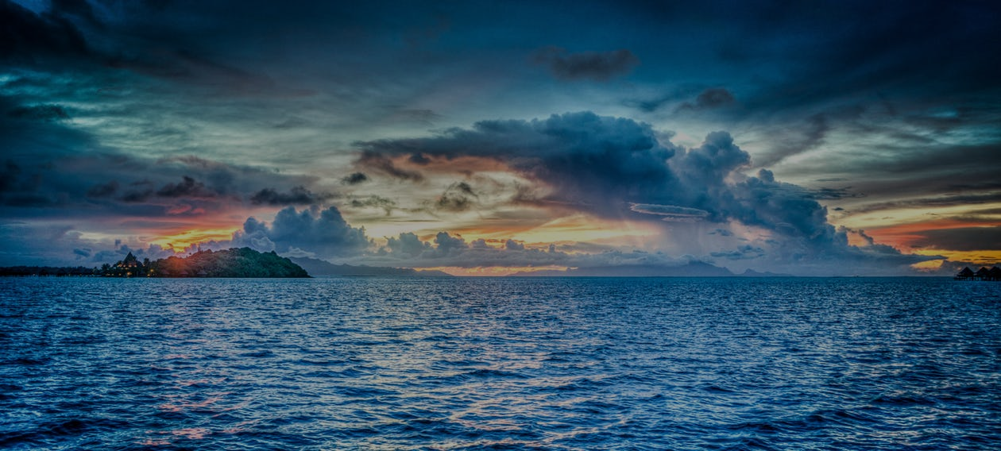
Have you been to the ocean, or someplace like it?
What do you love about the ocean? Why are they important?
And what would you do if they were at risk?
Notes:
Have you ever been to the ocean or someplace like it? What do you love about it? Do you know why they are so important? What would you do if they were at risk?

Slide 7
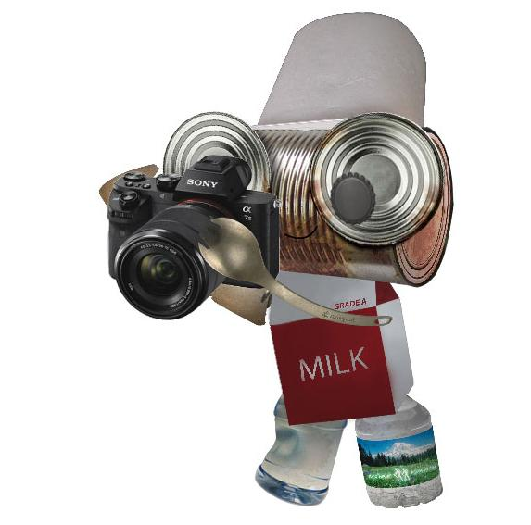
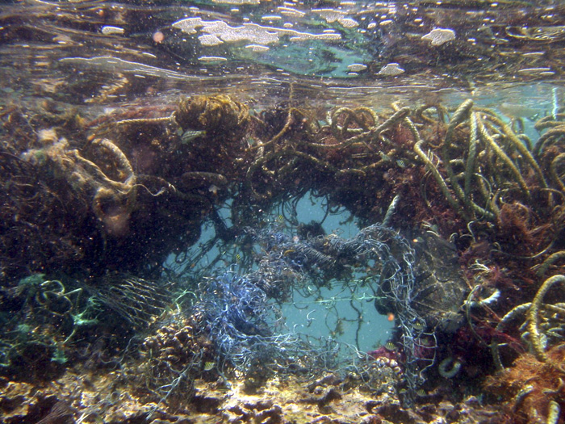
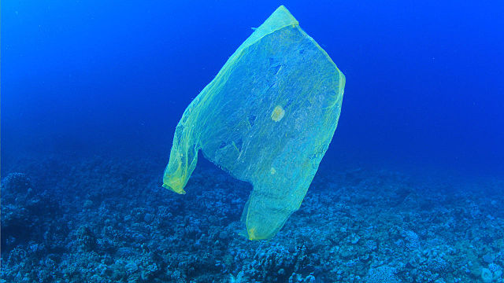
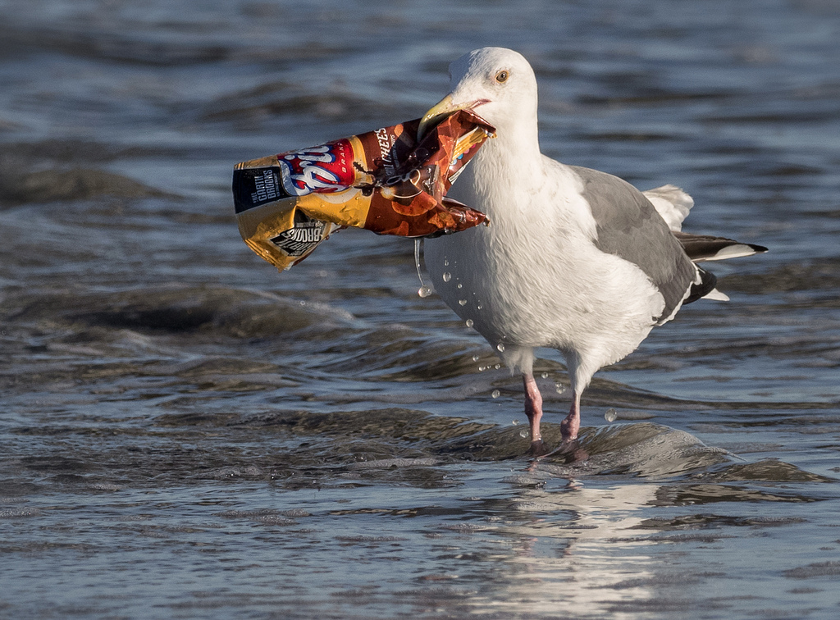
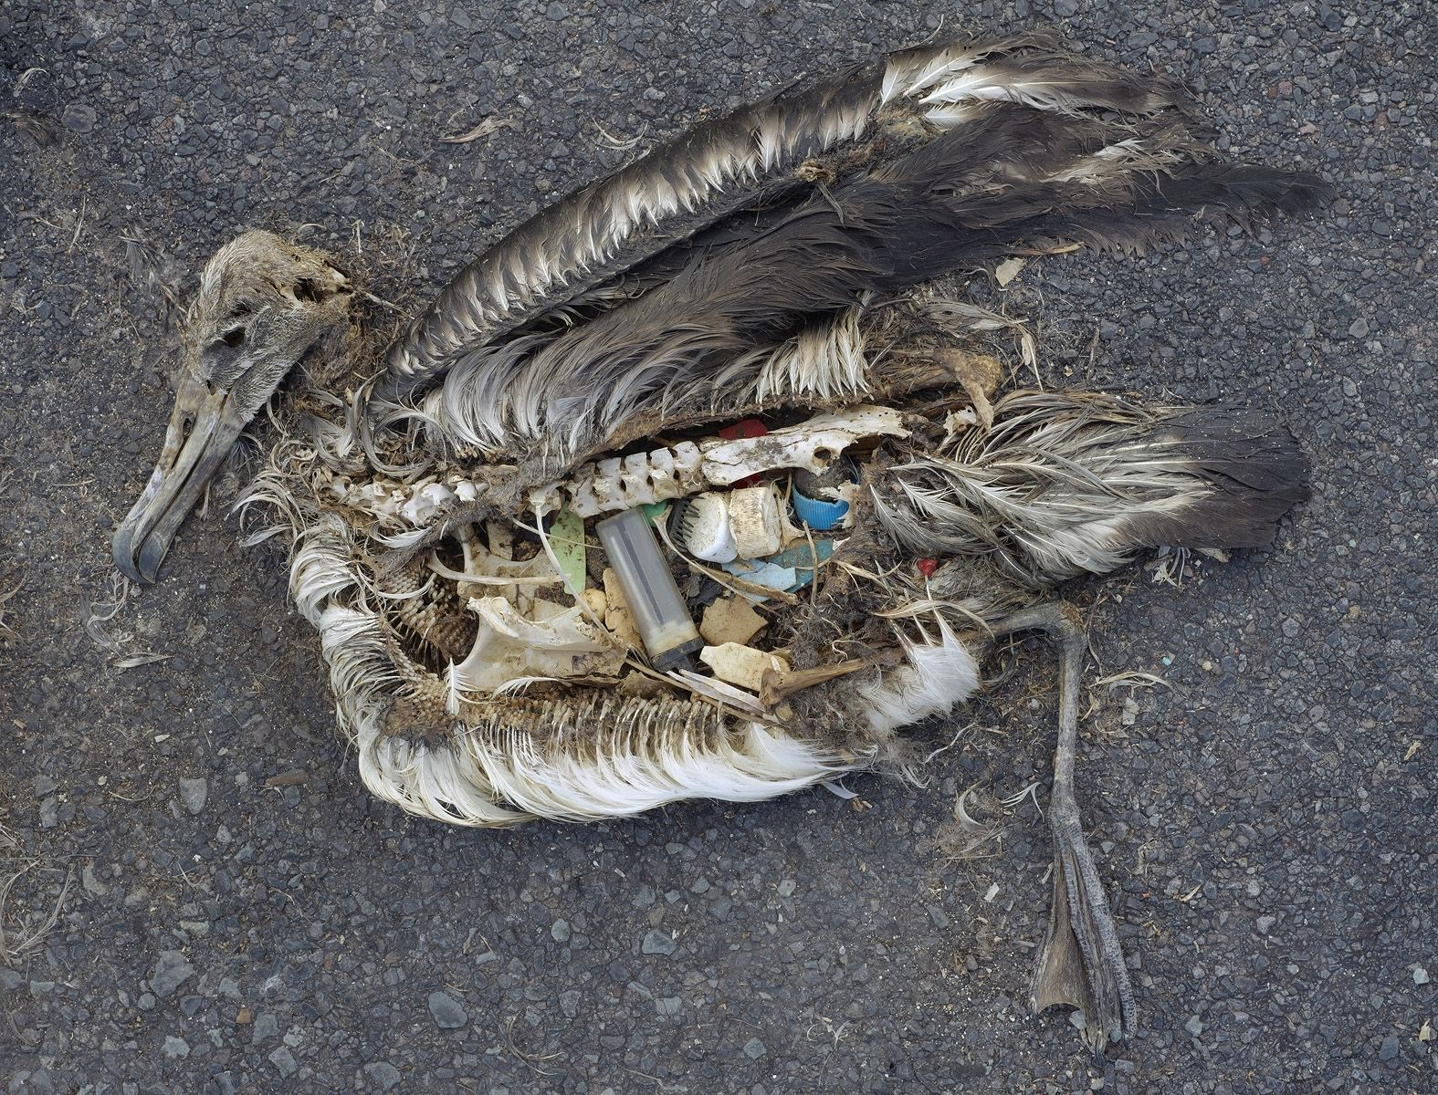
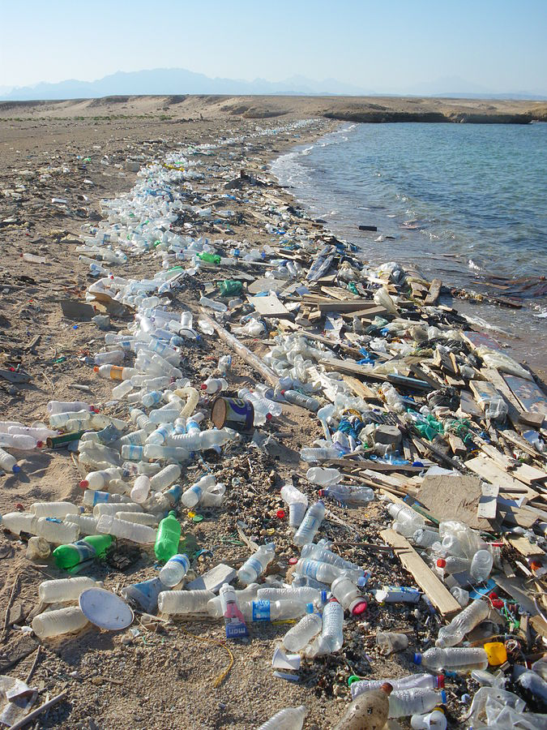
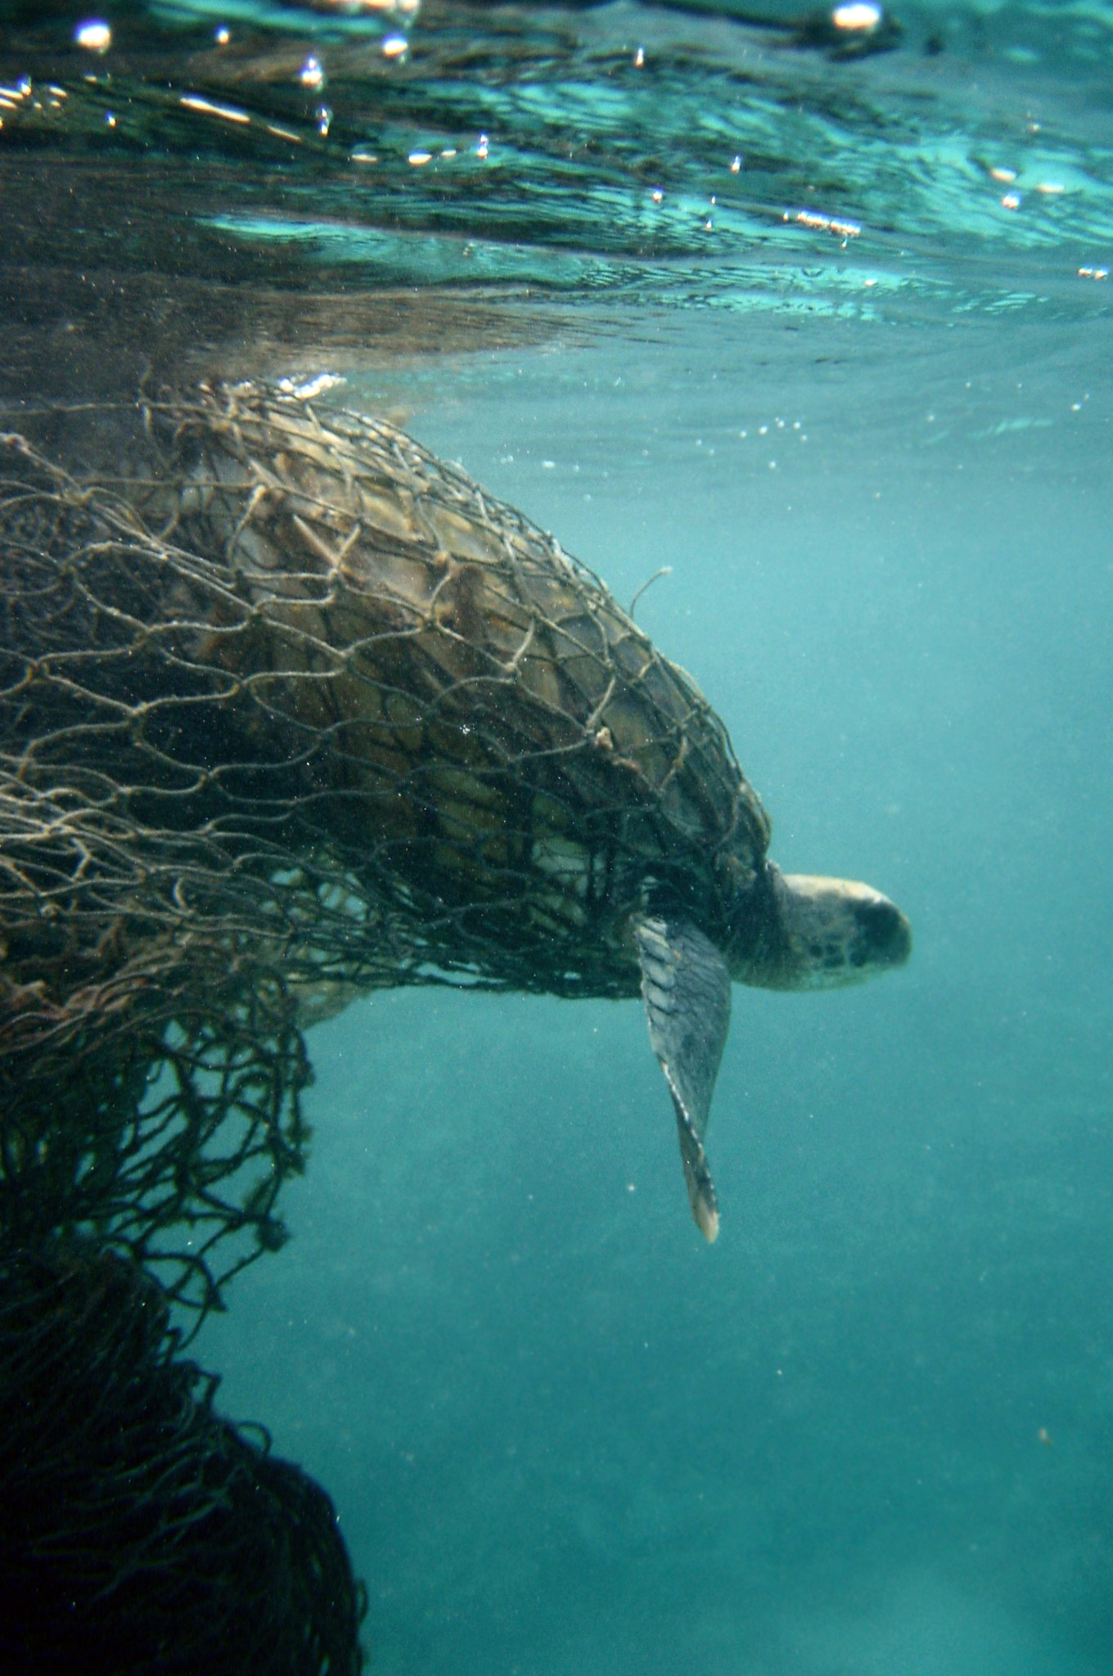
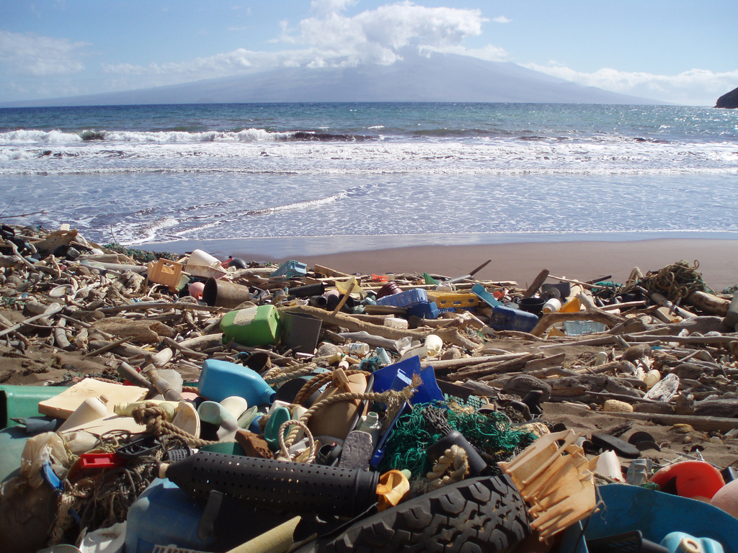
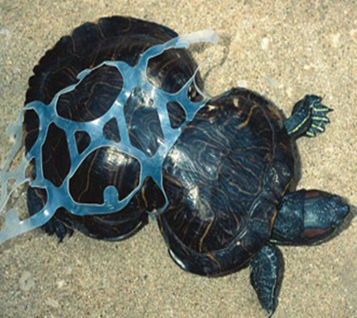
Notes:
Because, class, this is only half of the story. On my adventure, I also discovered a whole lot of really strange stuff, stuff that does not seem to belong in the oceans at all. It looks like this stuff is harming so many of the great things I have seen and shared with you. Many of the animals are mistaking it for food and they are getting really hurt by it when they eat it. Also, from what I have learned, when the fish eat this stuff - and then you humans eat the fish - it means...oh, class. It does not seem very good and I am getting really concerned.

Slide 8
Where did this stuff come from?
2. How did it get to
the oceans?
3. What must we
do about it today?
Notes:
So this is why I’m writing to you all today. We need to figure out how this is happening and solve this major problem together. In order for you to help me, I have sent your class a package. In the package are many things that I have collected from my ocean adventure. I hope you can use them to answer these three important questions:
Where did all of this stuff come from?
How did it get to the oceans?
And what must we do about it, starting today?
So do you think you can help me, class? I really hope so. I look forward to hearing from you and all about what you discover.
In sustainability,
Rusty

