Slide 1
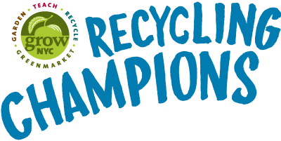
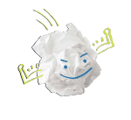
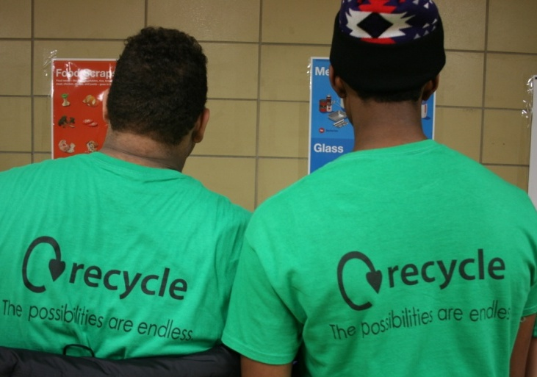
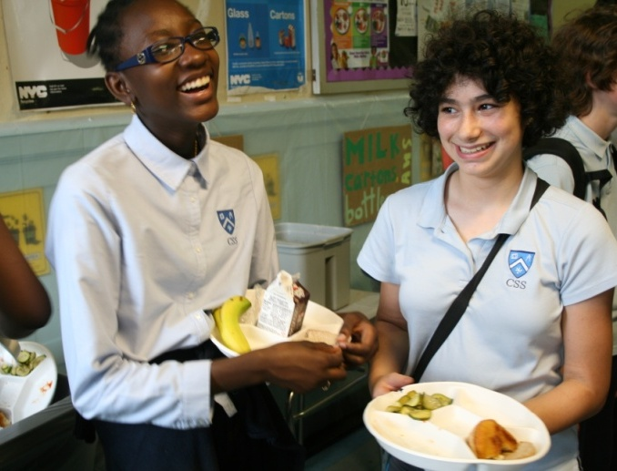
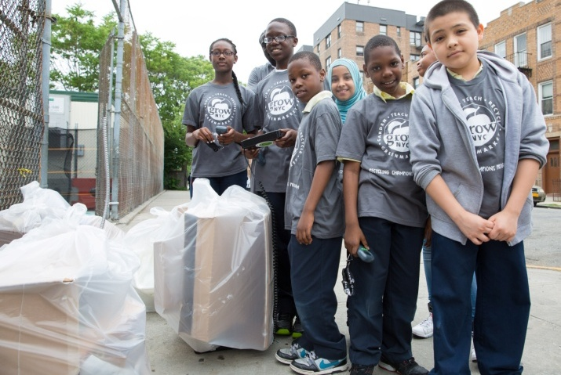
Sort it Out: Recycling in NYC Primary Ed
www.grownyc.org/rcp
Notes:
1

Slide 2
Thank You xxx
Do you know your three R’s?
Reduce, Reuse, Recycle
Thank you
The Three R’s are a way to help us care for our planet.
They are strategies we can use to prevent and reduce our waste.
“Going Green” can be led by students!
Understanding Sustainability
Notes:
Reduce, Reuse and Recycle, or “The Three R’s” allow students at school to practice sustainability. It can be measured, and does not require any large capital investments. Practicing the three RRR’s is part of learning environmental stewardship and responsibility. Zero waste is similar to the three R’s, but is an expanded goal to redesign resource life-cycles so that all materials are re-used and waste is minimal. Discarded materials are recycled back into nature (e.g. compost) or recycled back into the marketplace (e.g. plastic bottles). Using a systems approach, not only can we manufacture products with waste prevention in mind, but also redesign how we construct and operate buildings, and even entire communities. Resource recovery, or collecting materials for recycling, composting and re-use, is part of a zero waste strategy and is a growing part of the U.S. economy.
2

Slide 3
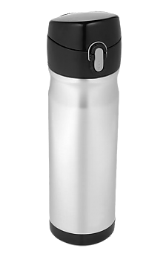
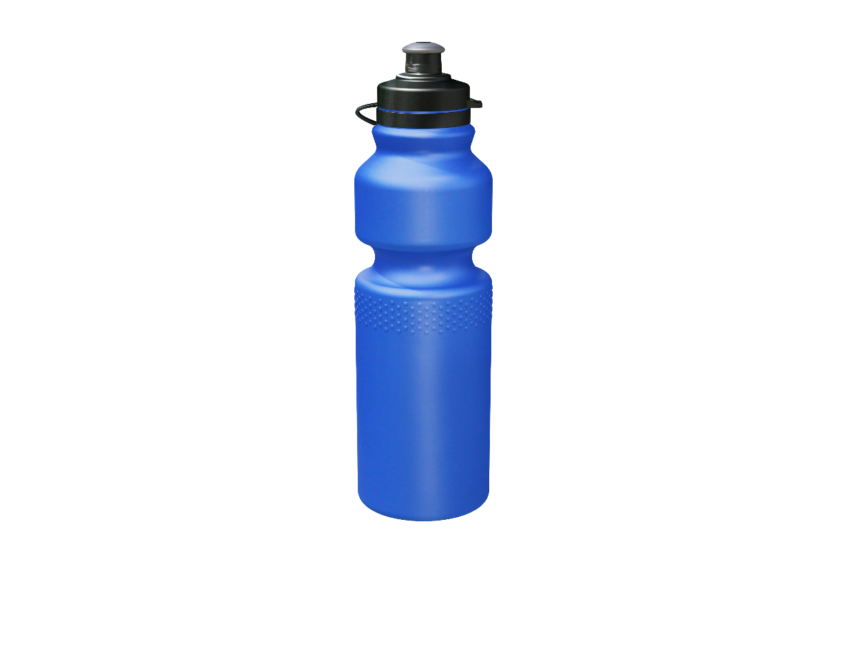
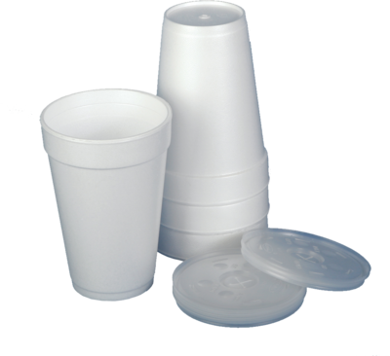
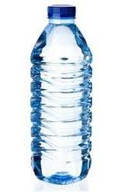
Thank You xxx
Reduce:
Thank you
Making decisions to create less waste
Understanding Sustainability
Notes:
Which photographs represent choices that reduce waste? Why? Reduce or Pre-cycling refers to decisions and practices that prevent waste: -Using re-usable items instead of single use: like backpacks and water bottles.
-Buying durable items that will last longer, avoiding useless items
-Purchasing items with less or recyclable packaging
3

Slide 4
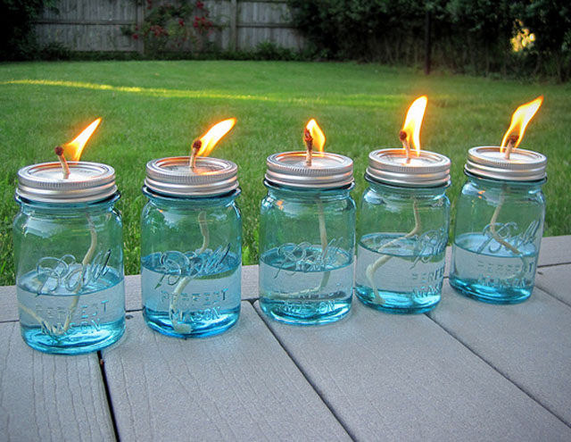
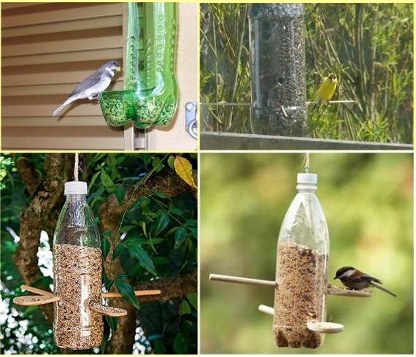
Re-use: Finding new ways to use old things
Have you ever made something new out of something old?
Understanding Sustainability
Notes:
Re-Use or Up-cycling refers to using an item again for another purpose, without re-manufacturing the material. Reducing the costs needed for materials for artists and the business community, up-cycled products can be found in craft markets, fashion shows, retail stores and online outlets.
How does waste reduction and up-cycling impact Return on Investment (ROI)?
4

Slide 5
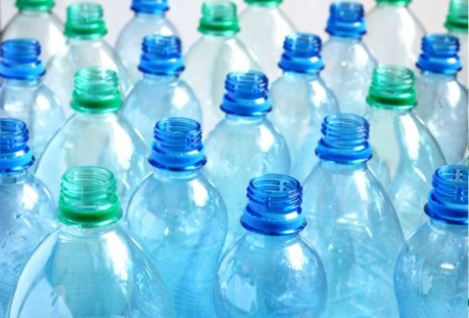
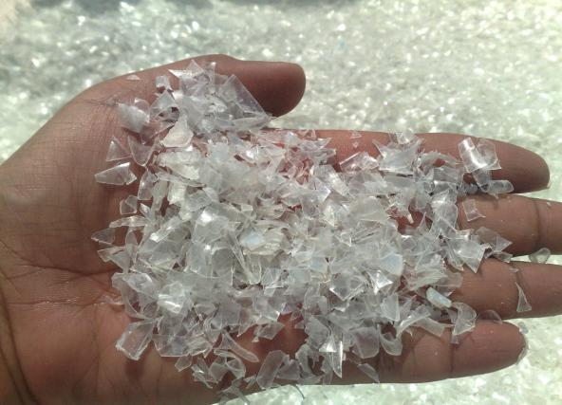
Recycle:
Break down and transform discarded things to make new ones
Understanding Sustainability
Notes:
Recycling is the process of breaking down materials in order to re-manufacture items into new products. Recycled content products are often labeled with the percentage of recycled material used- either recovered material (often scraps from factories ) and/or post-consumer material (discarded after use.)
5

Slide 6
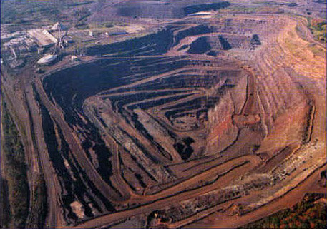
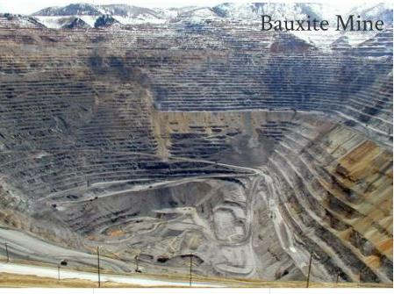
Thank You xxx
We Recycle
Because we make things from natural resources
Understanding Sustainability
Notes:
Raw materials are used to make plastic, metals, and paper despite the fact that we can make them from recycled materials. Plastic is manufactured from petroleum. Aluminum is manufactured from a mineral called bauxite. Steel is manufactured from iron ore. Paper is manufactured from trees.
Non-renewable resources refer to those materials that are in limited supply and can’t be replaced, and/or do not regenerate at the same rate of consumption. Oil, coal, bauxite and iron ore are examples of non-renewable resources. Renewable resources are materials that we use that can be or will be replenished naturally. Solar and wind energy, trees, and top soil are considered to be renewable resources.
6

Slide 7
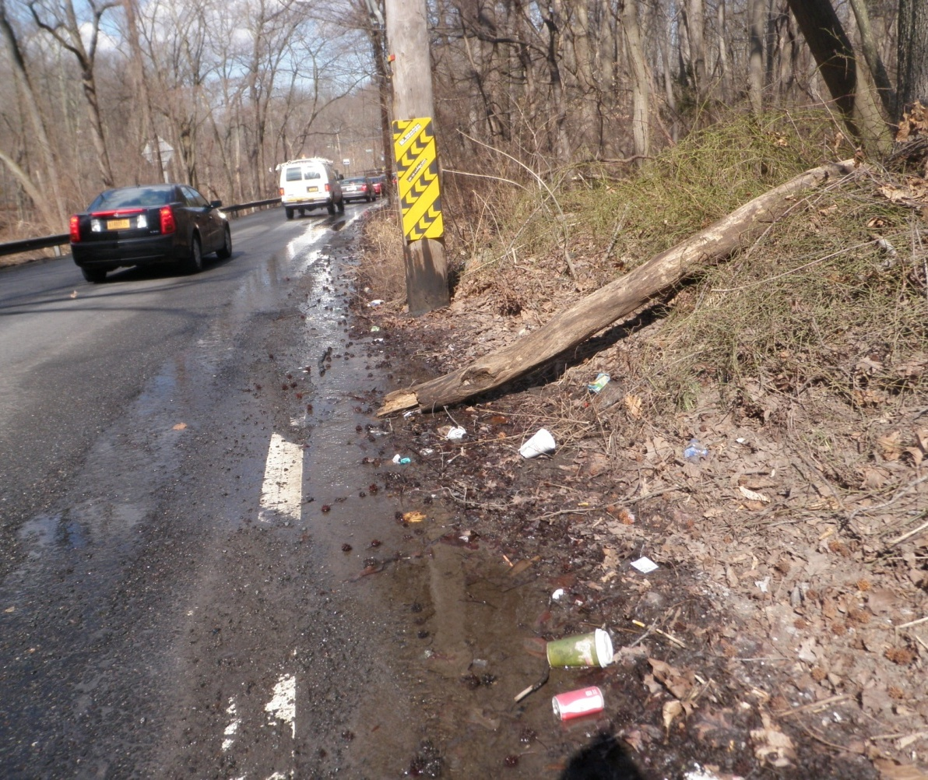
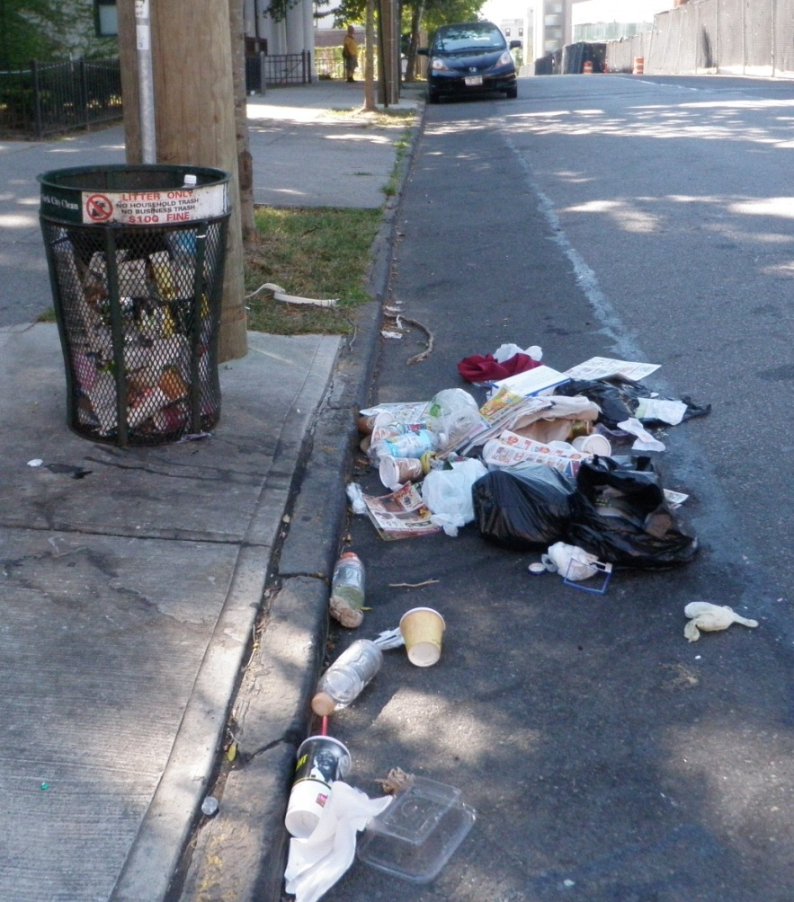
We recycle to prevent pollution
Trash left on streets can end up in our oceans and rivers, and would pollute our environment.
Notes:
7

Slide 8
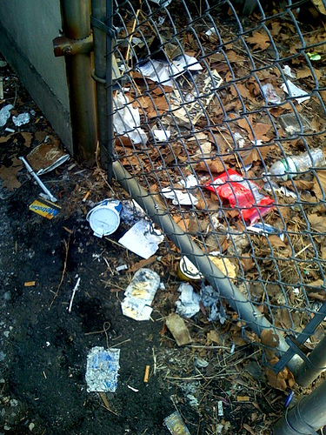
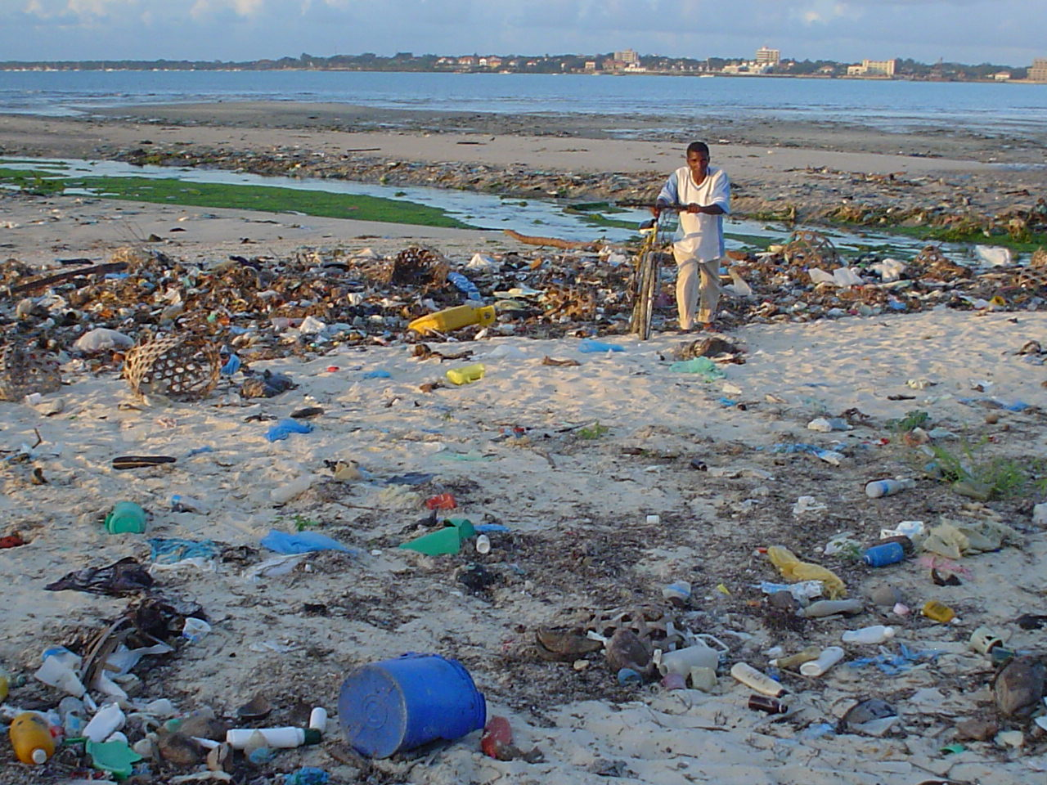
Trash Can Become Litter
Understanding Sustainability
Notes:
8

Slide 9
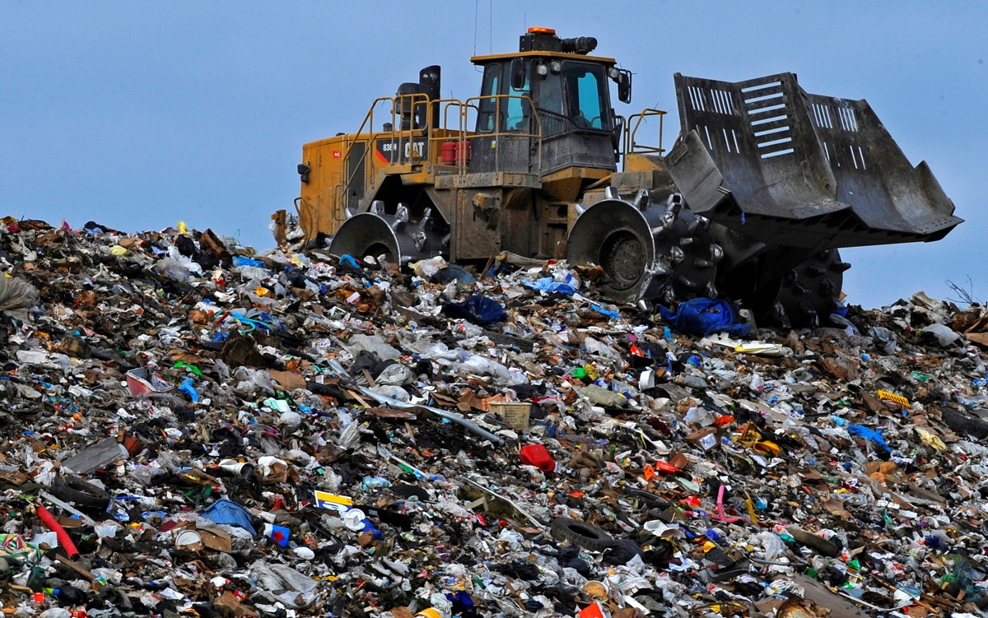
Trash goes
to landfills
Understanding Sustainability
Notes:
All of that waste goes here, to landfills. Trash in landfills takes lifetimes to decompose, taking up space, releasing methane, and harming the environment.
Trucking landfill to other states poses an environmental injustice as well, where people of certain socioeconomic conditions disproportionately have sites like this placed nearby to house our waste in their states.
9

Slide 10
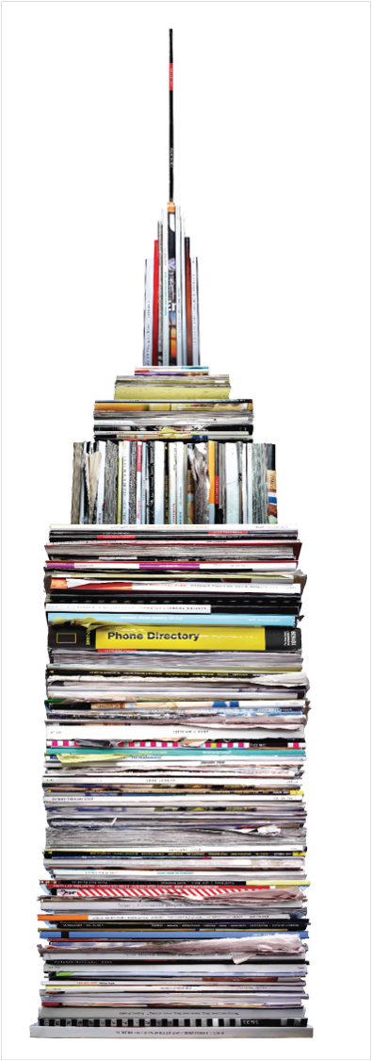
400,000 tons
That’s the amount of recyclable paper people in nyc throw away each year…
enough to fill the empire state building!
40%
of what we throw away in school is paper
?
What can we do better in the classroom
Notes:
Emphasize that paper is easy to recycle. Most of us know it is recyclable, we may even know where to recycle it (green bin), yet we are not collecting all the paper that could be recycled in NYC. About half of the paper that can be recycled is sent to the landfill each year. New Yorkers can do better… starting with our own classrooms.
Make some suggestions for reuse projects in the classroom and offices.
print or copy all handouts and notices double sided
use digital communications whenever possible
use both sides of writing and drawing paper in your classroom
save colorful used paper for collage making or to make decorations for class parties
Leading into following section:
How can you make sure you are collecting all of the paper you can be collecting in your classroom?
→Review with students what can be recycled
→Make sure recycling receptacles are available and easy to identify
10

Slide 11
Thank you
When we recycle at school Where do those materials go?
Understanding Sustainability
Notes:
11

Slide 12
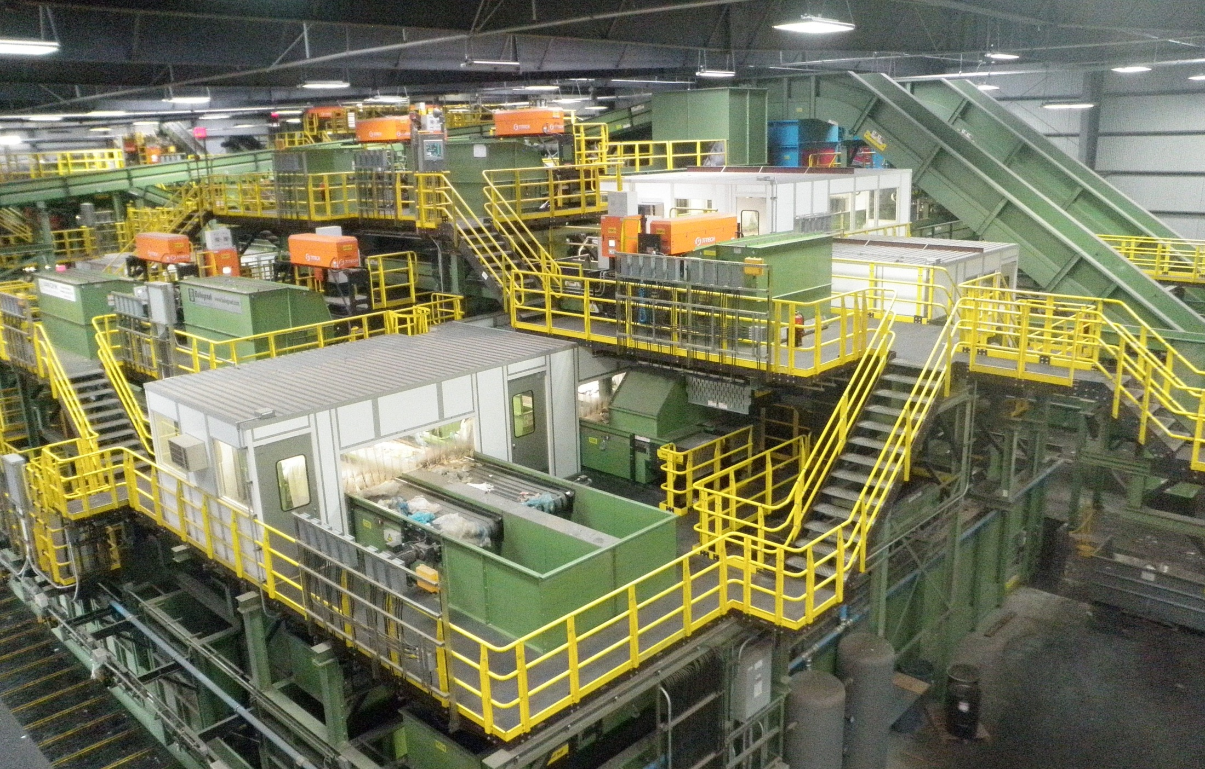
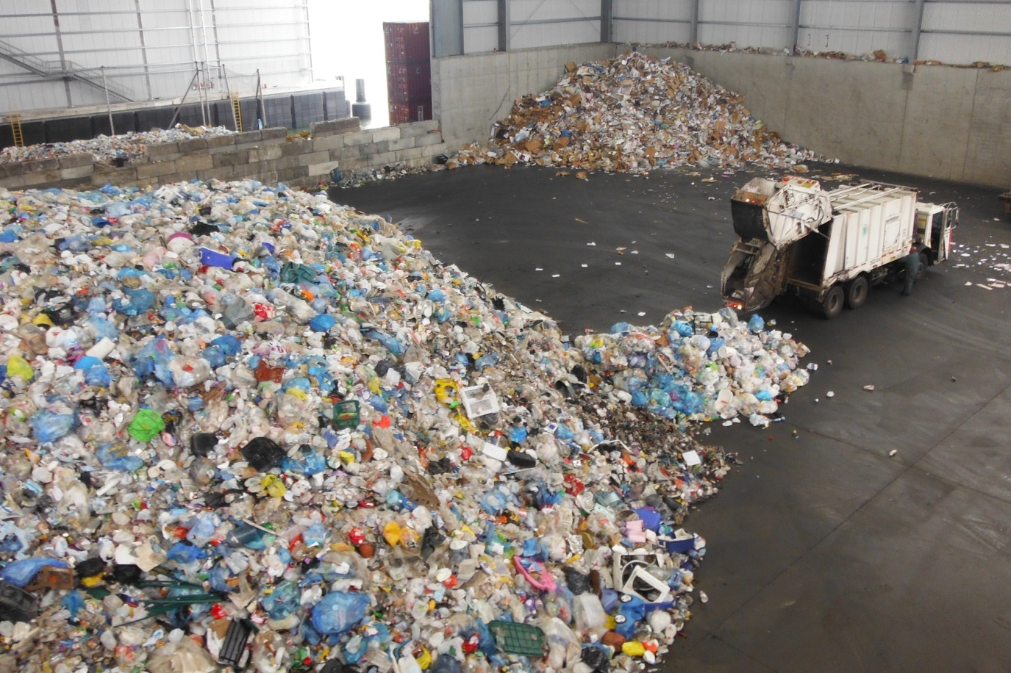
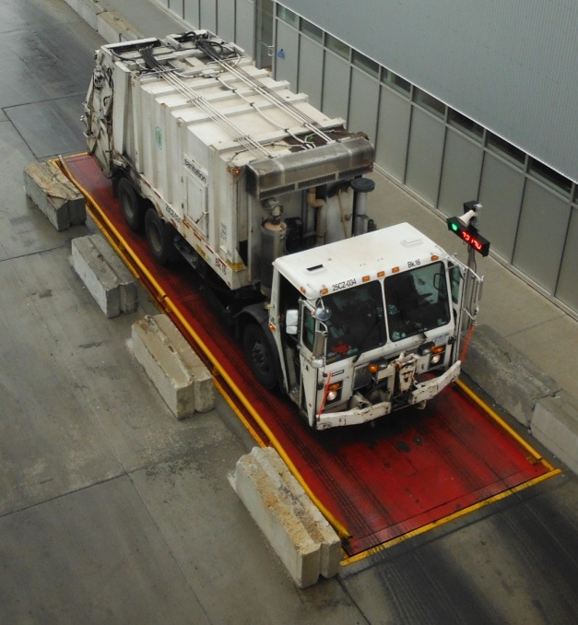
Recyclables go to a Material Recovery Facility
Sims Recycling Center
Sunset Park, Brooklyn

Slide 13
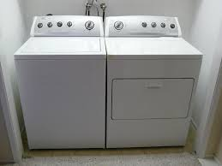
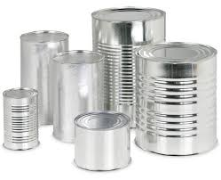
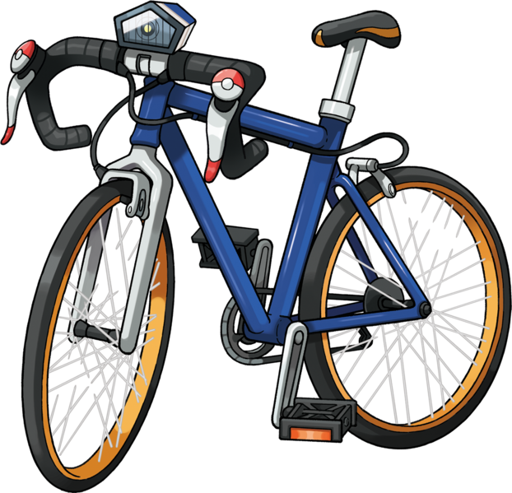
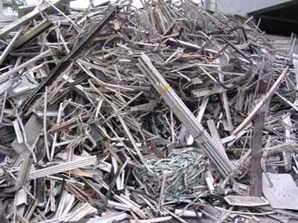
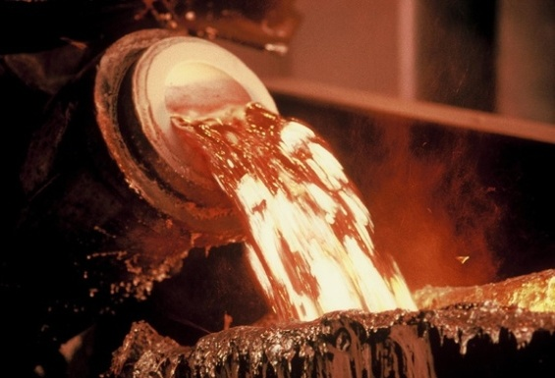
Recycling Steel Creates New Products

Slide 14
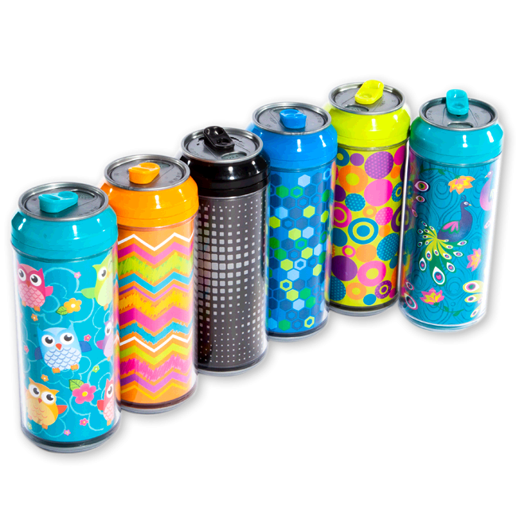
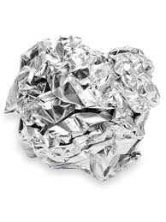
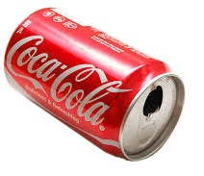
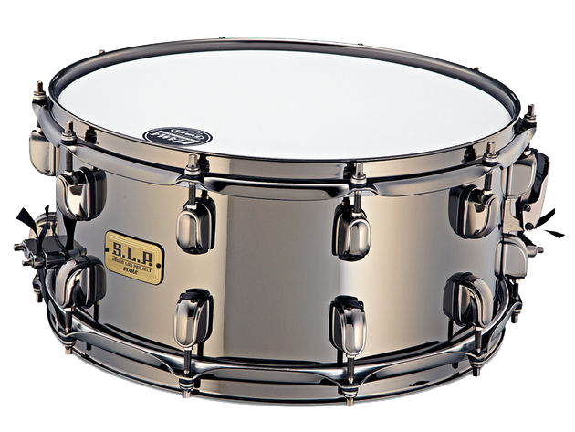
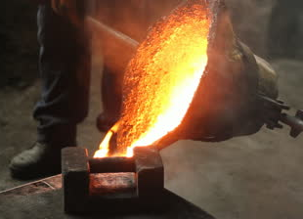
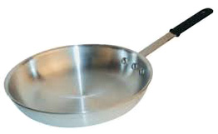
Recycling Aluminum Creates New Products

Slide 15
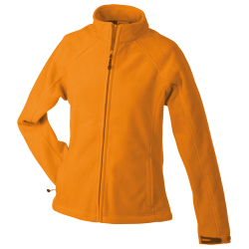
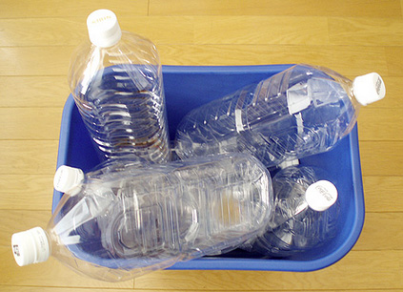
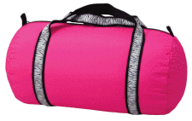
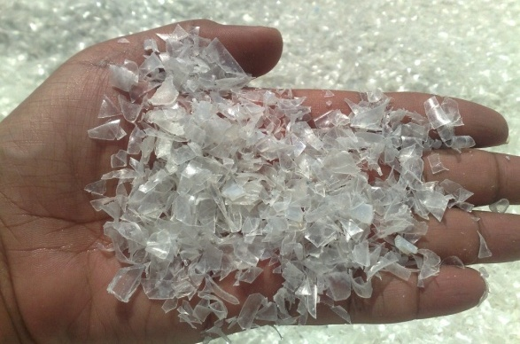
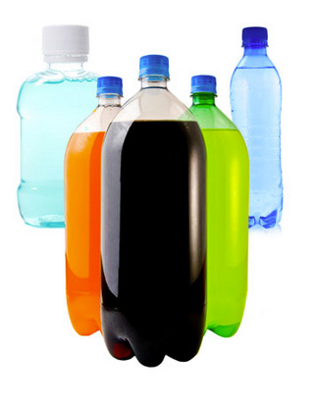
Recycling Plastic Bottles Creates New Products

Slide 16
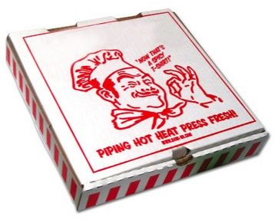
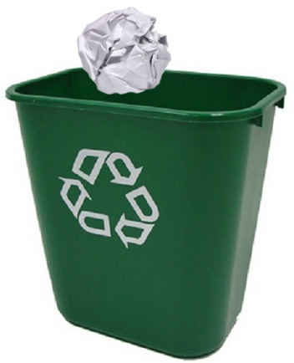
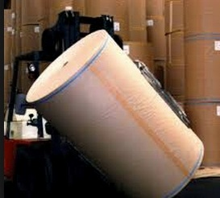
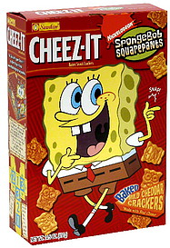
Recycling Paper and Cardboard Creates New Products

Slide 17
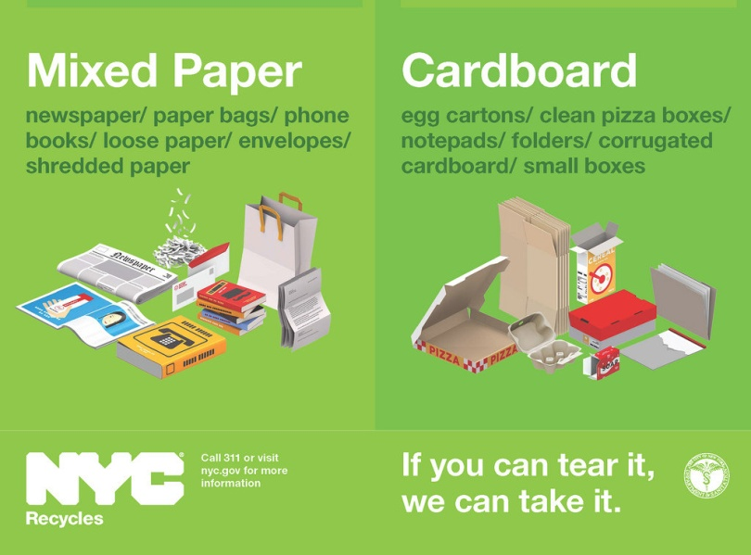
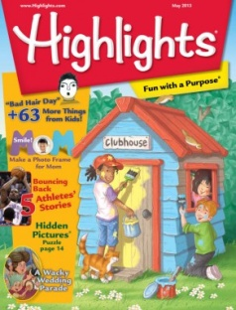
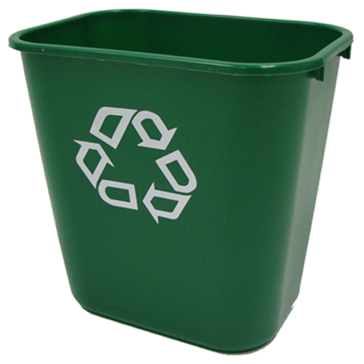
Recycle paper in Green
Thank you
Paper
Envelopes Cardboard
Newspapers
Magazines
Leave out: tissues, napkins, paper with too much paint.
Guidelines
Notes:
Commonly confused items that CAN be recycled in the paper bin include: enveloped with ‘windows’, paper with staples, pizza boxes (given they’re not too greasy), empty/dry (non-waxy) coffee cups, and paper plates.
17

Slide 18
Classroom and Office Paper Recycling
Guidelines
Notes:
18

Slide 19
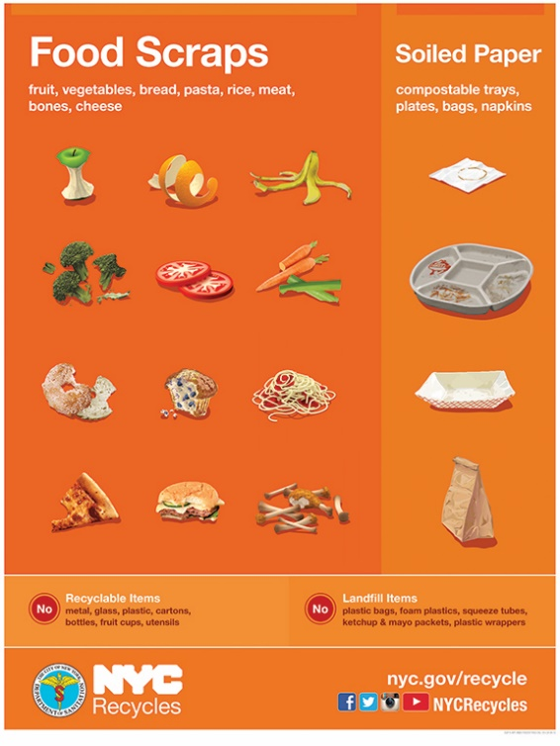
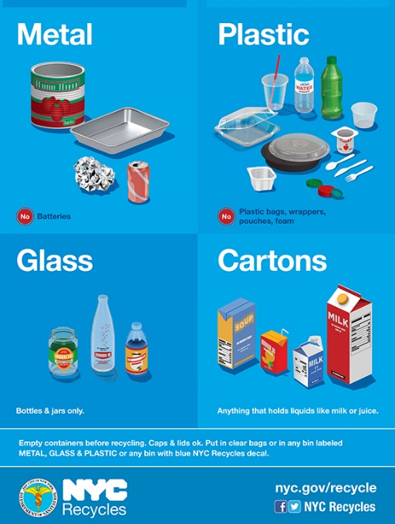
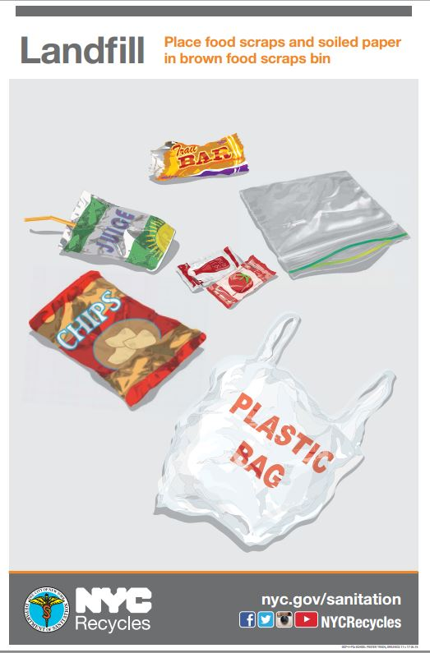
Introducing…
Cafeteria Recycling & Food Scrap Collection

Slide 20
Guidelines
Notes:
20

Slide 21
Thank You xxx
Please Empty Liquids First
Please empty leftover milk, juice, water and soda into the bucket before recycling the container
Cartons are emptied and then placed in the BLUE Bin
Guidelines
Notes:
21

Slide 22
Guidelines
Notes:
22

Slide 23
Thank You xxx
Recycle MGPC in Blue
Metal
Glass Hard Plastic
Cartons
Leave out: soft plastic (plastic bags, chips wrappers, Capri Sun pouches)
Guidelines
Notes:
The most important thing to remember is to leave out soft plastics. These cannot be recycled in DSNY curbside system, but plastic bags can be taken to your local pharmacy or supermarket, as they are required by law to recycle them.
Common confusion: coffee lids and straws. These CAN be recycled in your plastics bin.
23

Slide 24
Thank You xxx
Recycle in the BLUE BIN
Take-out containers
Plastic utensils
Fruit & pudding cups
Yogurt , dairy, deli & clamshell containers
All hard plastics in the blue bin
Guidelines
Notes:
Plastics recycling was expanded in NYC in 2013 to include rigid or hard plastics, like yogurt containers, take out and berry containers, plastic toys and hangers.
24

Slide 25
Recycle in the BLUE BIN
Anything Mostly Metal
Cans and foil in the blue bin
Guidelines
Notes:
25

Slide 26
Guidelines
Notes:
26

Slide 27
Landfill Bin: Soft plastic
Chip Bags
Candy wrappers
Plastic Bags
Zip Lock Bags
Capri Sun Pouches Plastic wrap
Soft PLASTIC can be crumpled up in your fist. Plastic you can SMASH is TRASH
Guidelines
Notes:
27

Slide 28
Remaining Trash Goes in the GRAY Landfill Bin
Guidelines
Notes:
28

Slide 29
Guidelines
Notes:
29

Slide 30
Add All Leftover Food Scraps to the Brown Organics Bin
Guidelines
Notes:
30

Slide 31
Add All Food Soiled Paper to the Brown Organics Bin
Compostable plates
Napkins
Paper cups, plates, boats
Guidelines
Notes:
31

Slide 32
What happens to food scraps?
Creates compost for NYC trees,
parks, and schools
Understanding Sustainability
Notes:
The New York City Organics Collection Program is collecting organic waste from public school cafeterias to make use of both aerobic and anaerobic composting technologies. The material is brought to commercial composting facilities to make compost for neighborhood parks, community gardens and street trees, as well as to the Newtown Creek Wastewater Treatment Facility to be processed in an anaerobic digester for methane capture. Organics are also being collected from residents in select neighborhoods and at local farmers markets.
According to the Environmental Protection Agency, food scraps are the No. 1 material sent to landfills in the U.S.—more than paper or plastic. This uneaten food accounts for about 14 percent of all municipal solid waste, contributing almost 25 percent of methane emissions and costing roughly $1.3 billion to transport and dump in US landfills. (Living in the United States of Food Waste, Ira Sager, Bloomberg Business Week, January 10, 2013 ) In NYC, 30-35% of residential and institutional waste is made up of organic materials that can be separated and either composted or made into energy (PLANYC, 2013 Progress Report.)
We generate 21.5 million tons of food waste each year. If we composted that food, it would reduce the same amount of greenhouse gas as taking 2 million cars off the road. https://www.dosomething.org/facts/11-facts-about-recycling
Composting is a method of speeding up the decomposition of organic or once living materials as they break down into a natural soil amendment that provides nutrients for plants. There are many types of composting or “aerobic digestion technologies” that utilize this natural breaking down of material to convert it into a valuable product.
32

Slide 33
Sort it Out!
Over 90% of what we throw out
in school is recyclable or compostable
Notes:
40% of school waste is mixed paper, 40% is food scraps, and 10% is metal, glass, plastic, and cartons.
33

Slide 34
Thank You xxx
Recycling Resources
Thank you
Recycling Champions Program
grownyc.org/rcp
NYC Dept. of Sanitation 2015 Golden Apple Awards RRResource Guide nyc.gov/recycle
DOE Sustainability Initiative
schools.nyc.gov/sustainability
schoolrecycling@grownyc.org
Notes:
Feel ready to recycle? You are not alone! Make use of these great resources to obtain ideas and lesson plans.

Slide 35
Thank You!
schoolrecycling@grownyc.org

